Slide 1
CTC 450 Review
Hydrostatics
Inclined Plane
Curved Surface
Buoyancy

Slide 2
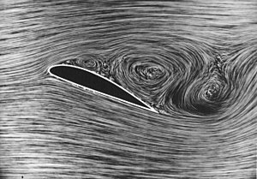
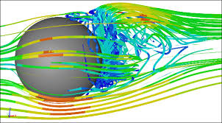
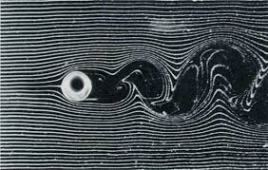
Objectives
Types of flow
Continuity Equation

Slide 3
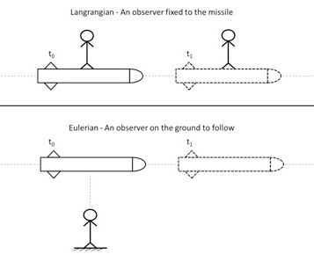
Velocity – 2 viewpoints
Lagrangian-individual particles
Cars
Rockets
Eulerian-observe motion passing a specific point
Traffic flow (vehicles/hour)

Slide 4
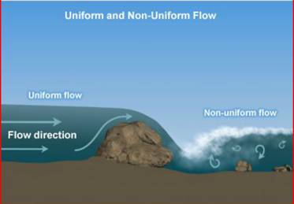
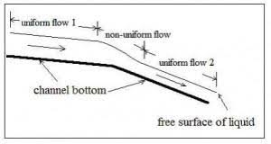
Flow Types (Space Criterion)
Uniform (space criterion)
Velocity doesn’t change w/ respect to channel reach
Nonuniform
Velocity does change w/ respect to reach

Slide 5
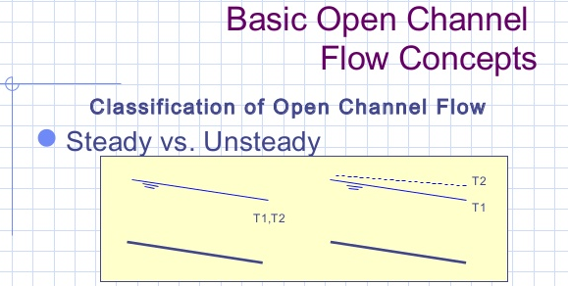
Flow Types (Time Criterion)
Steady---Velocity does not change w/ respect to time
Unsteady---Velocity does change w/ respect to time

Slide 6
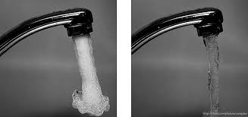
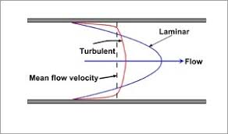
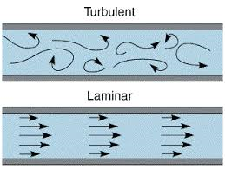
Types of Flow
Turbulent (mixed flow)
Laminar Flow (smooth flow)
Flow of water through a pipe is generally turbulent

Slide 7
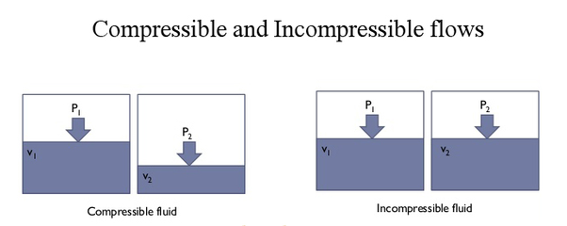
Types of Flow-Compressibility

Slide 8
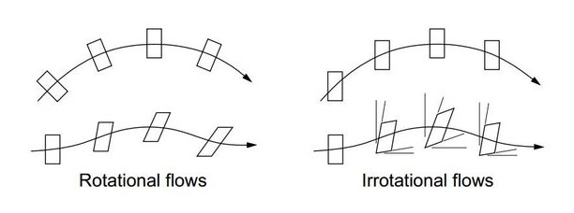
Types of Flow (Rotational/Irrotational)

Slide 9
Reynold’s Number
Re or Nr----Unitless---for Pipes (Diameter*Velocity)/Kinematic Viscosity
>4,000 turbulent
<2,000 laminar

Slide 10
Average Velocity
V=Q/A
Where:
V=average velocity
Q=flow rate
A=cross sectional area

Slide 11
Average Velocity-Example
A pipe 24-inch diameter pipe carries water with a velocity of 13 fps. What is the discharge in cfs and gpm?
Answers:
41 cfs
18,000 gpm

Slide 12
Residence Time
On average, how long water stays in a tank
=Tank volume/Flow rate

Slide 13
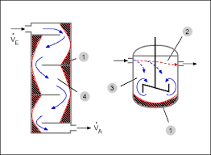
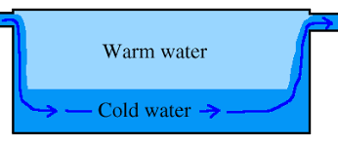
Residence Time-Example
If you have a 10-gallon tank and flow rate is 1 gpm then the theoretical average residence time = 10 minutes
Actual can vary from theoretical due to short circuiting or dead zones

Slide 14
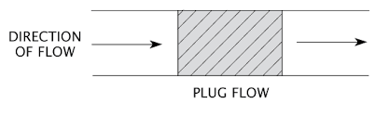
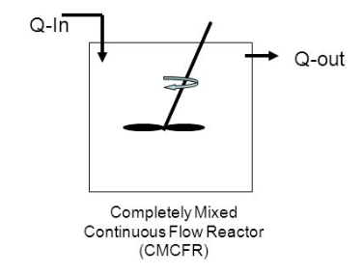
Process Types
Plug flow
Completely mixed

Slide 15
Continuity-Steady Flow
Q=A1*V1=A2*V2
If water flows from a smaller to larger pipe, then the velocity must decrease
If water flows from a larger to smaller pipe, then the velocity must increase

Slide 16
Continuity Example
A 120-cm pipe is in series with a 60-cm pipe. The rate of flow of water is 2 cubic meters/sec.
What is the velocity of flow in each pipe?
V₆₀=Q/A₆₀=7.1 m/s
V₁₂₀=Q/A₁₂₀=1.8 m/s

Slide 17
Continuity Non-Steady Flow
Storage/Discharge Rate
(How fast a tank is filling/emptying)
Ramping Rate
How fast the water is rising or lowering

Slide 18
Storage-Steady Flows
Q in=Qout+(Storage/Discharge Rate)
Qin=0.0175 cubic meters/sec
Qout=.003 cubic meters/sec
Storage or discharge?

Slide 19
Storage-Steady Flows (Cont)
Qin=0.0175 cubic meters/sec
Qout=.003 cubic meters/sec
Storage rate=.0145 cubic meters/sec
If storage is in a tank what would you do to find the rate of rise?

Slide 20
Storage Example
A river discharges into a reservoir at a rate of 400,000 cfs. The outflow rate through the dam is 250,000 cfs.
If the reservoir surface area is 40 square miles, what is the rate of rise in the reservoir?

Slide 21
Storage Example-Answer
Answer 11.5 ft/day
Find 3 reasons why this example is not very realistic.

Slide 22
Continuity Example Q varies as a function of water height
A 10-cm diameter jet of water discharges from the bottom of a 1-m diameter tank. The velocity in the jet = (2gh)^{.5} m/sec. How long will it take for the water surface in the tank to drop from 2 meters to 0.5 meter?
Use Calculus
Use spreadsheet

Slide 23
Calculus
Qout=Vel *Area = .035h^{.5} (Q is function of water height)
Discharge of tank=dh/dt*Area=0.785 dh/dt
Set the two equal to each other & rearrange:
dt=22.43h^{-.5} dh
Integrate time between 0 and t
Integrate h between 0.5 and 2 m
t=31.7 seconds

Slide 24
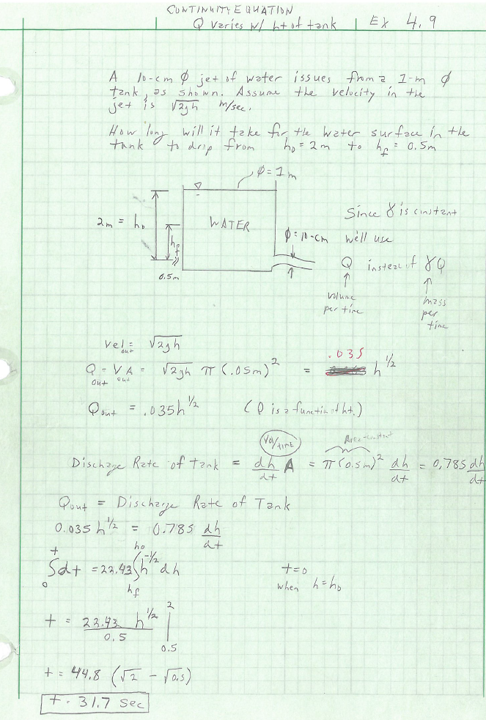
Empty Tank-Calculus

Slide 25
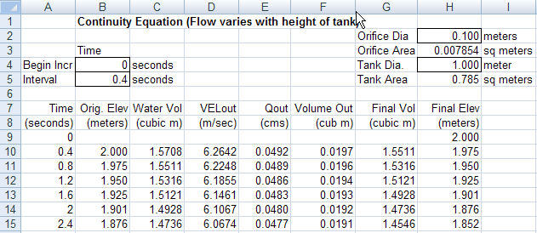
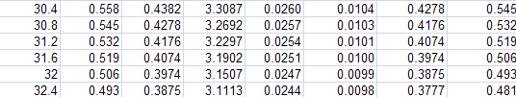
Spreadsheet Small time increment

Slide 26
Next Lecture
Bernoulli’s Equation
EGL/HGL graphs

