Slide 1
CTC 450 Review
Energy Equation
Pressure head
Velocity head
Potential energy
Pumps, turbines
Head losses due to friction

Slide 2
Objectives
Calculate friction loss along a pipe length using the Darcy-Weisbach equation and Moody’s diagram.
Calculate other head losses (inlets/outlets/valves/bends/,etc)

Slide 3
Studies have found that resistance to flow in a pipe is
Independent of pressure
Linearly proportional to pipe length
Inversely proportional to some power of the pipe’s diameter
Proportional to some power of the mean velocity
If turbulent flow, related to pipe roughness
If laminar flow, related to the Reynold’s number

Slide 4
Head Loss Equations
Darcy-Weisbach
Theoretically based
Hazen Williams
Frequently used-pressure pipe systems
Experimentally based
Chezy’s (Kutter’s) Equation
Frequently used-sanitary sewer design
Manning’s Equation

Slide 5
Darcy-Weisbach
h_{f}=f*(L/D)*(V²/2g)
Where:
f is friction factor (dimensionless) and determined by Moody’s diagram (PDF available on Brightspace)
L/D is pipe length divided by pipe diameter
V is velocity
g is gravitational constant

Slide 6
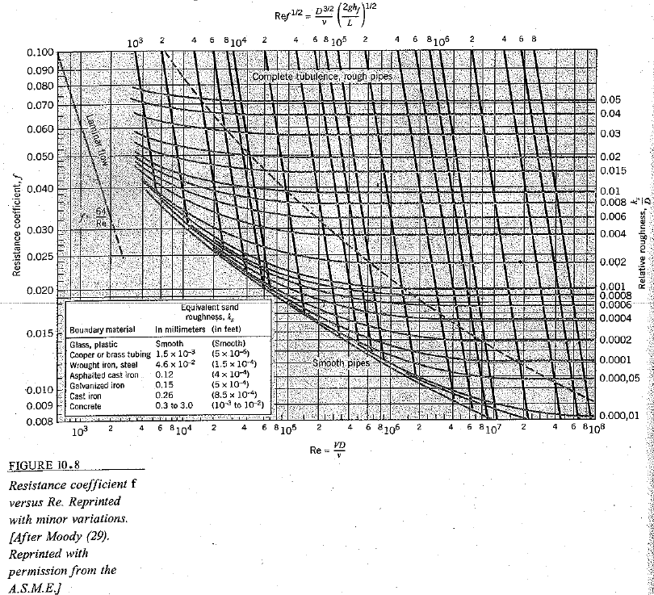
Moody’s Diagram
For Class Use Only: Origin Not Verified!!!

Slide 7
For Class Use Only: Origin Not Verified!!!

Slide 8
Problem Types
Determine friction loss
Determine flow
Determine pipe size
Some problems require iteration (guess f, solve for v, check for correct f)

Slide 9
Example Problems
PDF’s are available on Brightspace:
Determine head loss given Q (ex 10.4)
Find Q given head loss (ex 10.5)
Find Q (iteration required) (ex 10.6)

Slide 10
Find Head Loss Per Length of Pipe
Water at a temperature of 20-deg C flows at a rate of 0.05 cms in a 20-cm diameter asphalted cast-iron pipe. What is the head loss per km of pipe?
Calculate Velocity (1.59 m/sec)
Compute Reynolds’ # and ks/D (3.2E5; 6E-4)
Find f using the Moody’s diagram (.019)
Use Darcy-Weisbach (head loss=12.2m per km of pipe)

Slide 11
For Class Use Only: Origin Not Verified!!!

Slide 12
Find Q given Head Loss
The head loss per km of 20-cm asphalted cast-iron pipe is 12.2 m. What is Q?
Can’t compute Reynold’s # so calculate Re*f^{1/2} (4.4E4)
Compute ks/D (6E-4)
Find f using the Moody’s diagram (.019)
Use Darcy-Weisbach & solve for V (v=1.59 m/sec)
Solve Q=V*A (Q=.05 cms)

Slide 13
For Class Use Only: Origin Not Verified!!!

Slide 14
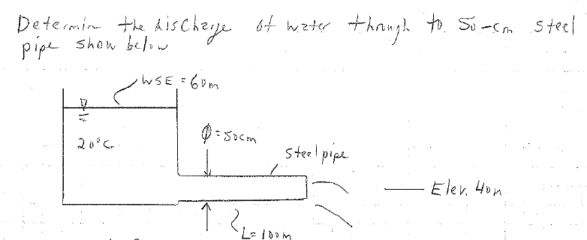
Find Q: Iteration Required
Similar to another problem we did previously; however, in this case we are accounting for friction in the outlet pipe. If friction not accounted for velocity=20 m/sec

Slide 15
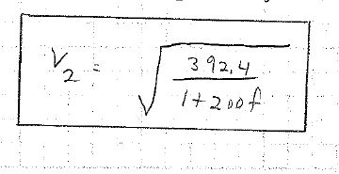
Iteration
Compute ks/D (9.2E-5)
Apply Energy Equation to get the Relationship between velocity and f
Iterate (guess f, calculate Re and find f on Moody’s diagram. Stop if solution matches assumption. If not, assume your new f and repeat steps).

Slide 16
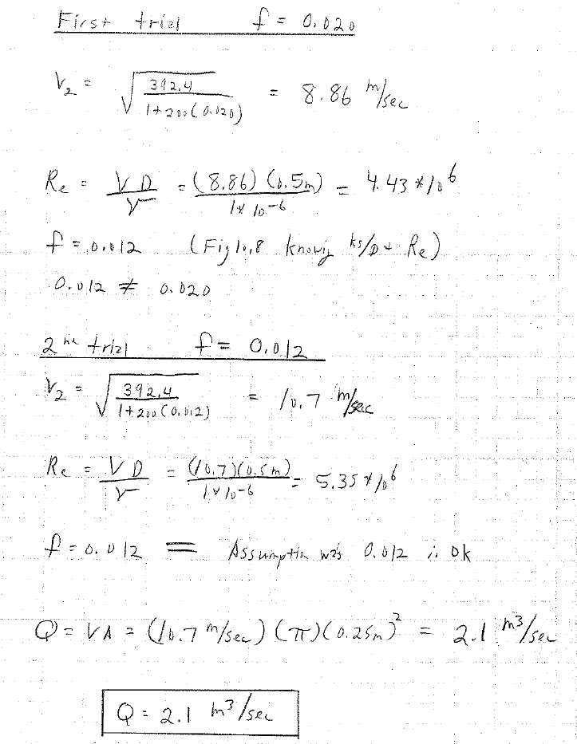
Iterate

Slide 17
Find Q w/ Pipe Friction
Similar to another problem we did previously; however, in this case we are accounting for friction in the outlet pipe. If friction not accounted for velocity=20 m/sec. If friction is accounted for vel=11 m/sec.

Slide 18
Other head losses
Inlets, outlets, fittings, entrances, exits
General equation is h_{L}=kV²/2g
where k is a fitting loss coefficient—careful w/ sources
(sometimes given as equivalent length)

Slide 19
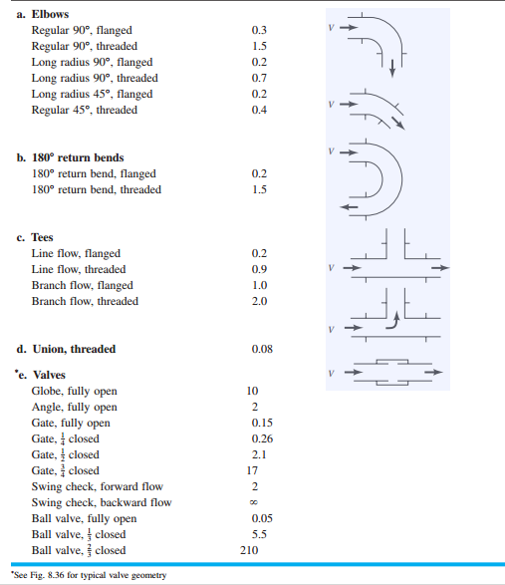
K values for calculating head losses

Slide 20
Head Loss of Abrupt Expansion
(v₁-v₂)² / 2g
Not v₁²-v₂²
If v₂ =0 (pipe entrance into tank or reservoir) then the fitting loss coefficient is 1

Slide 21
Hazen-Williams (pg 33)
Q=0.283CD^{2.63}S^{0.54}
Q is discharge in gpm
C is coefficient
D is pipe diameter in inches
S is hydraulic gradient

Slide 22
Manning’s Equation-English
Q=AV=(1.486/n)(A)(R_{h})^{2/3}S^{1/2}
Where:
Q=flow rate (cfs)
A=wetted cross-sectional area (ft²)
R_{h}=Hydraulic Radius=A/WP (ft)
WP=Wetter Perimeter (ft)
S=slope (ft/ft)
n=friction coefficient (dimensionless)

Slide 23
Manning’s
How would you estimate friction loss?

Slide 24
Next class
Hardy-Cross method for determining flow in pipe networks

