Slide 1
CTC 450 Review
Friction Loss (2 types)
Over a pipe length
Darcy-Weisbach (Moody’s diagram)
For iterative problems go back to the energy equation and derive relationship between v and f
Connections/fittings, etc. (K*velocity head)

Slide 2
Objectives
Determine how water distributes into 2 parallel pipes
Set up a spreadsheet to solve a simple water distribution system using the Hardy-Cross method

Slide 3
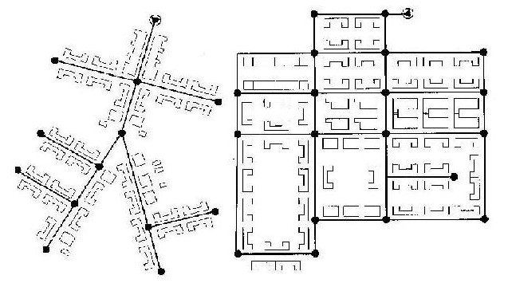
Pipe Systems
Water municipality systems consist of many junctions or nodes; many sources, and many outlets (loads)
Object for designing a system is to deliver flow at some design pressure for the lowest cost
Software makes the design of these systems easier than in the past; however, it’s important to understand what the software is doing

Slide 4
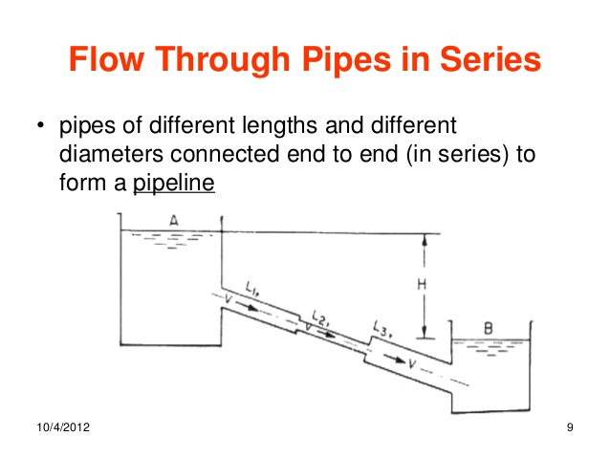
Pipes in Series

Slide 5
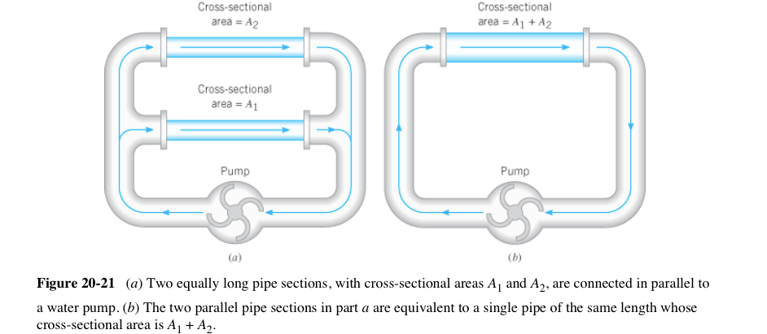
Pipes-Parallel & Equivalence

Slide 6
Two parallel pipes
If a pipe splits into two pipes how much flow will go into each pipe?
Each pipe has a length, friction factor and diameter
Head loss going through each pipe has to be equal

Slide 7
Two parallel pipes
f₁*(L₁/D₁)*(V₁²/2g)= f₂*(L₂/D₂)*(V₂²/2g)
Rearrange to:
V₁/V₂=[(f₂/f₁)(L₂/L₁)(D₁/D₂)] ^{.5}
This is one equation that relates v1 and v2 What is the other equation?

Slide 8
Determining flow distribution
What do you do for complex pipe systems?
Hardy-Cross (one method)
https://en.wikipedia.org/wiki/Hardy_Cross_method

Slide 9
Hardy-Cross Method---Rules
Q’s into a junction=Q’s out of a junction
Head loss between any 2 junctions must be the same no matter what path is taken (head loss around a loop must be zero)

Slide 10
Steps
Choose a positive direction (CW=+)
# all pipes or identify all nodes
Divide network into independent loops such that each branch is included in at least one loop

Slide 11
4. Calculate K’ for each pipe
Calc. K’ for each pipe
K’=(0.0252)fL/D⁵
For simplicity f is usually assumed to be the same (typical value is .02) in all parts of the network

Slide 12
5. Assume flow rates and directions
Requires assumptions the first time around
Must make sure that Q_{in}=Q_{out} at each node

Slide 13
6. Calculate Q_{t}-Q_{a} for each independent loop
Q_{t}-Q_{a} =-∑K’Q_{a}^{n}/n ∑ |Q_{a}^{n-1}|
n=2 (if Darcy-Weisbach is used)
Q_{t}-Q_{a} =-∑K’Q_{a}²/2 ∑ |Q_{a}^{n-1}|
Q_{t} is true flow
Q_{a} is assumed flow
Once the difference is zero, the problem is completed

Slide 14
7. Apply Q_{t}-Q_{a} to each pipe
Use sign convention of step one
Q_{t}-Q_{a} (which can be + or -) is added to CW flows and subtracted from CCW flows
If a pipe is common to two loops, two Q_{t}-Q_{a} corrections are added to the pipe

Slide 15
8. Return to step 6
Iterate until Q_{t}-Q_{a} = 0

Slide 16
Example Problem
2 loops; 6 pipes
By hand; 1 iteration
By spreadsheet

Slide 17
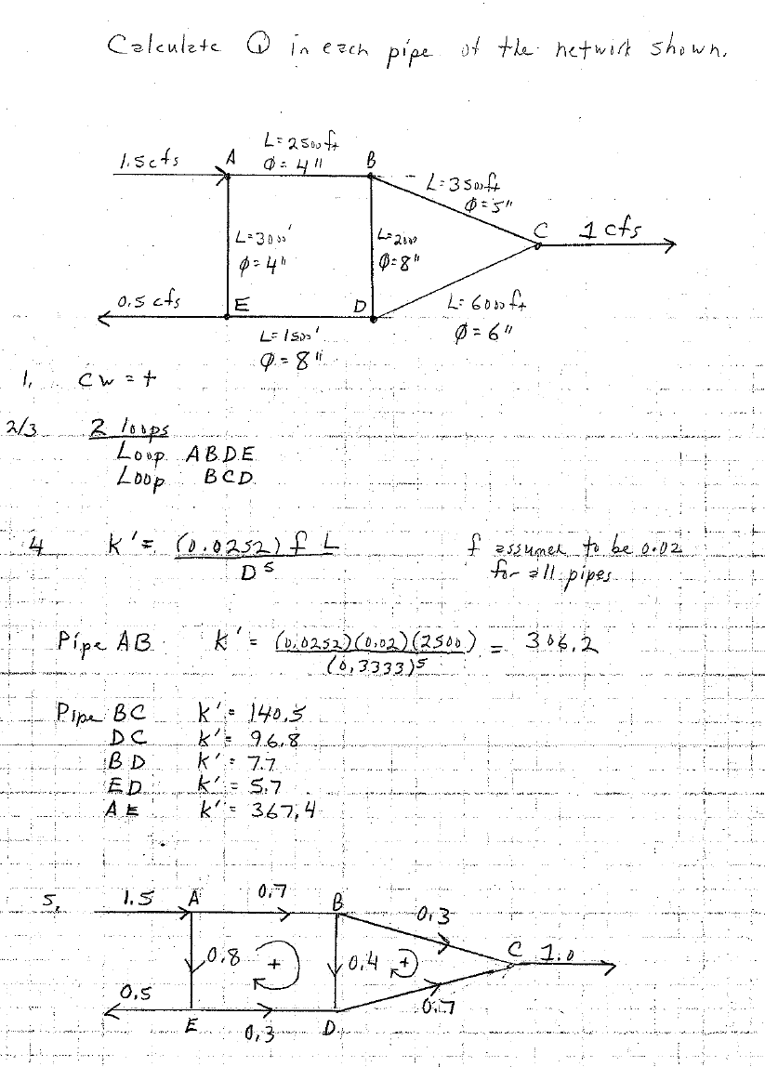
Hardy-Cross Example 1

Slide 18
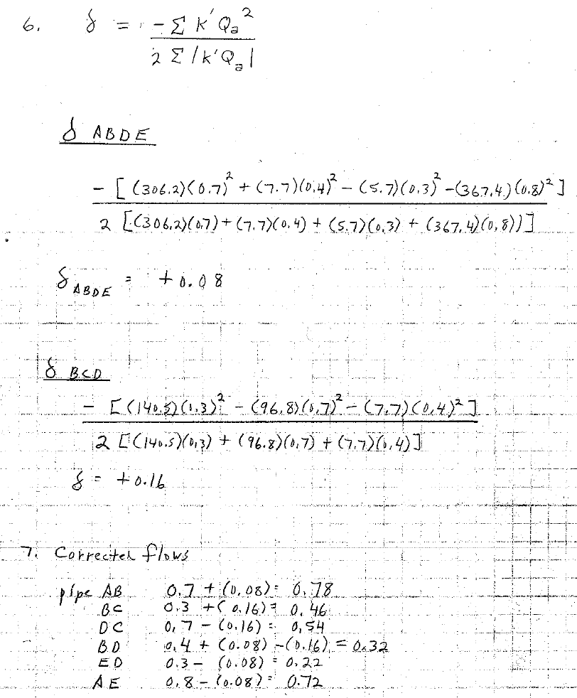
Hardy Cross Ex 2

Slide 19
Hardy Cross-Solve using Excel

Slide 20
Next Lecture
Equivalent Pipes
Pump Performance Curves
System Curves

