Slide 1
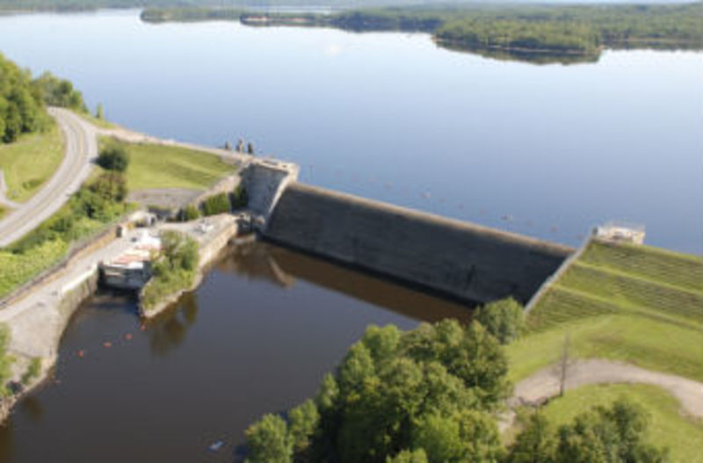
Hinckley Reservoir

Slide 2
Data
https://www.canals.ny.gov/Operations-and-Public-Projects/Water-Levels
Built:
Drainage Area:
Maximum Depth:

Slide 3
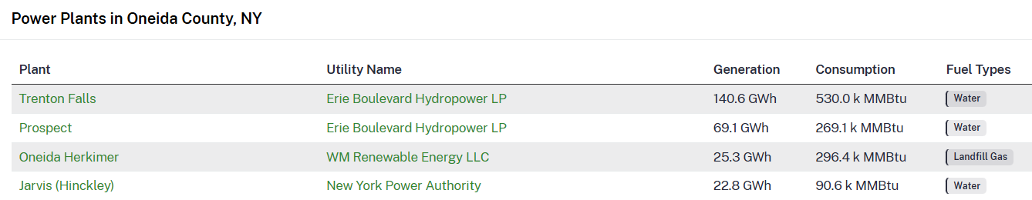
Power plants downstream
https://www.gridinfo.com/plant/trenton-falls/2619

Slide 4
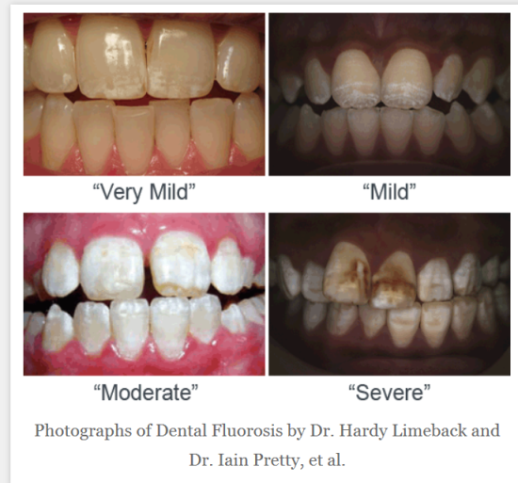
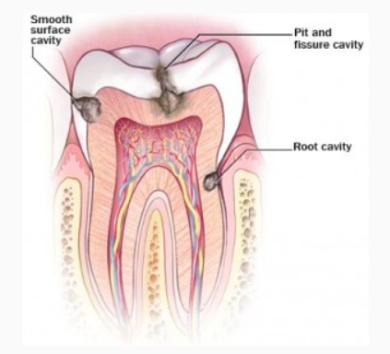
Fluoridation
Too little fluoride increases incidence of cavities
Too much fluoride can cause mottling of teeth (>2--4 mg/l)
Optimum fluoride reduces incidence of cavities (0.6 to 1.2 mg/l)
http://fluoridealert.org/issues/fluorosis/
http://mybrownstonedental.com/tooth-fillings-houston-dentist/cavity

Slide 5
Fluoride References
Fluoride Paper (in Blackboard)
Database: water supply fluoridation
https://nccd.cdc.gov/DOH_MWF/Default/Default.aspx

Slide 6
Fluoride
Add fluoride using sodium fluoride, sodium silicofluoride or fluorosilicic acid
Remove fluoride by activated alumina or bone char

Slide 7
Chlorination
Used for disinfection, oxidation and for providing a residual disinfection
Chemical reactions are complex and depend on pH, temperature, time and ammonia concentration

Slide 8
Chlorine
Heavier than air
Greenish-yellow-colored toxic gas
Strong oxidizer
Extremely corrosive
Respiratory irritant

Slide 9
Chlorine as Disinfectant
Chlorine combines w/ water to form hypochlorous acid (HOCl) which can then ionize to the hypochlorite ion H+ & OCl- when the PH>8
Chlorine combines with ammonia to form combined residuals
Adding additional chlorine results in free residual

Slide 10
Chlorine-Ammonia Products
Monochloramine (NH₂Cl)
Forms in pH range of 4.5 to 8.5
Monochloramine exists alone when pH > 8.5
Dichloramine (NHCl₂)
Forms in pH range of 4.5 to 8.5
Trichloramine (NCl₃)
Forms when pH < 4.4

Slide 11
Chlorination Curve
Chlorine first reacts w/ reducing agents (nitrites, ferrous iron and hydrogen sulfide)
Chlorine then reacts w/ ammonia to produce chloramines (mono,di and tri)
Chloramines are then oxidized which produces nitrous oxide, nitrogen and nitrogen trichloride
Breakpoint occurs
Freely available chlorine

Slide 12
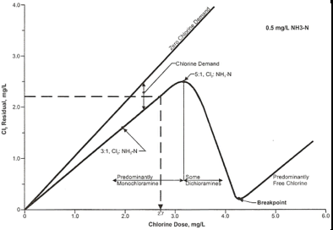
See Fig 6-14 of your book (page 146)

Slide 13
Oxidation
Chlorine is a strong oxidizer and can also be used for iron and manganese removal

Slide 14
Providing a residual
A chlorine residual is usually provided to prevent overgrowth in the piping systems beyond the treatment plant
Also chlorine is used to disinfect new equipment, repaired equipment, etc.

Slide 15
Chlorine By-Products
THM’s (trihalomethanes)
HAA5 (haloacetic acids)
NDMA (N-nitrosodimethyalmine)-formed from a reaction with dimethylamine when recycling wastewater
All are suspected carcinogens

Slide 16
Minimizing By-Products
Improve clarification process
Add activated carbon
Use alternative disinfectants
Apply chlorine at later stages (after filtration)

Slide 17
Other disinfectants
Chlorine dioxide (potential formation of toxic chemicals and high cost; however, doesn’t react with ammonia and doesn’t form THM’s)
Ozone (high cost; doesn’t provide residual; however, ozone doesn’t form THM’s and may remove other toxic trace organic chemicals)
Ultraviolet Radiation (no chemicals; can supplement chlorine; inactivates cryptosporidium)

Slide 18
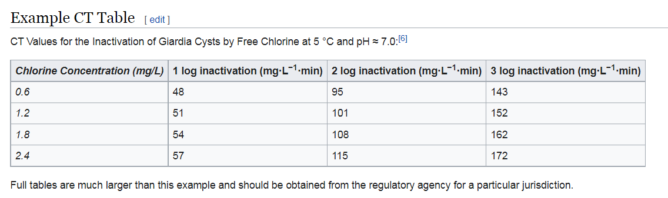
Disinfection C*t Product
Inactivating pathogens is a function of the chemical concentration (C) and the time of contact (t)

Slide 19
Determining C*t values in water treatment
EPA Guidance Manual describes procedure
C*t is determined by summing C*t for tanks, reservoirs, and piping before it arrives to the first customer
C is the free chlorine residual measured at the end of each chlorination segment (mg/l)
t is the calculated contact time of the segment in minutes

Slide 20
Contact Time
Contact time in reservoirs or tanks is not usually the detention time (short-circuiting and back-mixing)
Tracer study is usually used and the contact time is determined when 10% of the tracer has passed through the reservoir

Slide 22
Surface Water Disinfection
EPA requires 99.9% (3 log) removal of Giardia cysts, 99% (2 log) of Cryptosporidium and 99.99% (4 log) removal of enteric viruses
Filtration is the major method used to get these removal rates
Very rarely is unfiltered water allowed for a community water system

Slide 23
Groundwater Disinfection
Groundwater not under the influence of surface water may or may not be disinfected

Slide 24
Ion Exchange
Used for softening
Used for removal of specific contaminants (nitrate)

Slide 25
Removal of Dissolved Salts
Distillation http://www.excelwater.com/eng/bottling/water-treatment-commercial-distillation.php
Reverse Osmosis http://www.hcti.com/sm/aboutro/aboutro.html
Electrodialysis http://www.fumatech.com/EN/Membrane-technology/Membrane-processes/Electrodialysis/
Reject brine is treated via evaporating ponds, deep-well injection, or piping to the ocean

Slide 26
Sources of Wastes
Coagulation/Iron & Manganese Removal Wastes
Filter Backwash Water

Slide 27
Waste Treatment Processes
Lagoons
Drying Beds
Gravity Thickening
Centrifugation
Pressure Filtration

Slide 28
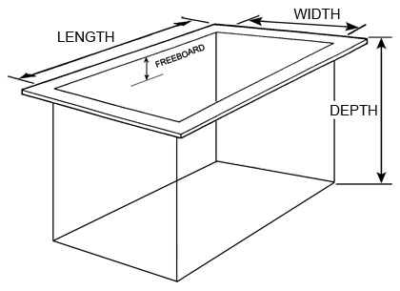
Freeboard (waves/backup/sloshing)

