Slide 1
Review
Biology Review
Organisms of interest in water and wastewater treatment
BOD (unseeded)

Slide 2
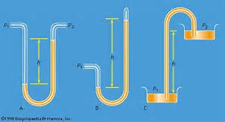
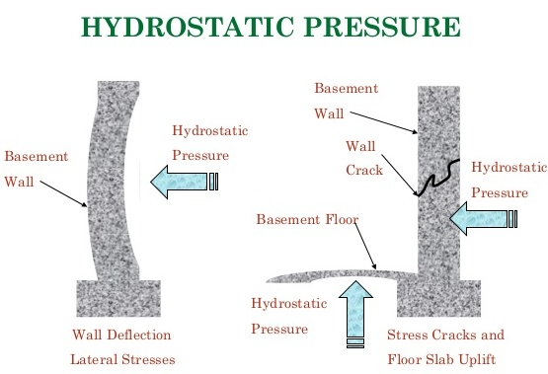
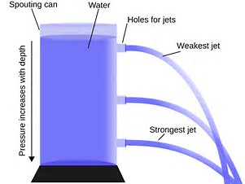
CTC 450
Hydrostatics (water at rest)

Slide 3
Objectives
Know common fluid properties
Difference between absolute and gage pressure
How to convert pressure to pressure head
Calculate hydrostatic pressure and resultant force on a horizontal plane surface
Calculate hydrostatic pressure and resultant force on a rectangular, vertical plane surface

Slide 4
Fluid Properties
Property | SI | USC/FPS
Temperature | K (273+C) | F (9/5C+32)
Mass | Kg | Slug
Length | Meter | Foot
Time | Sec | Sec
Force | Newton | Lb
Pressure | Pascal (N/m²) | Psi
Gravity Constant | 9.81 m/sec² | 32.2 ft/sec²

Slide 5
Other fluid properties
Specific Weight-Gravitational force per unit volume
Water at 20C (68F): 9.79 kN/m³ (62.3 #/ft³)
Mass Density-mass per unit volume
Water at 4C (39F): 1000 kg/m³ (1.94 slugs/ft³)
Specific Gravity-Specific weight of a liquid/specific weight of water at some std. reference temperature

Slide 6
Water Properties
Dependent on water temperature and pressure

Slide 7
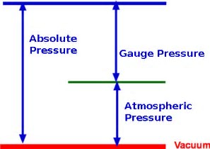
Absolute vs Gage Pressure
Gage pressure is the difference between absolute pressure and the surrounding ambient pressure (atmospheric pressure)
Absolute pressure is the gage pressure plus atmospheric pressure
In civil engineering applications, gage pressure is the commonly used pressure

Slide 8
Atmospheric Pressure
Approximately 14.7 psia
What is the equivalent gage pressure?

Slide 9
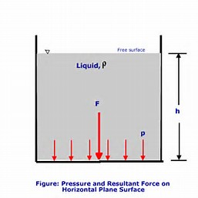
Hydrostatic Pressure and Resultant Force on a Horizontal Plane Surface
Pressure is uniform because the depth of liquid is the same across the plane surface
Pressure=Specific weight * liquid depth (h)

Slide 10
Hydrostatic Pressure & Resultant Force on a Horizontal Plane Surface
Cylinder of water 1 foot high; area = 1 ft²
What is the pressure at the bottom of the cylinder?
P=Specific Wt * Height of Water
P=62.4 #/ ft²
F=Pressure * Area
F=62.4 #

Slide 11
Force on Horizontal Plane Surface
The magnitude of the force is 62.4#
Where does it act?

Slide 12
Center of Pressure-Horizontal Plane Surface
Corresponds to the centroid of the horizontal plane surface
Circle
Triangle
Rectangle
Composite of simple shapes

Slide 13
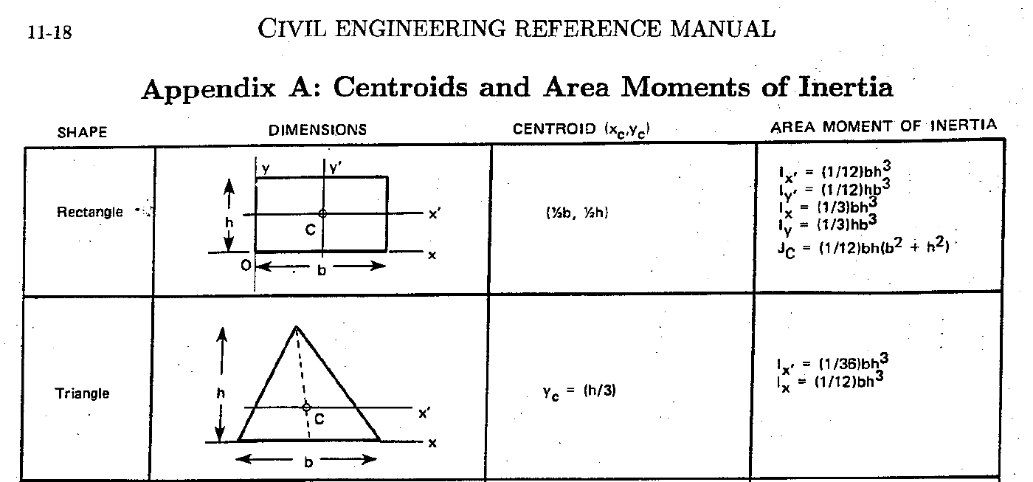
Centroids and Moment of Inertia

Slide 14
Hydrostatic Pressure
Varies linearly w/ depth
Is a function of specific wt and depth
Acts through the center of pressure
Acts normal to the exposed surface

Slide 15
Pressure and Pressure Head
In civil engineering water pressure (psi) is often expressed in terms of water head (ft)

Slide 16
Converting Pressure to Pressure Head
Pressure Head = Pressure/Specific Weight
Example:
Atmospheric pressure = 14.7 psia
(14.7 psia)(144 in²/ft²)/(62.4#/ft³)=33.9 ft H₂O
The specific gravity of mercury (Hg) is 13.6 therefore the pressure head in terms of Hg would be 2.49 ft

Slide 17
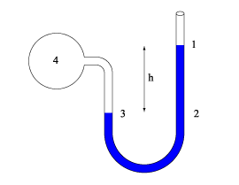
Manometer Principles
Point 1: Pressure=0
Point 2: Pressure=h*specific weight of liquid
Point 3: Pressure=Pressure @ 2
Point 4: Pressure=Pressure @ 3 –d*specific weight of liquid in vessel 4
As you go down pressure increases.
As you go up pressure decreases.
As long as you know pressure at some point (& fluid properties & d/h values) you can determine pressures at all other points.

Slide 18
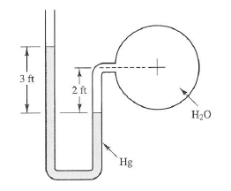
Manometer Example
A manometer is mounted on a city water supply main pipe to monitor the water pressure. Determine the water pressure in the pipe (psi).
Answer: 16.8 psi

Slide 19
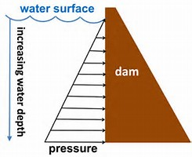
Vertical, rectangular plane surface (1/2)
Consider a dam section 1’ wide and 10’ deep
What is the pressure distribution and resultant force of the water pressure?
Pressure @ top = 0
Pressure @ bottom = 624 #/ft²

Slide 20
Vertical Rectangular Plane Surface (2/2)
Magnitude of force = Avg Pressure * Area
Avg Pressure is (0+624)/2=312 psf
Area of plane surface is 10 square feet
F=3,120 #
Where is the resultant force located?
Centroid of the dam (rectangular) or
Centroid of the pressure distribution (triangular)?

Slide 21
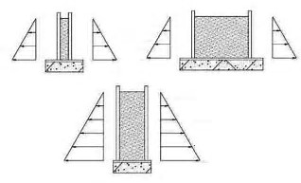
Example (Vertical-Rectangular 1/2)
Assume that freshly poured concrete exerts a hydrostatic force similar to that exerted by a liquid of equal specific weight
What is the force acting on one side of a form that is 8’V by 4’H used for pouring a basement wall

Slide 22
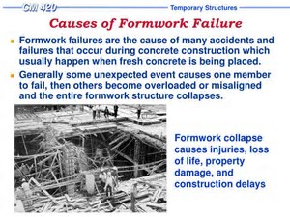
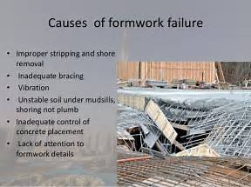
Example of Vertical Rectangular (2/2)
Concrete specific wt = 150#/ft³
Area = 32 ft²
F=Avg Pressure * Area
F=19,200# = 9.6 tons

Slide 23
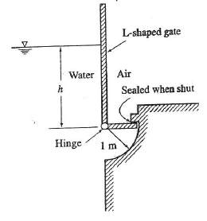
Example (Horizontal and Vertical Water Pressure) Class Exercise: who can get correct answer?
An L-shaped rectangular gate can rotate about the hinge. As the water level rises, the gate will open when the level reaches a critical height. If the length of the lower horizontal arm is 1 meter, find the critical height. (Neglect the weight of the gate).
Answer: h=square root of 3 (m)

Slide 24
What if Vertical Rectangular Plane Surface is Submerged?
Pressure distribution is not triangular but?

Slide 25
Review Questions
What is the difference between gage and absolute pressure?
What is the atmospheric absolute pressure at sea level?
What is the atmospheric gage pressure at sea level?
What is the difference between specific weight and specific gravity?
What is the difference between specific weight and mass density? What is the relationship between the two?
What is the equation for hydrostatic pressure acting on a horizontal plane surface?
How do you calculate the resultant force of pressure acting on a horizontal plane surface? Where is that force located?
Does hydrostatic pressure vary linearly with depth?
The pressure distribution on a vertical rectangular plane surface is either triangular or trapezoidal. When is it triangular? When is it trapezoidal?
Can you use the “average pressure” method for vertical rectangular surfaces?
Can you use the “average pressure” method for vertical triangular surfaces?

Slide 26
Next
Hydrostatic pressure on an inclined plane surface
Hydrostatic pressure on a curved surface
Buoyancy

