Slide 1
CTC 261
Hydrostatics (water at rest)

Slide 2
Review
Fluid properties & Pressure (gage and absolute)
Converting pressure to pressure head & Manometers
Resultant force on a horizontal, planar surface
Resultant force on a vertical, rectangular surface (unsubmerged and submerged)
F=Average Pressure * Surface Area
Center of pressure-Find centroid of pressure distribution

Slide 3
Objectives
Know how to calculate hydrostatic pressure on an inclined, submerged planar surface
Understand buoyancy and solve buoyancy problems

Slide 4
Inclined, submerged plane surface

Slide 5
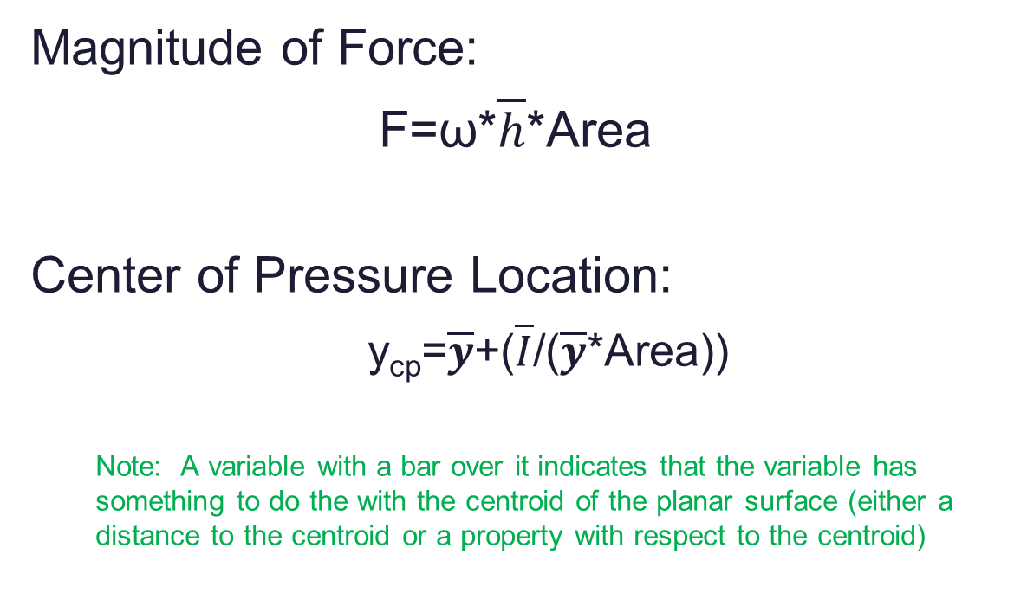
Hydrostatic forces on inclined, submerged planes
Magnitude of Force:
F=ω*$\overline{h}$*Area
Center of Pressure Location:
y_{cp}=$\overline{y}$+($\overline{I}$/($\overline{y}$*Area))
Note: A variable with a bar over it indicates that the variable has something to do the with the centroid of the planar surface (either a distance to the centroid or a property with respect to the centroid)

Slide 6
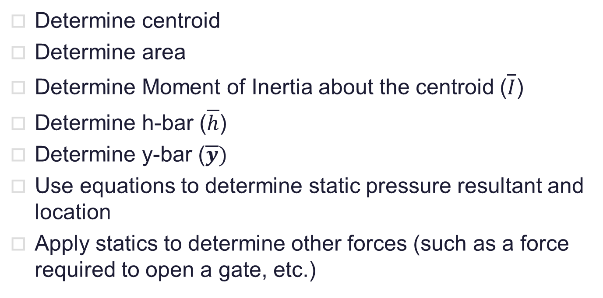
Hydrostatic forces on inclined, submerged planes-Basic Steps
Determine centroid
Determine area
Determine Moment of Inertia about the centroid ($\overline{I}$)
Determine h-bar ($\overline{h}$)
Determine y-bar ($\overline{y})$
Use equations to determine static pressure resultant and location
Apply statics to determine other forces (such as a force required to open a gate, etc.)

Slide 7
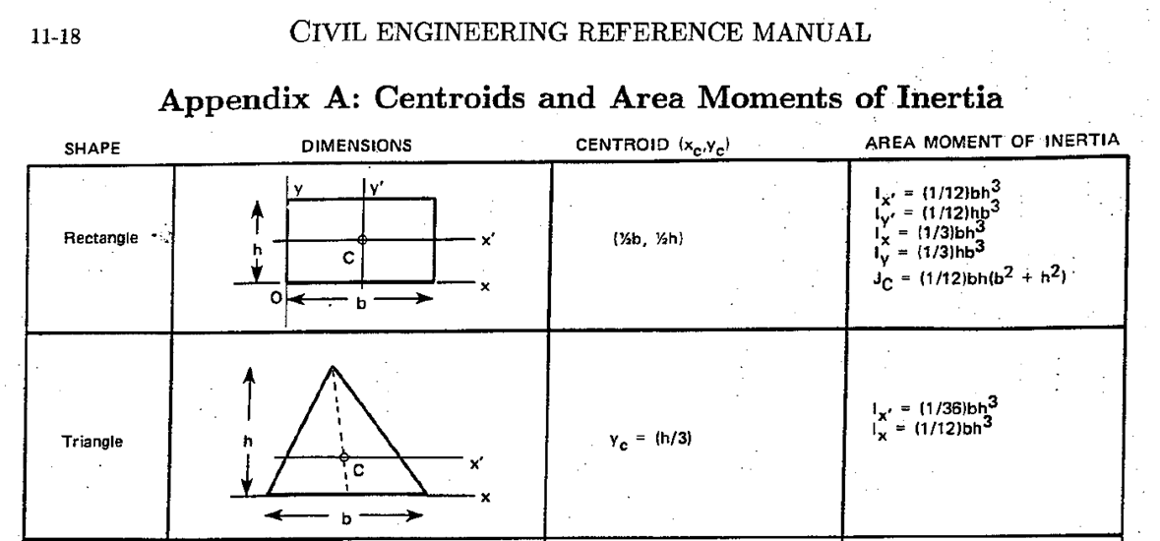
Centroids and Moment of Inertia See Brightspace

Slide 8
Hydrostatic forces on inclined, submerged planes
Review Examples on Brightspace (Content, Fluid Statics Examples)
Vertical non-rectangular gate
Inclined submerged gate and having to use a FBD to solve for an unknown force

Slide 9
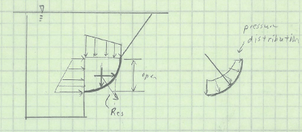
Forces on Curved Surfaces
Find horizontal and vertical components
Use vector addition to solved for magnitude and direction

Slide 10
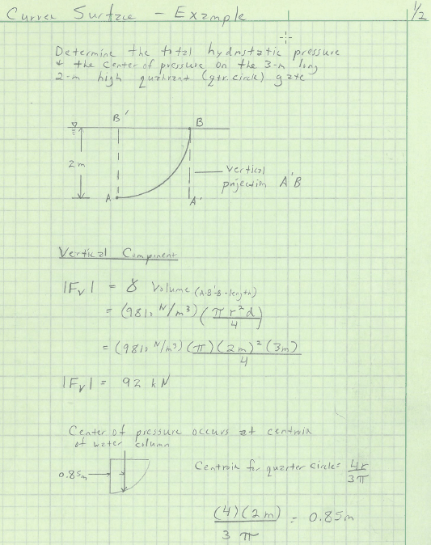
Curved Gate Problem-1/2

Slide 11
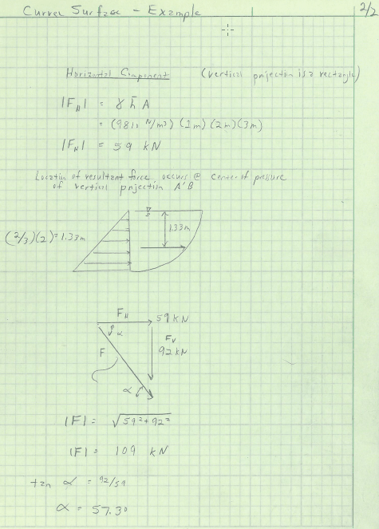
Curved Gate Problem-2/2

Slide 12
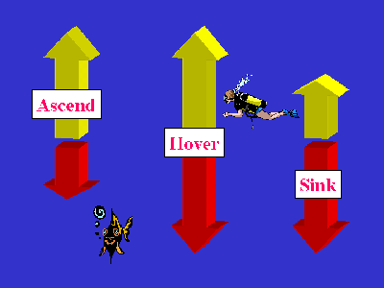
Buoyancy
http://scubaexpert.blogspot.com/2007/03/buoyancy-what-is-it-and-why-is-it.html

Slide 13
Buoyancy
Buoyancy is the uplifting force exerted by water on a submerged solid object
The buoyant force is equal to the weight of water displaced by the volume
If the buoyant force is > than the weight of the object, the object will float. If < object will sink. If equal (hover)

Slide 14
Buoyancy-Basic Steps
Draw the FBD
Identify all buoyant forces
Identify all weight forces
Identify other forces (pushing, pulling)
Apply equilibrium equation in the y-direction

Slide 15
Buoyancy-Other Hints
Every submerged object has a buoyant force and a weight force. Just because an object is light, don’t ignore the weight. Just because an object is heavy and dense, don’t ignore the buoyant force.
If the weight is noted “in water” then the buoyant force is already accounted for

Slide 16
Buoyancy-Example
A 50-gal oil barrel, filled with air, is to be used to help a diver raise an ancient ship anchor from the bottom of the ocean. The anchor weighs 400-lb in water and the barrel weighs 50-lb in air.
How much weight will the diver be required to lift when the submerged (air-filled) barrel is attached to the anchor?

Slide 17
Buoyancy-Example
Draw the FBD: on board
Identify all buoyant forces:
Anchor—already accounted for
Barrel-50 gal/(7.48 gal/ft³)*64.1#/ft³=428#
Identify all weight forces
Anchor-400#
Barrel-50#
Sea water has a higher specific weight than fresh water http://hypertextbook.com/facts/2002/EdwardLaValley.shtml

Slide 18
Buoyancy-Example
Identify other forces (pushing, pulling)
Pulling up of diver (unknown)
Apply equilibrium equation in the y-direction
Diver Force=400+50=428=22 #
Answer=Just over 22#

Slide 19
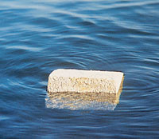
Buoyancy Problem: try this at home
A block of wood 30-cm square in cross section and 60-cm long weighs 318N.
How much of the block is below water?
Answer: 18cm
http://www.cement.org/basics/concreteproducts_acc.asp

Slide 20
Higher-Level Topic
Stability
How stable is an object floating in the water.
If slightly tipped, does it go back to a floating position or does it flip over?

Slide 21
Review Questions
What is the bar above a variable mean?
For inclined plane problems you must use two coordinate systems---what are they?
What is the moment of inertia?
Which moment of inertia is used for inclined plane problems?
How do you determine buoyancy?
What does the weight “in water” mean?
Is the specific weight of sea water different than that of fresh water? Why?

Slide 22
Next Lecture
Fluid Flow

