Slide 1
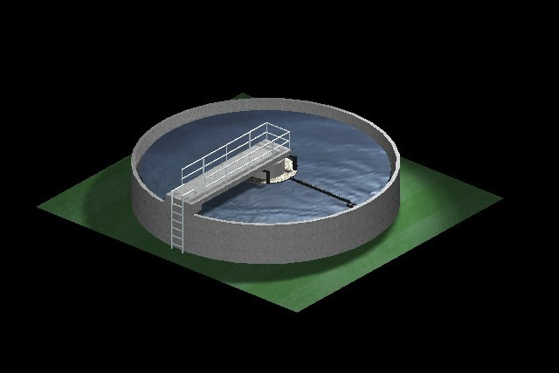
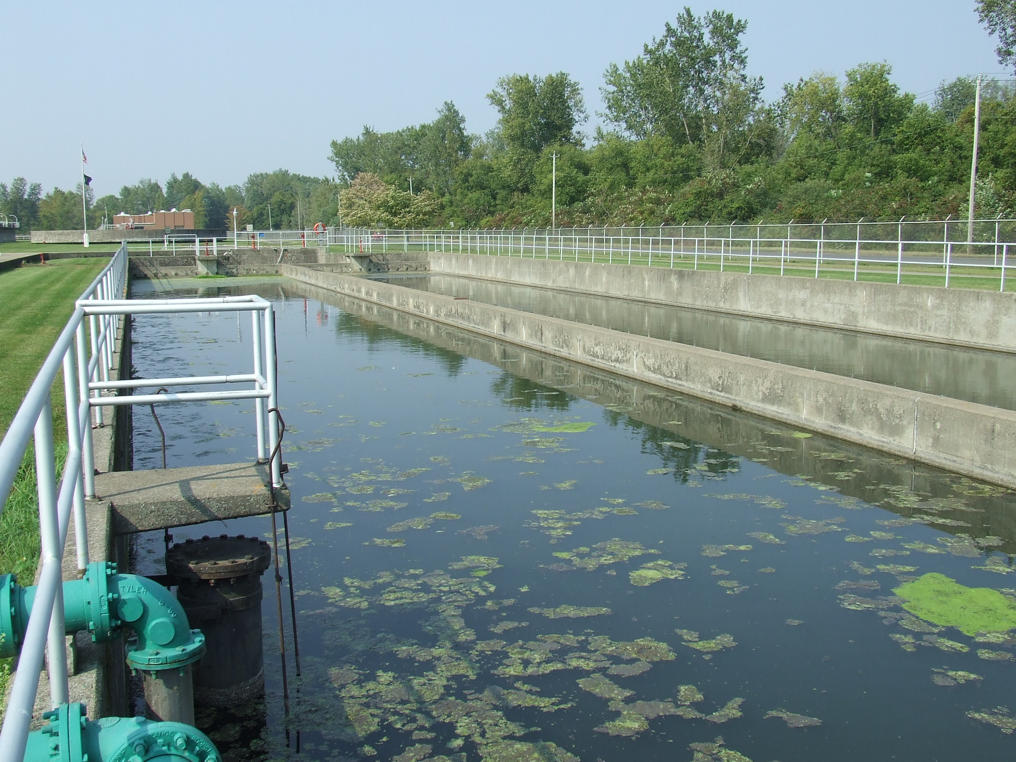
Water and Wastewater Technology
Introduction

Slide 2
Separation & the Tool of Money
If we grew our own food, we wouldn't waste a third of it as we do today. If we made our own tables and chairs, we wouldn't throw them out the moment we changed the interior decor. If we had to clean our own drinking water, we probably wouldn't contaminate it.
http://www.guardian.co.uk/environment/green-living-blog/2009/oct/28/live-without-money

Slide 3
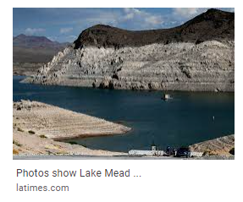
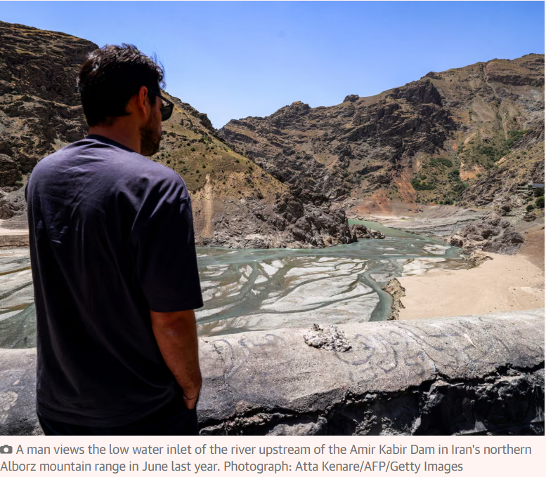
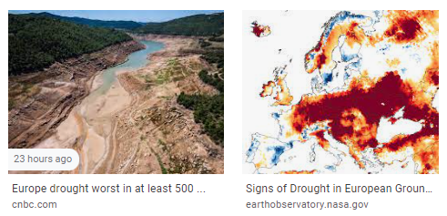
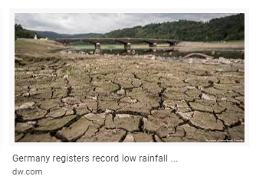
Drought Examples

Slide 4
Objectives
Class Requirements
Intro to Water & Wastewater Treatment

Slide 5
Class Info
http://people.sunypoly.edu/~barans/
Syllabus
Schedule
Projects
Grades
Brightspace (assignments/dropoff boxes)

Slide 6
Broad & Diverse
Chemistry
Biology
Hydrology
Hydraulics
Water Quality
Water Resources
Unit Operations for Facilities

Slide 7
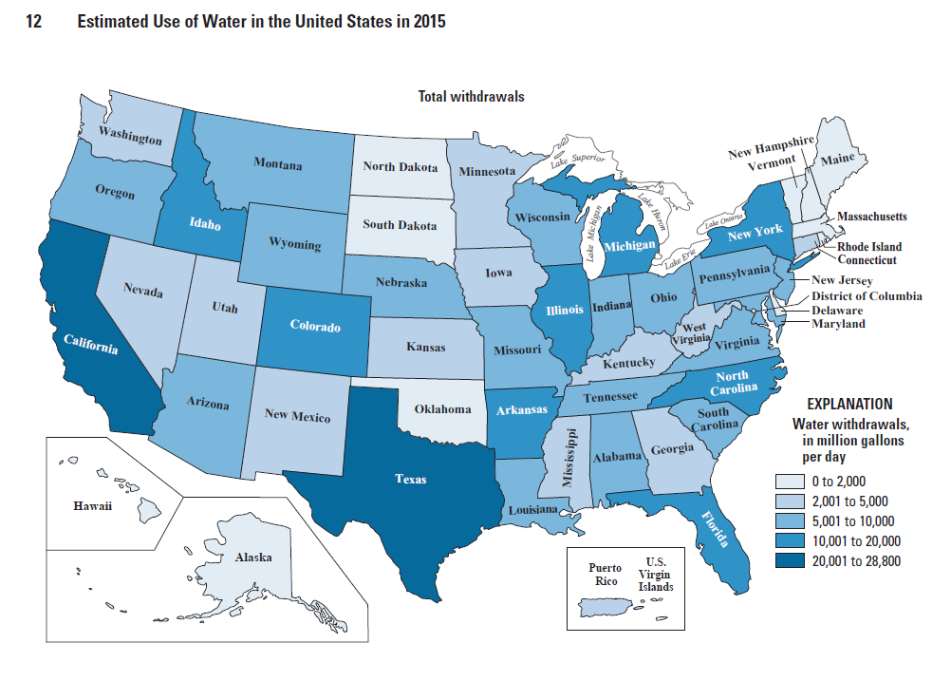
Ref: https://pubs.usgs.gov/circ/1441/circ1441.pdf

Slide 8
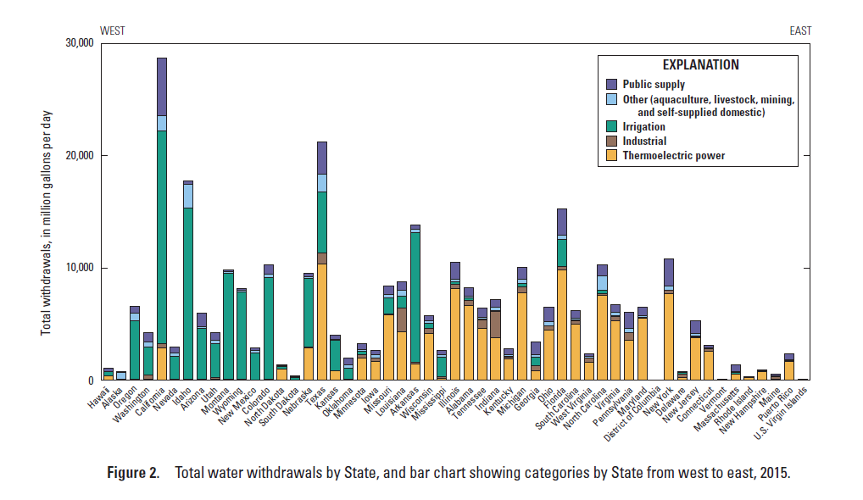
Ref: https://pubs.usgs.gov/circ/1441/circ1441.pdf

Slide 9
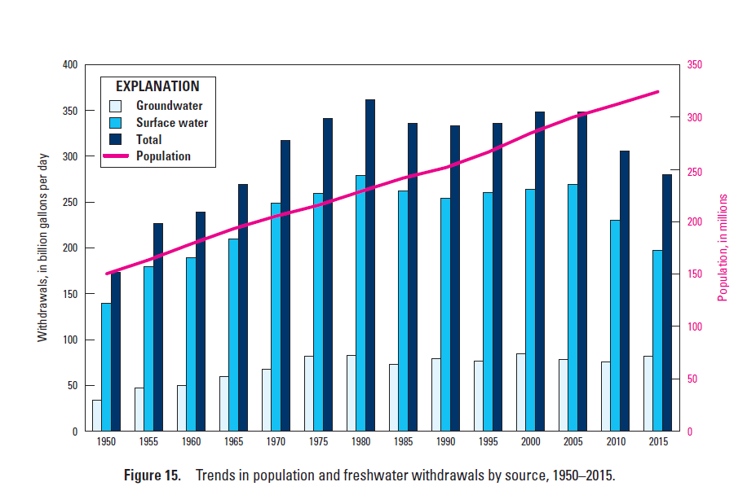
Ref: https://pubs.usgs.gov/circ/1441/circ1441.pdf

Slide 10
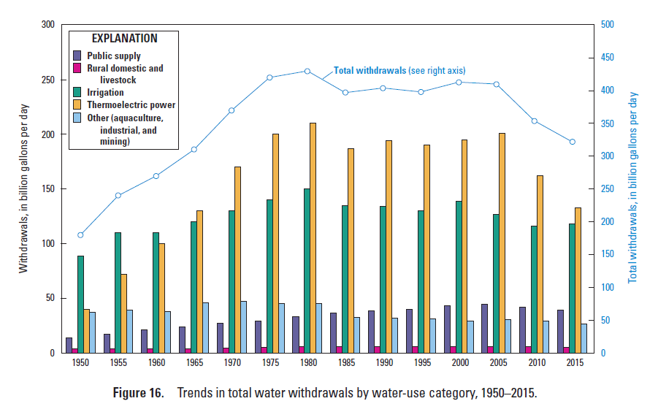
Ref: https://pubs.usgs.gov/circ/1441/circ1441.pdf

Slide 11
Water Exercise
On-Site
Public

Slide 12
Wastewater Exercise
On-Site
Public

Slide 13
Wastewater Infrastructure Needs of New York State
For next class:
Read:
Chapter 1 of your book
“WW Infrastructure Needs of New York State”
Not collected but be prepared to answer the following questions:

Slide 14
WW Needs of NYS
What do the acronyms CWA, MS4, EPA, CSO, NYSERDA, and TMDL stand for?
What % of all children deaths (under age 5) worldwide are due to lack of safe water?
How many municipal wastewater plants are located in New York State?
What is the expected useful life of a wastewater treatment plant?
A permit is needed for construction sites greater than ___ acres?

