Slide 1
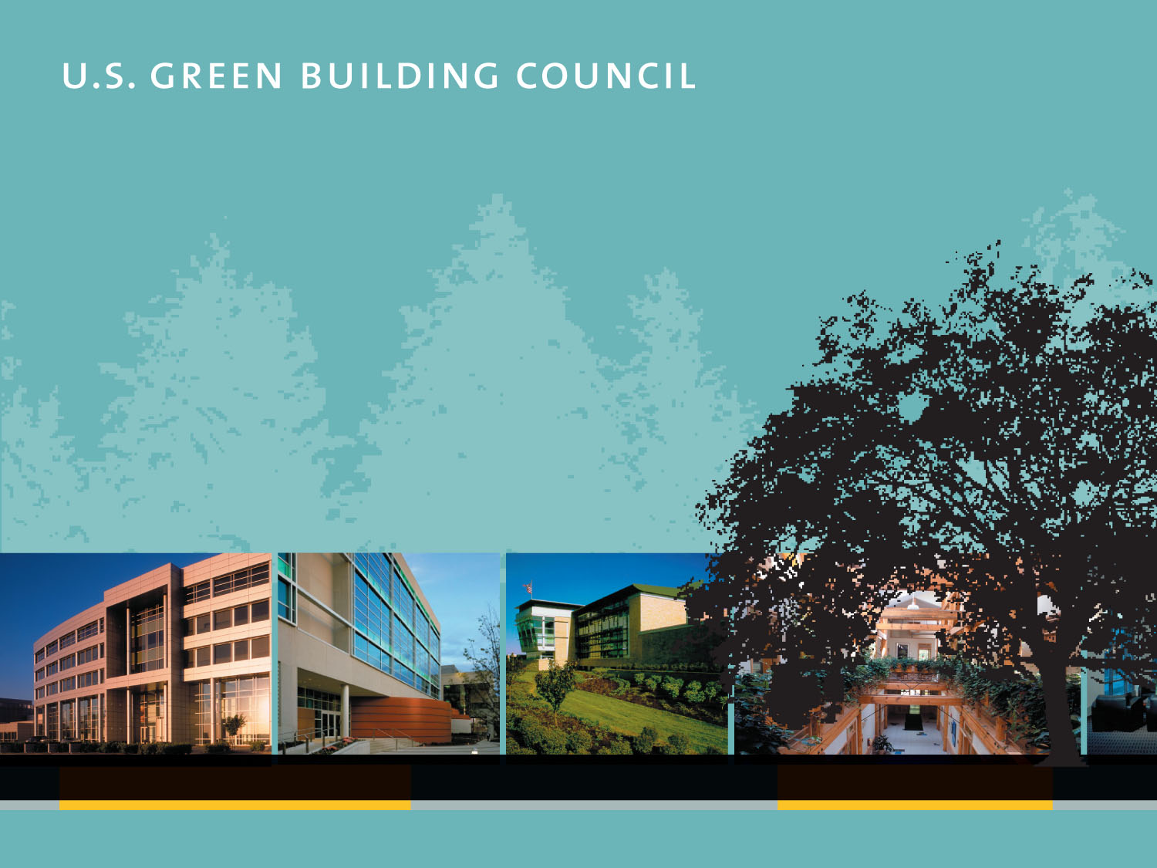
An Introduction to the
U.S. Green Building Council and the
LEED Green Building
Rating System®
December 2004
Copyright 2004, U.S. Green Building Council
Notes:
This presentation provides a general overview of:
the U.S. Green Building Council;
the environmental impact of buildings;
green building and its benefits; and
the LEED Rating System.
The U.S. Green Building Council periodically updates this presentation. Please check www.usgbc.org for the latest version.

Slide 2
USGBC’s MISSION:
to promote the design and construction of buildings that are environmentally responsible, profitable, and healthy places to live and work.
The organization’s activities…
  Integrate building industry sectors
  Lead market transformation
  Educate owners and practitioners
Notes:
“Hines is committed to ongoing product innovation in the built environment. As such, our membership in the U.S. Green Building Council and our participation on LEED Product Committees signals our continued and real commitment to excellence in energy efficiency and environmental performance.”
– Kenneth W. Hubbard, Executive Vice President, Hines
“The leadership that the U.S. Green Building Council has shown to promote green building is extraordinary, and so important to our future. As the agency that manages space in 8,300 buildings, we understand how big a difference we can make for the environment. GSA supports what the Council is doing, and we are committed to using the LEED rating system in our buildings.”
– Dave Barram, former Administrator, U.S. GSA
“At Anderson, we believe we’re responsible for a lot more than high quality windows and patio doors. Our corporate vision includes the notion of going beyond the bottom line to support the environment, our community and customer needs. Membership in the Council gives us satisfaction knowing we’re part of a high-impact coalition that is transforming the building industry in ways that support our own corporate priorities. In short, membership is an excellent way to challenge our company to respond to the needs of the market.”
– John Gardner, Commercial Markets Business Manager, Anderson Windows
“The USGBC is providing a significant and important service to real estate developers by creating standards and guidelines which help companies like ours develop more sustainable environments for our customers, tenants and families.”
– James F. Jacoby, Chairman, Jacoby Development, Inc.
“LEED is good architecture. It makes sense.”
– Robert Kobet, AIA, Hanson Design Group
“Our involvement in the U.S. Green Building Council has expanded our knowledge of sustainable design, strengthened our relationships with industry leaders and practitioners, and given us unparalleled access to new products and emerging trends. We appreciate the USGBC’s unique, inclusive approach within the industry and its creation of LEED, a tool that we rely on to educate our clients, design better buildings, and promote sustainable practices within HNTB.”
– Steven Reiss, AIA, Chairman, Architecture Services Group, HNTB

Slide 3
USGBC is...
A national nonprofit organization
A diverse membership of organizations
Consensus-driven
Committee-based product development
Developer and administrator of the LEED® Green Building Rating System
Notes:
The Council is a national nonprofit organization that was formed in 1993. Its quickly growing membership includes representation from organizations across the building industry:
Architecture firms, engineering firms, builders, manufacturers, service contractors, government entities (federal, state, and local), real estate developers and owners, financial institutions, universities, retail companies, nonprofit associations, utilities, and others.
USGBC serves its members and the community through the development of industry standards, design practices and tools, policy advocacy, information exchange, and education.

Slide 4
What is “Green” Design?
Design and construction practices that significantly reduce or eliminate the negative impact of buildings on the environment and occupants in five broad areas:
Sustainable site planning
Safeguarding water and water efficiency
Energy efficiency and renewable energy
Conservation of materials and resources
Indoor environmental quality
Notes:
The goal of green design is to create high-performance buildings. Often called “sustainable design,” it evolved from a variety of concerns, experiences, and needs…..
Energy efficiency gained importance during the 1970s oil crisis.
Recycling efforts in the U.S. in the 1970s onward became commonplace and came to the attention of the building industry.
In the 1980s, the “sick building syndrome” concept emerged and concern for worker health and productivity became an issue. The concern for toxic material emissions also became an issue that needed to be addressed.
Projects in water-scarce areas began to focus on water conservation.
Early green designs usually focused on one issue at a time, mainly energy efficiency or use of recycled materials.
Green building architects in the 1980s and 1990s began to realize that the integration of all the factors mentioned here would produce the best results and, in essence, a “high performance” building.

Slide 5
Environmental Impact of Buildings*
  65.2% of total U.S. electricity consumption ¹
  > 36% of total U.S. primary energy use ²
  30% of total U.S. greenhouse gas emissions ³
  136 million tons of construction and demolition waste in the U.S. (approx. 2.8 lbs/person/day) ⁴
  12% of potable water in the U.S. ⁵
  40% (3 billion tons annually) of raw materials use globally ⁶
  * Commercial and residential
Notes:
Buildings fundamentally impact people’s lives and the health of the planet. In the U.S., buildings use one third of our total energy, two-thirds of our electricity, one-eighth of our water, and transform land that provides valuable ecological services. Atmospheric emissions from the use of energy lead to acid rain, ground-level ozone, smog, and global climate change.
Footnotes:
1. U.S. Department of Energy, Energy Information Administration, March 2001, Monthly Energy Review.
Ibid.
U.S. Department of Energy, Energy Information Administration, “Emissions of Greenhouse Gases in the United States 1999.”
U.S. EPA, 1998, “Characterization of Building-Related Construction and Demolition Debris in the United States.”
U.S. Geological Service, 1995 data.
Lenssen and Roodman, 1995, “Worldwatch Paper 124: A Building Revolution: How Ecology and Health Concerns are Transforming Construction,” Worldwatch Institute.

Slide 6
Benefits of Green Building
Environmental benefits
  Reduce the impacts of natural resource consumption
Economic benefits
  Improve the bottom line
Health and safety benefits
  Enhance occupant comfort and health
Community benefits
  Minimize strain on local infrastructures and improve quality of life
Notes:
The benefits of green design can be summarized as follows:
The local and global environment benefits from protecting air quality, water quality, and overall biodiversity and ecosystem health.
Economic benefits are experienced in building operations, asset value, worker productivity, and the local economy.
Occupants benefit from health and safety features. This also relates to risk management and economics. The U.S. EPA found that average Americans spend more than 90% of their time indoors, and indoor air quality can be two to five times worse than outdoor air quality.¹
Community and municipal benefits include: lessened demand for large-scale infrastructure such as landfills, water supply, stormwater sewers, and their related development and operational costs; and decreased transportation development and maintenance burden (roads) and increased economic performance of mass transit systems.
Footnotes:
1. U.S. EPA Office of Air and Radiation, 1989, Report to Congress on Indoor Air Quality, Volume II: Assessment and Control of Indoor Air Pollution.

Slide 7
Economic Benefits
Competitive first costs
  Integrated design allows high benefit at low cost by achieving synergies between disciplines and between technologies
Reduce operating costs
  Lower utility costs significantly
Optimize life-cycle economic performance
Notes:
Highlighting the economic benefits…
Green buildings can potentially reduce project costs. Green Building projects that are well integrated and are comprehensive in scope can result in lower or neutral project development costs. Rehabilitating an existing building can lower infrastructure and materials costs. Integrated design can use the payback from some strategies to pay for others. Energy-efficient building envelopes can reduce equipment needs – downsizing some equipment, such as chillers, or eliminating equipment, such as perimeter heating. Using pervious paving and other runoff prevention strategies can reduce the size and cost of stormwater management structures.
Energy- and water-efficient buildings have been able to reduce their operating costs significantly. Use can be cut to less than half than that of a traditional building, or even better, by employing aggressive and well-integrated green design concepts.

Slide 8
Economic Benefits
Increase building valuation and ROI
  Using the income-capitalization method: asset value = net operating income (NOI) divided by the capitalization rate (return). If the cap rate is 7%, divide the reduction in annual operating costs by 7% to calculate the increase in the building’s asset value
  Quantify financial benefit in terms of Return On Investment (ROI) instead of payback time.
Decrease vacancy, improve retention
  Marketing advantages
Reduce liability
  Improve risk management
Notes:
Green buildings can enhance asset value and profits. A high performance environment can yield valuable gains in labor productivity, retail sales, and manufacturing quality and output. These improvements combined with lower operating cost create a key competitive advantage and improve real estate value, which is helpful when securing loans or building resale. Green buildings typically sell or lease faster, and attract and retain tenants better because they combine superior amenity and comfort with lower occupancy costs and more competitive terms. Energy efficiency buffers operating budgets from potential short- or long-term increases in energy prices.
A healthy indoor environment can reduce the likelihood of lawsuits and insurance claims. In Bloomquist v. Wapello (500 N.W.2d 1, Iowa, 1993), plaintiffs successfully sued employers and builders for creating an unsafe work environment due to inadequate ventilation and pesticide applications.
Insurance companies are using climate change protection activities as a means to manage risk and maintain profitability.

Slide 9
Productivity Benefits
Improve occupant performance
  Estimated $29 –168 billion in national productivity losses per year ¹
  Student performance is better in daylit schools. ^{2, 3}
Reduce absenteeism and turnover
  Providing a healthy workplace improves employee satisfaction
Increase retail sales with daylighting
  Studies have shown ~40% improvement ⁴
Notes:
Healthy indoor environments can increase employee productivity according to an increasing number of case studies. Since workers are by far the largest expense for most companies (for offices, salaries are 72 times higher than energy costs, and they account for 92% of the life-cycle cost of a building), this has a tremendous effect on overall costs (See Green Developments by the Rocky Mountain Institute for more information).
Studies have shown that student performance, as well as energy performance, is better in schools built according to green design principles. ^{2, 3}
More than 17 million Americans suffer from asthma, and 4.8 million of them are children. Ten million school days are missed by children each year because of asthma, which is exacerbated by poor IAQ.
Employees in buildings with healthy interiors have less absenteeism and tend to stay in their jobs. The Internationale Nederlanden (ING) Bank headquarters in Amsterdam uses only 10% of the energy of its predecessor and has cut worker absenteeism by 15%. The combined savings equal $3.4 million per year.⁵
Footnotes:
1. Fisk and Rosenfeld, 1998, “Improved Indoor Environment Could Save Billions of Dollars”
2. Nicklas and Bailey, “Analysis of the Performance of Students in Daylit Schools,” Innovative Design, Raleigh, NC, www.innovativedesign.net.
3. Hathaway, Hargreaves, Thompson, and Novitsky, 1992, “A Study Into the Effects of Light on Children of Elementary School Age - A Case of Daylight Robbery,” Policy and Planning Branch, Planning and Information Services Division, Alberta Education, Canada.
4. Heschong, 1999, “Skylighting and Retail Sales: An Investigation into the Relationship Between Daylighting and Human Performance,” www.h-m-g.com/Daylighting.
5. Lenssen and Roodman, 1995, “Worldwatch Paper 124: A Building Revolution”

Slide 10
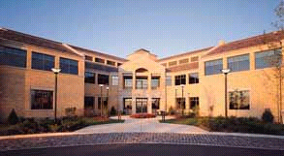
West Bend Mutual
Insurance Company
(West Bend, WI)
Notes:
Office workers are often dissatisfied with the temperature, indoor air quality, acoustics and lighting.
The West Bend Mutual Insurance Company documented a 16% productivity gain in the early 1990s due to their new 150,000 sq.ft. green building. With an annual payroll of $13 million at that time, the increase was worth over $2 million each year. Design strategies included daylighting, individually-controlled workstations, connectivity to nature, and improved lighting. Correspondingly, compared to the previously used facility, energy costs were reduced by an estimated 40%.
For more case studies on this topic, see:
Betterbricks.com, an information-sharing program created to help businesses discover the employee productivity gains that can be made in a well-designed workspace.
“Greening the Building and the Bottom Line” and Green Developments in Real Estate by Rocky Mountain Institute, www.rmi.org.
Sources for West Bend case study:
Beck, Paul, 1993, “Intelligent Design Passes IQ Test,” Consulting-Specifying Engineer, January 1993, pp. 34-38.
Lenssen and Roodman, 1995, “Worldwatch Paper 124: A Building Revolution”
Kroner, W., Stark-Martin, J., Willemain, T., 1992, Using Advanced Office Technology to Increase Productivity – The Impact of Environmentally Responsive Workstations (ERWs) on Productivity and Worker Attitude. The West Bend Mutual Study, Center for Architectural Research, Rensellaer Polytechnic Institute, Troy, NY.

Slide 11
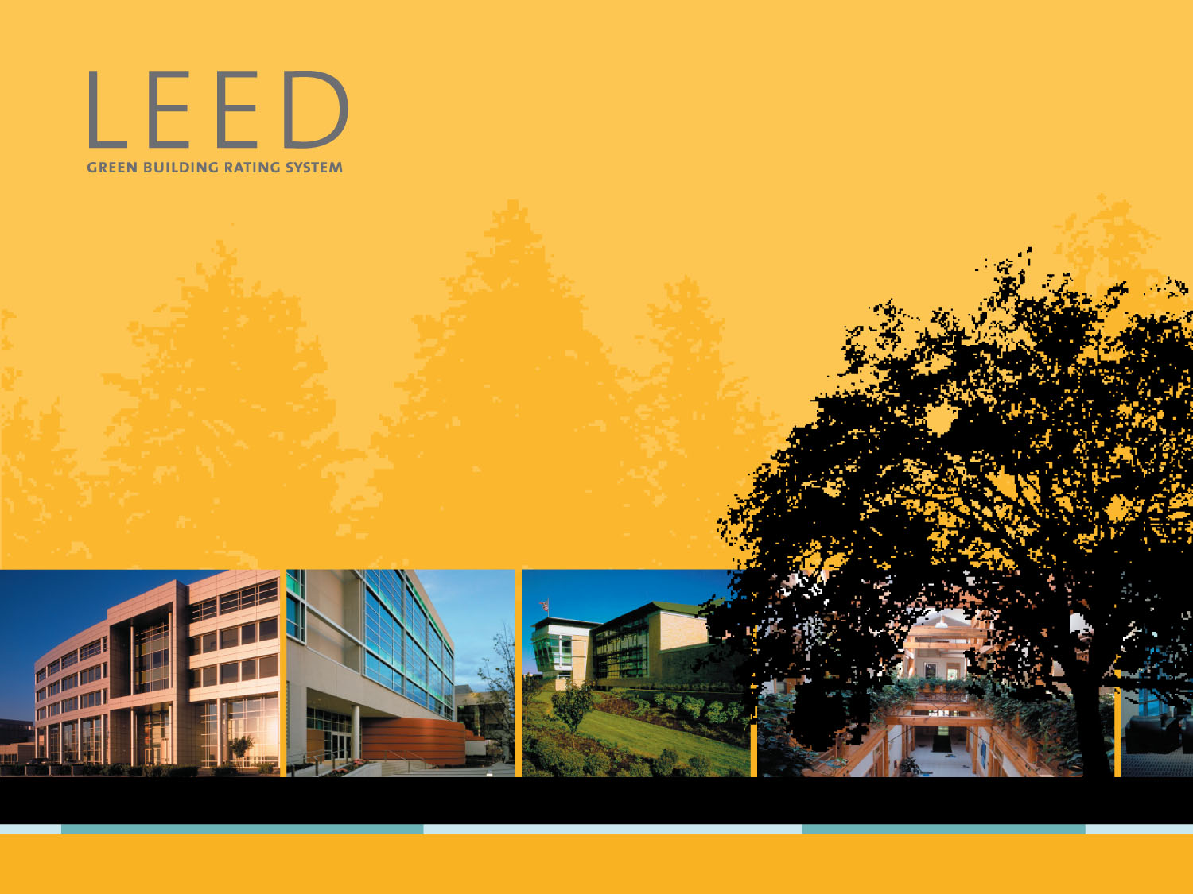
Leadership in Energy & Environmental Design®
A leading-edge system for designing, constructing, operating and certifying the world’s greenest buildings.

Slide 12
Why Was LEED® Created?
Facilitate positive results for the environment, occupant health and financial return
Define “green” by providing a standard for measurement
Prevent “greenwashing” (false or exaggerated claims)
Promote whole-building, integrated design processes

Slide 13
Why Was LEED® Created?
Use as a design guideline
Recognize leaders
Stimulate green competition
Establish market value with recognizable national “brand”
Raise consumer awareness
Transform the marketplace!

Slide 14
LEED® Products
LEED covers many different types of buildings and construction. These are covered under the following LEED products:
LEED-NC: LEED for New Construction and Major Renovations/Additions (for commercial and institutional buildings, released in 2000)
LEED-EB: LEED for Existing Buildings (public release: Winter 2004)
LEED-CI: LEED for Commercial Interiors (public release: Winter 2004)
LEED-CS: LEED for Core and Shell (public release: 2005)
LEED-H: LEED for Homes (public release: 2006)

Slide 15
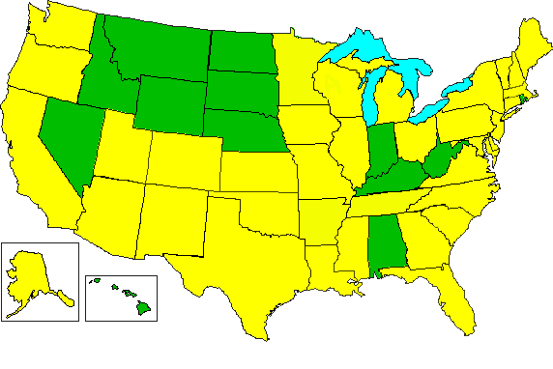
LEED-NC® Market Transformation
157 Certified Projects
1706 Registered Projects
  207 M gsf 50 States 13 Countries
As of 12.08.04
All statistics exclude pilot projects
Notes:
Since the release of LEED 2.0 in March 2000, over 1700 project teams have registered their buildings, thus expressing their intent to apply for official LEED-NC® Certification by the U.S. Green Building Council.

Slide 16
LEED-NC® Market Transformation
Registered Projects by State - Top 10
As of 12.08.04
All statistics exclude pilot projects

Slide 17
LEED-NC® Market Transformation
Registered Projects by Building Type
As of 12.08.04
All statistics exclude pilot projects

Slide 18
LEED-NC® Market Transformation
Registered Projects by Owner Type
As of 12.08.04
All statistics exclude pilot projects

Slide 19
LEED-NC® in the USA
  Federal Government Use:
  General Services Administration (GSA)
    LEED Certified projects beginning in 2003
  U.S. Air Force
    LEED Application Guide for Lodging
  U.S. Army Corps of Engineers
    Adaptation of LEED: SPiRiT
  Department of State
  Department of Energy (DOE)
  Environmental Protection Agency (EPA)
    Grant for LEED Existing Buildings
  U.S. Navy
    Grant for LEED Residential
Notes:
FEDERAL USERS: Federal government projects account for over 10 percent of construction in the United States.
GSA: The General Services Administration requires that all building projects in the 2003 construction budget meet LEED Certified level standards. It is not requiring that all projects apply for certification, however, it has more than 10 projects registered including federal courthouses, laboratories, border stations, and office buildings. The GSA is the nation's largest tenant, managing space in over 8,300 owned and leased buildings for over one million federal employees. GSA was the Council's first federal member.
Air Force: The Air Force has developed a LEED Application Guide for Lodging projects currently awaiting release and has registered one project for LEED Certification.
Army: The Army has adopted LEED into its Sustainable Project Rating Tool (SpiRiT), but is not requiring certification of its projects.
Department of State: The Department of State has committed to using LEED on future projects.
DOE: The Department of Energy supported the development of the LEED Rating System, training workshops, and reference materials.
EPA: The Environmental Protection Agency participated in the pilot testing of LEED version 1.0, but did not earned project certification. The Agency currently has two laboratory projects registered and is supporting development of LEED for Existing Buildings.
Navy: The Navy was the first federal entity to certify a LEED project, the Bachelor Enlisted Quarters at the Great Lakes Naval Training Center. This project was certified under the Pilot version of LEED. Navy currently has one project registered with LEED and is supporting the development of LEED Residential.

Slide 20
LEED-NC® in the USA
State Government Use*:
Local Government Use*:
  Austin, TX
  Arlington, VA
  Boulder, CO
  Chicago and Cook County, IL
  Los Angeles, CA
  Portland, OR
  San Jose, CA
  San Francisco, CA
  Seattle, WA
California
Maryland
Massachusetts
New Jersey
New York
Oregon
Pennsylvania
Washington
*Not limited to these examples
Notes:
STATE USERS: At present, no state requires LEED for public projects although several are considering it and encouraging use of LEED in both current public and private projects:
California: California is currently considering LEED adoption and development of California LEED Supplement for state projects.
Maryland: Maryland adopted LEED certification for all capital projects greater than 5,000 gsf in October 2001. An implementation plan for the new policy is pending. The state currently offers a green building tax credit for non-residential projects: http://business.marylandtaxes.com/taxinfo/taxcredit/greenbldg/default.asp
MD Green Building Council contacts:
Mark Bundy, MD Dept. of Natural Resources, 410-260-8720, mbundy@dnr.state.md.us
Steve Gilliss, MD Dept. of General Services, 410-767-4675, sgilliss@dgs.state.md.us
Massachusetts: Massachusetts is considering LEED adoption for all state projects
Contact: John DiModica, Dept. of Capital Planning, 617-727-4030, John.DiModica@dcp.state.ma.us
New Jersey: The New Jersey Economic Development Authority is encouraging the use of LEED but not requiring certification of new projects built under its $12 billion public school construction program.
New York: Governor Pataki issued an executive order in June 2001 encouraging but not requiring state projects to seek LEED Certification. The New York State Green Building Tax Credit Program provides a tax incentives to commercial developments incorporating specific green strategies (not directly tied to LEED).
Contact: Craig Kneeland, NYSERDA, 518-862-1090, ext. 3311 cek@nyserda.org
New York Green Building Tax Incentive Program: http://www.dec.state.ny.us/website/dar/ood/grnbldg.html
Oregon: Oregon's 35% Business Energy Tax Credit for commercial development is tied to LEED certification
100,000 sf. LEED Silver building eligible for $105,000 tax credit
100,000 sf. LEED Gold building.eligible for $142,500 tax credit
Pennsylvania: LEED Silver certification is required in new construction RFPs issued by the Dept. of Environmental Protection and Dept. of General Services.
Contact: Catherine Brownlee, Governor’s Green Government Council (717) 783-8411, www.gggc.state.pa.us/
*These states and others including Arizona, Missouri, New York, and Wisconsin are currently using LEED on public projects and intend to seek LEED certification.

Slide 21
Global Interest in LEED®
  Japan*
  Spain*
  Mexico*
  Italy*
  Guam*
  Côte d'Ivoire*
  Guatemala*
  Australia
  Canada**
  China*
  France
  Hong Kong
  India **
*Certified Projects
*Registered Projects

Slide 22
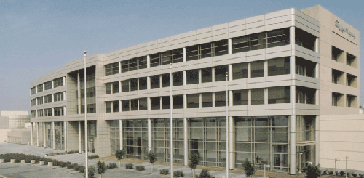
Premier Automotive Group
North American Headquarters
Ford Motor Company
Irvine, California
Project Highlights:
Sustainable Sites
Alternative Transportation: Three bus routes are located within ¼ mile; bicycle racks and showers provided; 30 electric vehicle recharging stations provided.
Water Efficiency
Innovative Wastewater Technologies: All toilets use reclaimed water, accounting for more than 50% of total sewage conveyance.
Energy and Atmosphere
Optimize Energy Performance: Exceeds ASHRAE 90.1-1999 by 40% using a high efficiency glazing system, high efficiency lighting with T5 lamps, an underfloor air distribution system in office tower, increased chiller efficiency and a variable speed drive on one chiller.
Materials and Resources
Construction Waste Management: 57% of all construction waste was recycled including concrete, asphalt, paper, metal and cardboard.
Indoor Environmental Quality
Construction IAQ Management Plan: All ducts and permeable materials were protected against contamination during construction; all construction filtration media was replaced before occupancy.
LEED® v2 Certified 2001
Building Statistics
Completion Date: November 2001
Cost: $60 Million
(construction contract only)
Size: 253,000 gross square feet
Footprint: 74,000 square feet
Construction Type: Commercial/Industrial
Use Group: Office and Design Center
Lot Size: 11.5 acres
Annual Energy Use: 24,356,010 kBtu/h
Occupancy: 700

Slide 23
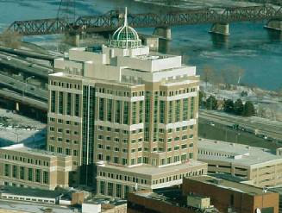
New York State Department of
Environmental Conservation
Office Complex at 625 Broadway Avenue
Albany, New York
Project Highlights:
Sustainable Sites
Urban Redevelopment: Urban infill site was previously a gravel parking lot.
Alternative Transportation: Located 80 yards from 4 bus lines; bicycle racks and showers; 15 electric vehicle charging stations; priority carpool parking.
Energy and Atmosphere
Optimize Energy Performance: Exceeds ASHRAE/IESNA 90.1-1999 by 23.7%.
Additional Commissioning: Verified that the building is designed, constructed and calibrated to operate as intended.
Materials and Resources
Construction Waste Management: 51% of construction waste was recycled.
Indoor Environmental Quality
CO₂ Monitoring: CO₂ monitoring system has 83 sensors integrated with the building’s building management system.
Low-Emitting Materials: All adhesives, sealants, paints, coatings, carpeting, composite wood emit low or no volatile organic compounds.
LEED® v2 Silver 2002
Owner: Picotte Companies
Building Statistics
Completion Date: September 2002
Size: 471,000 gross square feet
Footprint: 45,600 square feet
Construction Type: Commercial
Use Group: Office
Lot Size: 2.18 acres
Annual Energy Use: 22,232,209 kBtu/year
Occupancy: 1700 Staff

Slide 24
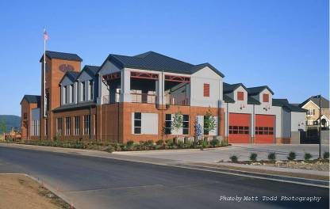
Issaquah Highlands Fire Station #73
City of Issaquah
Issaquah, Washington
LEED® v2 Silver 2003
On October 30, 2003, Issaquah Highlands Fire Station #73 in Issaquah, Washington, was awarded LEED® v2 Silver and became the first LEED certified fire station. This 2 story 3 bay fire station incorporates many water efficient technologies for both the building and landscaping to maximize efficiency. Within the building, the project achieves 55% potable water use reduction for waste conveyance and 36% water use reduction for flush and flow fixtures. In addition, the landscape design does not require a permanent irrigation system, further reducing the need for potable water on site. During construction, a waste management plan was implemented to divert 76% of materials from the landfill. Fire Station #73 supports the regional economy as 44% of building materials are locally manufactured, and of those, 55% are locally harvested, demonstrating exemplary performance. For the interior, the project includes several indoor environmental quality strategies, such as carbon dioxide monitoring systems and the use of low-emitting materials. Furthermore, a construction IAQ management plan was implemented during construction as well as before occupancy to help sustain the comfort and well-being of the fire fighters. A biodiesel fuel storage tank supplies the building’s emergency generator and also has the capability to provide fuel for the fire service vehicles based at the station. To further demonstrate innovative performance, a rain water catchment system and underground cistern provide non-potable water for truck washing, conserving 4,500 gallons of water annually.

Slide 25
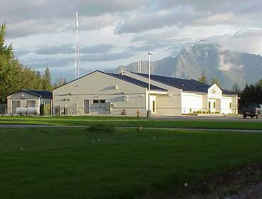
West Coast & Alaska
Tsunami Warning Center
National Oceanic and Atmospheric Administration/
National Weather Service
Palmer, Alaska
LEED v2 Certified 2004
The West Coast and Alaska Tsunami Warning Center in Palmer, Alaska, achieved LEED® v2 Certified on December 23, 2003. As the first LEED certified building for Alaska, this one story 6,690 sf building monitors potential tsunamigenic earthquakes occurring in the coastal areas of California, Oregon, Washington, Alaska, and British Columbia. The project reused an existing site, relocating the old warning center building and storage facility for reuse at another site. By planting adaptive vegetation which does not require irrigation, more than half of the site was restored, and within the building, water usage is reduced by more than 30%. Additional commissioning helps the building to achieve 28% energy efficiency over ASHRAE 90.1-1999. Through the implementation of a construction waste management plan, 82% of materials were diverted from the landfill. To improve indoor air quality, the project includes carbon dioxide monitoring, a construction IAQ management plan during construction and before occupancy, and installation of low-emitting adhesives, sealants, and paints. To connect staff to the beautiful Palmer scenery, the building is designed with views from 90% of spaces.

Slide 26
Technical Overview of LEED®
Green building rating system, currently for commercial and institutional new construction and major renovation.
Existing, proven technologies
Evaluates and recognizes performance in accepted green design categories
LEED product development includes existing buildings, commercial interiors, multiple buildings, core & shell, and homes
Notes:
LEED is based on accepted energy and environmental principles and strikes a balance between known effective practices and emerging concepts. The development of LEED was instigated by the USGBC membership, representing all segments of the building industry, and was developed using a transparent process open to the public.
The rating system provides a framework to help move the U.S. building industry to more sustainable practices. It responds to the U.S. marketplace and to budgets of U.S. design practices.
The LEED Rating System is on a five-year review cycle. Several incremental 2.x versions will be developed and piloted before making the leap to version 3.0 (ETA 2005).

Slide 27
Technical Overview of LEED®
Whole-building approach encourages and guides a collaborative, integrated design and construction process
Optimizes environmental and economic factors
Four levels of LEED-NC certification:
  Certified Level 26 - 32 points
  Silver Level 33 - 38 points
  Gold Level 39 - 51 points
  Platinum Level 52+ points (69 possible)
Notes:
LEED defines a threshold for green buildings and introduces a tool to promote and guide comprehensive and integrated building design.
LEED is performance-based where possible, compatible with standard design processes, self-evaluating, self-documenting, but not self-certifying. Certification is solely done by the USGBC.

Slide 28
LEED-NC® Point Distribution
Five LEED credit categories
Notes:
The five environmental categories are further divided into “credits.” For each credit, the rating system identifies the intent, requirements, and technologies or strategies to achieve the credit. One or more points are available within each credit, and points are achieved by meeting specified requirements.
Most categories contain prerequisites. ALL seven prerequisites MUST be met in order to qualify for ANY certification level.
In addition to the five environmental categories, there is also an “Innovation and Design Process” category.
69 points total:
Sustainable Sites: 8 credits, 14 points
Water Efficiency: 3 credits, 5 points
Energy and Atmosphere: 6 credits, 17 points
Materials and Resources: 7 credits, 13 points
Indoor Environmental Quality: 8 credits, 15 points
Innovation: 4 points
LEED Accredited Professional: 1 point

Slide 29
LEED-NC® Certification Process
A three step process:
  Step 1: Project Registration
      LEED Letter Templates, CIR access, and on-line project listing
  Step 2: Technical Support
      Reference Package
      Credit Inquiries and Rulings (CIR)
  Step 3: Building Certification
      Upon documentation submittal and USGBC review
Notes:
LEED is a registered trademark of USGBC. Only buildings certified by USGBC under the LEED Green Building Rating System may refer to themselves as LEED buildings. The certification process involves the following:
Register the Project to initiate a relationship with USGBC and receive orientation materials. Registration during pre-design phase is highly recommended.
Technical Support comes in the form of the Reference Guide and Credit Rulings. In some cases, the design team may encounter questions about the application of a LEED prerequisite or credit to the specifics of their project. The project contact should first thoroughly consult the Reference Guide. If questions remain, the contact should use the following credit interpretation procedure:
The project contact reviews the intent of the credit or prerequisite in question to self-evaluate whether their project meets this intent.
The project contact reviews the LEED Credit Rulings Page for a previously logged credit interpretation request (CIR) that may assist in answering their particular question. All LEED project contacts have access to this page.
If no similar or relevant credit interpretation has been logged, then the project contact may submit an on-line CIR to the USGBC.
Within two to five weeks, the USGBC Credit Ruling Committee posts its decision on the Credit Rulings Page.
Apply for certification. Application review can take anywhere from six weeks to several months. There are several opportunities for response and appeal throughout the review stages (administrative, preliminary technical, and final technical reviews).

Slide 30
LEED® Certification Benefits
Recognition of Quality Buildings and Environmental Stewardship
Third party validation of achievement
Qualify for growing array of state and local government incentives
Contribute to growing knowledge base
LEED certification plaque to mount on building
Official certificate
Receive marketing exposure through USGBC Web site, case studies, media announcements
Notes:
In addition to the rewards that you get from the Council upon certification, you also receive the implicit benefits from using LEED and building green.
LEED facilitates integrated design from start to finish – it encourages design teams to use a holistic approach and to measure progress. Using LEED ensures that your building will have a low impact on its occupants and the environment, and a positive economic impact over the lifecycle of the building.

Slide 31
Resources
LEED Green Building Rating System
Training Workshop
Reference Package
Professional Accreditation
Welcome Packet
Credit Rulings
Website (www.leedbuilding.org)
Email (leedinfo@usgbc.org)
Notes:
The LEED-NC Rating System is available for free download from the website, along with the LEED checklist and summaries of the documentation requirements. Pilot rating systems are posted as well.
The LEED Training Workshop. Introductory, intermediate and advanced level training programs offer professionals a three levels of knowledge about the LEED Rating System. Each workshop is taught by an official member of the LEED training faculty, who is also a building industry professional.
The LEED-NC Reference Package available for purchase on www.leedbuilding.org, contains an essential set of tools for green building and LEED certification. It includes the 270-page Reference Guide, the Welcome Packet, LEED Calculator spreadsheets, Application Template, this Introductory Slideshow, the Rating System, and the Accreditation Exam Study Guide. The Reference Guide is a design assistance manual and LEED user’s manual. For each credit, it discusses green building concerns; a summary of any standards that are part of the credit or prerequisite; strategies and resources for achieving it; potential synergies and trade-offs with other credits and strategies; calculations; and documentation requirements. Where possible, cost estimates and case studies are provided.
The LEED Accredited Professional Exam tests individual knowledge of LEED and green building in order to recognize green building specialists and facilitate networking between clients and service providers.
The Registered Project Welcome Packet provides instruction for LEED documentation and various tools, such as samples, calculation spreadsheets, and a template to facilitate project management and the certification process.
LEED technical assistance is available through the Credit Rulings page on the website, as described earlier.
The USGBC Web site is informational and functional.

Slide 32
For more information please visit www.usgbc.org

