Slide 1
CTC 450 Review
Distributing flow in a pipe network
  Hardy-Cross Method
    At any node: Flows in = flows out
    Head losses around a loop = 0
Equivalent Pipes (parallel/series)
Pump (performance and system curves)

Slide 2
Objectives
Manning’s Equation-Open Channel Flow
Rational Method

Slide 3
Uniform Flow in Open Channels
Water depth, flow area, Q and V distribution at all sections throughout the entire channel reach remains unchanged
The EGL, HGL and channel bottom lines are parallel to each other
No acceleration or deceleration

Slide 4
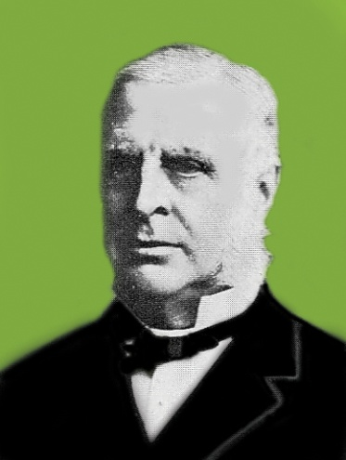
Manning’s Equation
Irish Engineer
“On the Flow of Water in Open Channels and Pipes” 1891
(“On the Origin of Species”-1859)
Empirical equation
See more on history:
  http://manning.sdsu.edu/\
  http://el.erdc.usace.army.mil/elpubs/pdf/sr10.pdf#search=%22manning%20irish%20engineer%22

Slide 5
Manning’s Equation-Metric
Q=AV=(1/n)(A)(R_{h})^{2/3}S^{1/2}
Where:
Q=flow rate (cms)
A=wetted cross-sectional area (m²)
R_{h}=Hydraulic Radius=A/WP (m)
WP=Wetted Perimeter (m)
S=slope (m/m)
n=friction coefficient (dimensionless)

Slide 6
Manning’s Equation-English
Q=AV=(1.486/n)(A)(R_{h})^{2/3}S^{1/2}
Where:
Q=flow rate (cfs)
A=wetted cross-sectional area (ft²)
R_{h}=hydraulic radius=A/WP (ft)
WP=wetted perimeter (ft)
S=slope (ft/ft)
n=friction coefficient (dimensionless)

Slide 7
Manning’s Equation-Solve for Q or Velocity
Can also divide both sides by area and write the equation to solve for velocity

Slide 8
Manning’s Equation-Velocity-Metric
V=(1/n)(R_{h})^{2/3}S^{1/2}
Where:
V=velocity (meters/sec)
R_{h}=Hydraulic Radius=A/WP (m)
WP=Wetter Perimeter (m)
S=slope (m/m)
n=friction coefficient (dimensionless)

Slide 9
Manning’s Equation-Velocity-English
V=(1.486/n)(R_{h})^{2/3}S^{1/2}
Where:
V=velocity (feet per second)
R_{h}=hydraulic radius=A/WP (ft)
WP=wetted perimeter (ft)
S=slope (ft/ft)
n=friction coefficient (dimensionless)

Slide 10
Manning’s Friction Coefficient
http://www.lmnoeng.com/manningn.htm
Typical values:
  Concrete pipe: n=.013
  CMP pipe: n=.024

Slide 11
Example-Find Q
Find the discharge of a rectangular channel 5’ wide w/ a 5% grade, flowing 1’ deep. The channel has a stone and weed bank (n=.035).
A=5 sf; WP=7’; R_{h}=0.714 ft
S=.05
Q=38 cfs

Slide 12
Example-Find S
A 3-m wide rectangular irrigation channel carries a discharge of 25.3 cms @ a uniform depth of 1.2m. Determine the slope of the channel if Manning’s n=.022
A=3.6 sm; WP=5.4m; R_{h}=0.667m
S=.041=4.1%

Slide 13
Friction loss
How would you use Manning’s equation to estimate friction loss?
Find slope and multiply by length

Slide 14
Triangular/Trapezoidal Channels
Must use geometry to determine area and wetted perimeters

Slide 15
Pipe Flow
Hydraulic radii and wetted perimeters are easy to calculate if the pipe is flowing full or half-full
If pipe flow is at some other depth, then tables are usually used

Slide 16
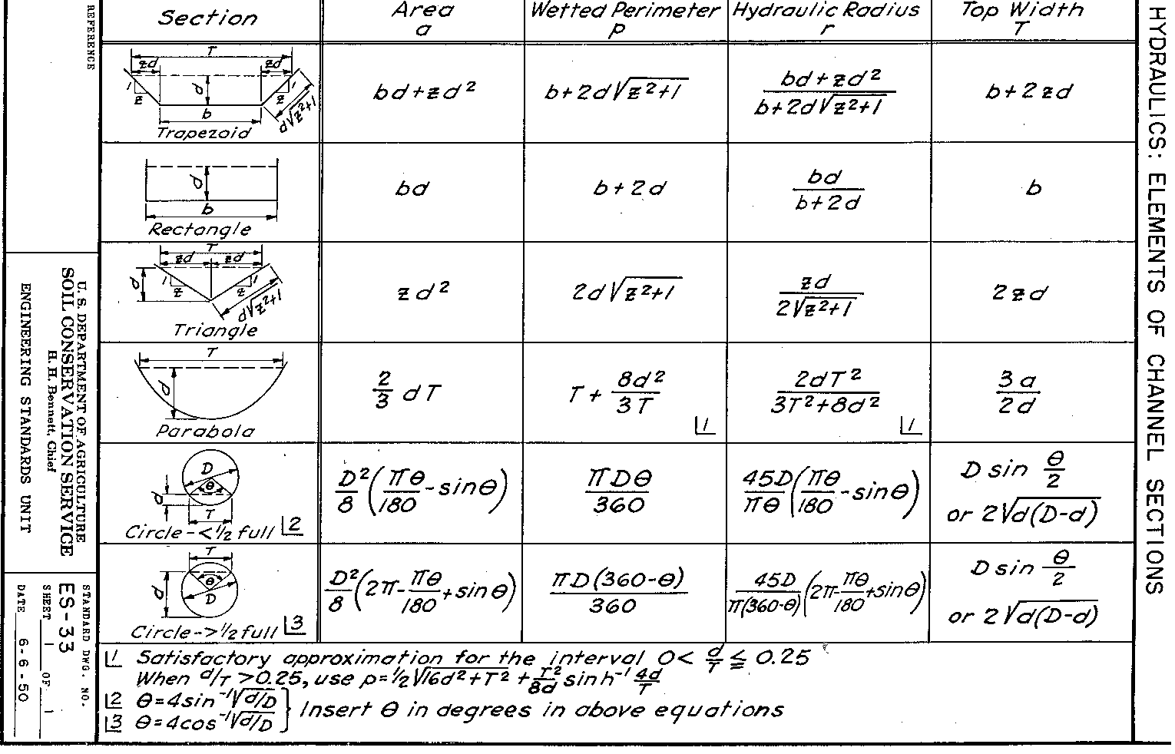
Historic SCS data for channels

Slide 17
Using Manning’s equation to estimate pipe size
Size pipe for Q=39 cfs
Assume full flow
Assume concrete pipe on a 2% grade
Put R_{h} and A in terms of Dia.
Solve for D=2.15 ft = 25.8”
Choose a 27” or 30” RCP

Slide 18
Project 3 (Flowmaster)

Slide 19
Rational Formula
Used to estimate peak flows
Empirical equation
For drainage areas<200 acres
Other methods:
  TR-55 (up to 2,000 acres)
  TR-20
  Regression Models

Slide 20
Peak Runoff Variables
Drainage area
Infiltration
Time of Concentration
Land Slope
Rainfall Intensity
Storage (swamps, ponds)

Slide 21
Rational Method
Q=CIA
Q is flowrate (cfs)
C is rational coefficient (dimensionless)
I is rainfall intensity (in/hr)
A is drainage area (acres)
Note: Units work because 1 acre-inch/hr = 1 cfs

Slide 22
Derivision
Assume a storm duration = time of conc.
Volume of runoff assuming no infiltration
= avg. intensity*drainage area*storm duration
=I*A*Tc

Slide 23
Theoretical runoff hydrograph
Area under hydrograph = ½ *2Tc*Qp=Tc*Qp

Slide 24
Derivision of Rational Method
Volume of rain = Volume observed as Runoff
I*A*Tc=Tc*Qp
Qp=IA
To account for infiltration, evaporation, and storage add a coefficient C (C<1)
Qp=CIA

Slide 25
Rational Coefficient C
Don’t confuse w/ Manning’s coefficients
Typical values:
  Pavement 0.9
  Lawns 0.3
  Forest 0.2
  There are also many detailed tables available

Slide 26
Weighted Rational Coefficient C
Must be weighted if you have different area types within the drainage area
Drainage area = 8 acres:
2 acres; C=0.35 (residential suburban)
6 acres; C=0.2 (undeveloped-unimproved)
Weighted C=[(2)(.35)+(6)(.2)]/8 = 0.24

Slide 27
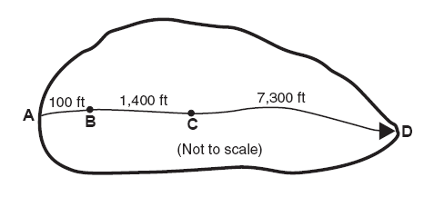
Time of Concentration
Time required for water to flow from the most distant part of a drainage area to the drainage structure
Sheet flow
Shallow, concentrated Flow
Open Channel Flow

Slide 28
IDF Curve
Shows the relationship between rainfall intensity, storm duration, and storm frequency.
IDF curves are dependent on the geographical area
Set time of concentration = storm duration

Slide 29
IDF Curve (SUNY Poly)
SUNY Poly Campus

Slide 30
MA7CD10 Definitions (7Q10)
Minimum Average seven-consecutive-day low flow with a ten year return frequency
The lowest stream flow for seven consecutive days that would be expected to occur once in ten years.
The period of lowest stream flow during a seven-day interval that is expected to occur once every 10 years

Slide 31
7Q10 Importance
WW treatment plants usually discharge to nearby rivers
7Q10 is considered a low-flow value (least dilution capacity)

Slide 32


Determining 7Q10
See your book page 64:
Streamflow data (lowest 7-day avg flow)
Calculate probability
Graph data on logarithmic probability paper (find line of best fit)
Extrapolate line to 90% (probability of larger flow) and determine 7Q10

Slide 33
Next Lecture
Water Quality
Water Distribution Systems

