Slide 1
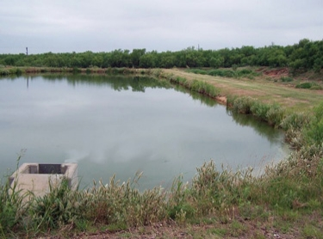
Stabilization Ponds for Wastewater Treatment

Slide 2
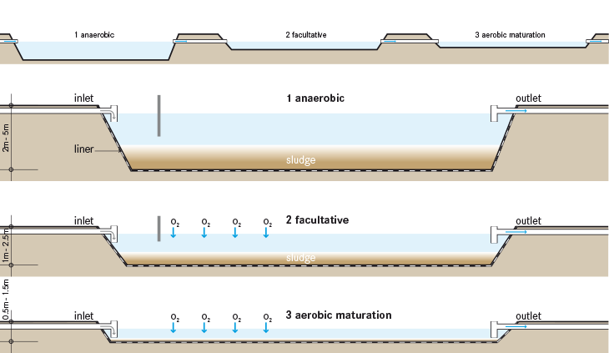
Objectives
Categories of stabilization ponds

Slide 3
Stabilization Ponds
Lagoons or oxidation ponds
Facultative
Tertiary
Aerated
Anaerobic
Secondary treatment in rural areas
Polishing ponds
Serve 7% of population (1000’s)
90% of ponds serve populations <10,000

Slide 4
Pretreatment Classifications
None – receives raw untreated WW
Screening – receives screened raw untreated WW
Primary – pond acts as a form of secondary treatment
Secondary-pond acts as a tertiary (polishing) treatment

Slide 5
Discharge Classifications
Complete retention – water removed via evaporation/percolation
Controlled discharge
Discharge is regulated
Long detention times
Continuous discharge
Discharge is not regulated
Q_{out} = Q_{in}

Slide 6
Facultative
Most Common
Anaerobic (bottom layer) and aerobic (upper)
Bacteria break down organics
Nitrogen/phosphorous/CO₂
Algae and reaeration (wind) provides O₂
BOD <30 mg/l in warm weather
SS usually > 30 mg/l because of algae (50-100 mg/l)
Don’t operate well in cold weather
Can’t handle industrial ww’s

Slide 7
Facultative-Design
Water Depths 2-5 ft (3 ft freeboard)
<2’ encourages weeds
>5’ encourages anaerobic conditions
Usually enclosed by earth dikes into cells
Cells designed for flexibility to operate in parallel or series
BOD loadings 20# per acre per day (north)
BOD loadings up to 50# /acre-day (south)
Typical retention times of 3-6 months

Slide 8
Tertiary Ponds
Maturation/polishing ponds
Can reduce SS/BOD/fecal coliform/ammonia
Used after trickling filters/activated sludge
Water depth 2-3’ (mixing, sunlight)
BOD load <15 # per acre-day
Detention times 10-15 days

Slide 9
Aerated Lagoons
Completely mixed
First-stage treatment of municipal WW
Pre-treatment of industrial WW
Basins 10-12’ deep
Pier-mounted floating mechanical aerators
No algae
Odor-free if highly aerated

Slide 10
Anaerobic Lagoons
May be covered
High-strength WW (meat processing/dairy waste)
Temperatures must be high--- 75-82F
BOD loading 20 # per thousand ft³ per day
Gaseous end products of CO₂ and CH₄
https://www.eenews.net/articles/cow-power-goes-dark-as-manure-to-electricity-fizzles/

Slide 11
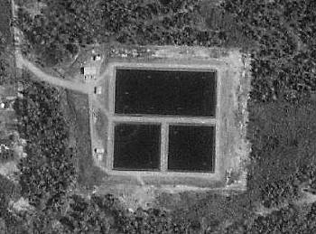
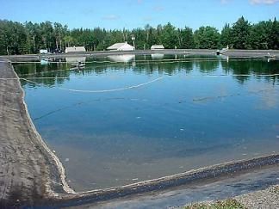
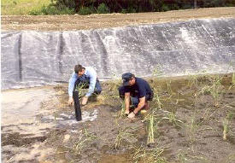
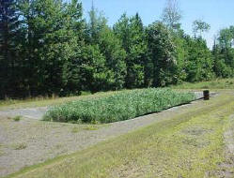
Example---Milo, Maine
http://www.lagoonsonline.com/milo.htm

Slide 12
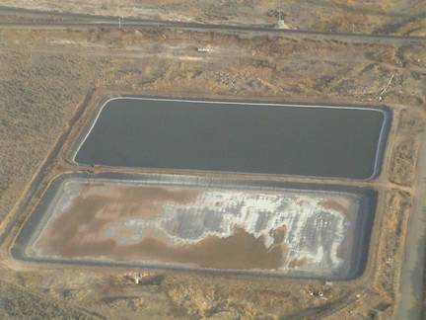
Example-Dietrich, Idaho
www.dietrichidaho.com/history/

