Slide 1
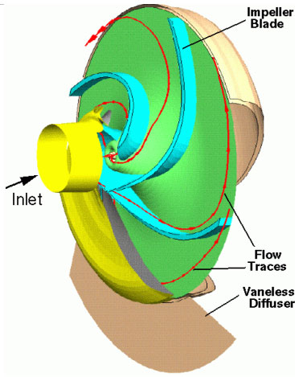
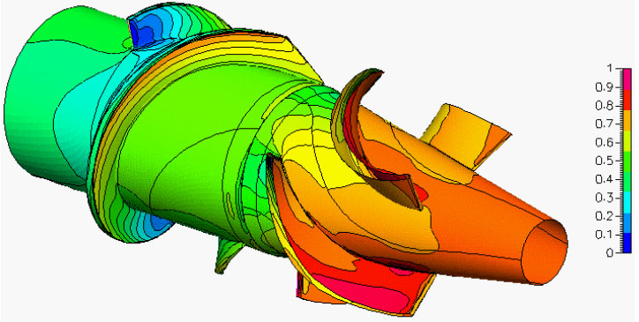
CTC 450
Pumps
http://www.esi-group.com/SimulationSoftware/CFD_ACE/blood.html

Slide 2
Objectives
Ability to simplify pipe systems by use of equivalent pipes (parallel and series)
Know what types of pumps are available
Ability to develop a pump performance curve
Ability to develop a simple system curve

Slide 3
Equivalent Pipes
An imaginary conduit that replaces a section of a real system such that the head losses are identical for the quantity of flow
Note: Use Chapter 2, page 34 (Figure 2-15) to solve Ch 7 (#15) Homework

Slide 4
Equivalent Pipe to Replace Parallel Pipes
Determine an equivalent pipe 1000’ in length to replace two parallel pipes (8” pipe @ 1000’ and 6” pipe @ 800’)
Assume a head loss (10’) and calculate HGL slopes of both pipes (10’/1000’) and (10’/800’). Using diameters and HGL slopes calculate Q in both pipes from Hazen-Williams nomograph (550 & 290 gpm)
Total Q’s (840 gpm)
Use nomograph w/ HGL slope (10’/1000’) and total Q to get equivalent pipe size (answer=9.4”)

Slide 5
Equivalent Pipe to Replace Serial Pipes
Determine an equivalent pipe 2000’ in length to replace three pipes in series (8” pipe @ 400’ , 9.4” pipe @ 1,000’ and 10” pipe @ 600’)
Assume a flow (500 gpm) and calculate head losses in all 3 pipes from Hazen-Williams equation or nomograph (3.3+3.8+1.6=8.7’ per 2000’)
Determine head losses per 1000’ (4.4’ per 1,000 ft)
Use nomograph w/ calculated head loss and assumed Q to get equivalent pipe size (answer=9.2”)

Slide 6
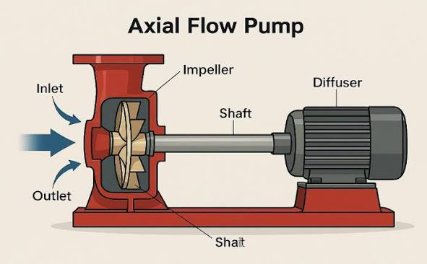
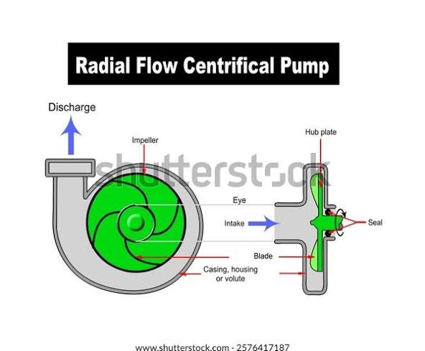
Pumps
Machines that do work on fluids
Pumps increase the pressure in a pipe, or lift water, or move water
Axial-flow
Flow is parallel to axis
Best suited for low heads and high flows
Radial-flow (centrifugal)
Flow is perpendicular to axis
Best suited for high heads

Slide 7
Pump Performance Curves
Obtained by experimental data and plotted on graphs (usually for a specific pump at a specific rotation speed)
Head versus discharge
Efficiency versus discharge
Shutoff head is the pressure head if discharge is completely stopped (Q=0)

Slide 8
Pump Efficiency
Efficiency is defined as the motor power input divided by the power output
Centrifugal pump efficiency is usually in the range of 60-85%
Axial pump efficiency is usually in the range of 75-92% (highly efficient in high-flow, low-lift conditions)

Slide 9
Pump Curve (1750 rpm)

Slide 10
Variable Speed Pumps
Pumps which can be operated at variable speeds
Have 2 pump curves (high speed and low speed) and pump can operate between the curves

Slide 11
System Head Curves accounts for static head and friction losses
Static head (lifting of water to a higher elevation)
Friction losses (increases as the flow increases)
In real systems, outputs are variable and the system head “curve” is actually a “band”
Pump should be operated at the intersection of the system-head curve and the head-discharge curve

Slide 12
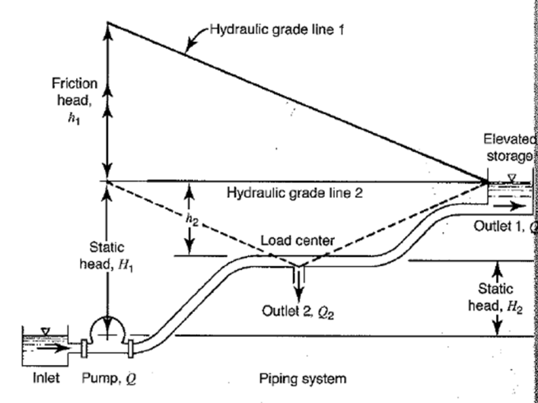
System Head Curve Example
Curve 1 – Pump is used to “raise” water from a lower source to a higher tank (outlet 1)
Curve 2 – Pump is used to raise water to a load center (outlet 2)
Actual operation can vary between the curves depending on how much flow is discharging from outlet 1 and 2

Slide 13

System Curve-Simple Example

Slide 14

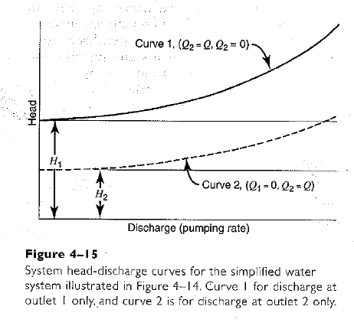
System Curves Curve 1: Pump to Storage Curve 2: Pump to Load
What do H1 and H2 represent?
How do you calculate the increase in head based on the pumping rate?
Answer: Use Hazen Williams (Vary Q for C and D; find slope)

Slide 15
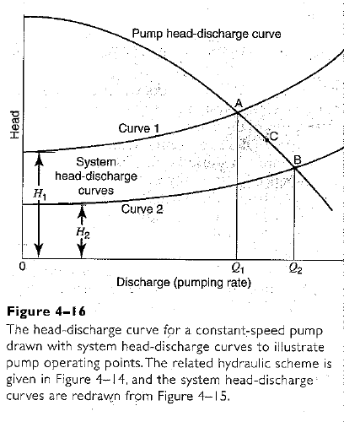
Pump & System Head Curves Example
Pump operates at A when pumping only to storage
Pump operates at B when pumping only to the load
Pump operates at C when pumping partly to the storage tank and partly to the load

Slide 16
Example-Discussion of Pumps Small Systems
Small system
Use 2 constant speed pumps with same capacity
Intermittently pump to tank
Control by fluctuation of water level in tank
Elevated storage maintains pressure in the system

Slide 17
Example-Discussion of Pumps Large System
Large system
Use 3 pumps in parallel (1 as standby)
Operate pumps individually or in combination to meet demand

Slide 18
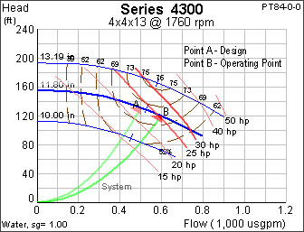
Example Pump Curve-Armstrong
http://www.armstrongpumps.com/present_newsletter.asp?groupid=1&nlfile=00_00_054

Slide 19
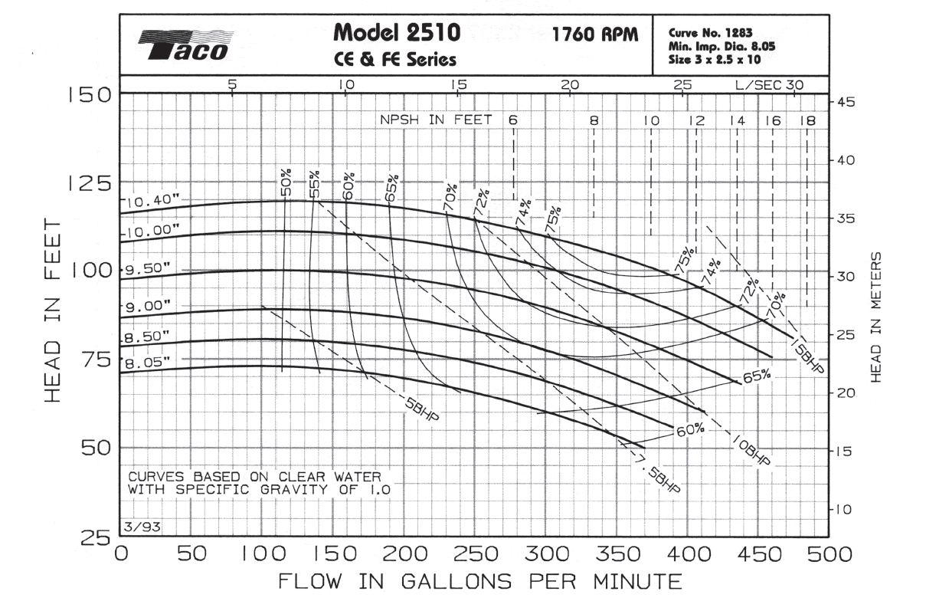
Example Pump Curve-Taco

Slide 20
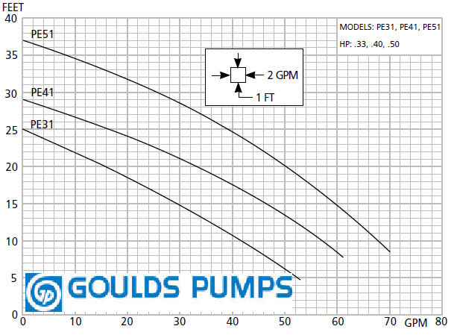
Example Pump Curve-Goulds

Slide 21
Pump Operation Scenarios Single Pump
Constant speed (as flows change the pump pressure changes)
Variable speed (maintains a constant pressure over a wide range of flows by varying the rotational speed of the pump impellor)

Slide 22
Pump Operation Scenarios Multiple Pumps
Multiple pumps – parallel – one as “standby”
Multiple pumps – series – to increase discharge head

Slide 23
Pump Simulation
http://www.simerics.com/simulation_gallery.html

Slide 24
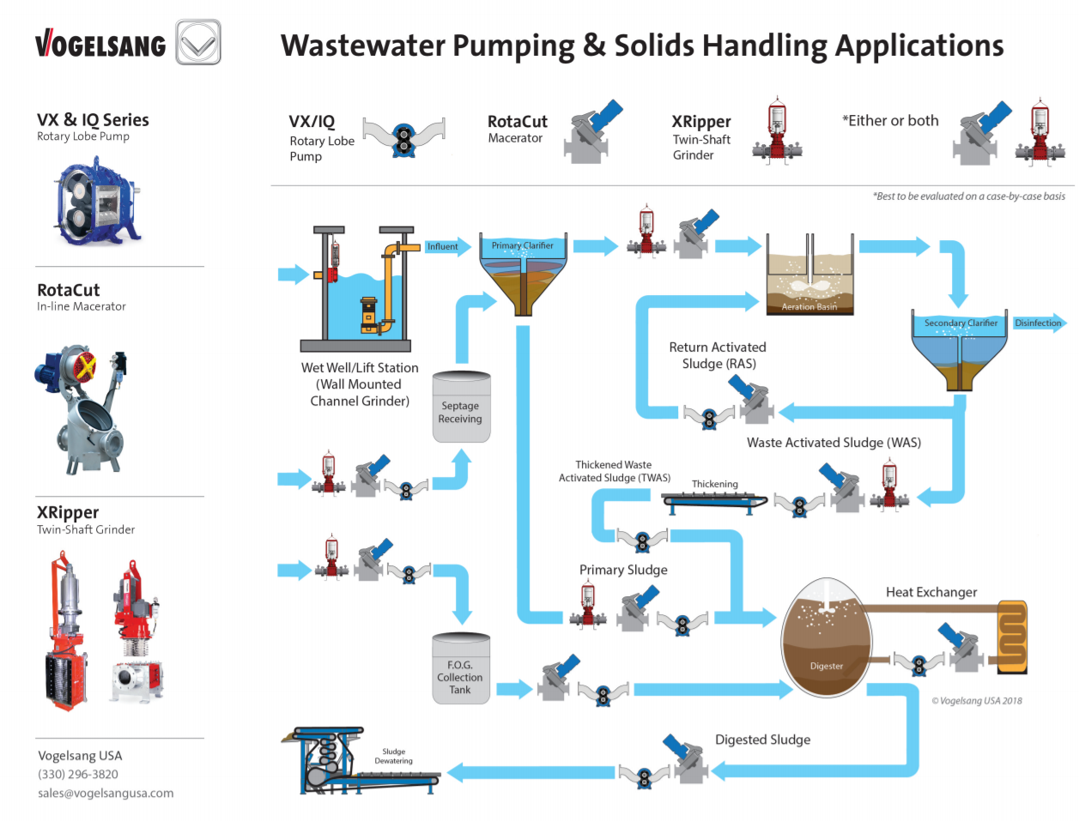
WW/Solids Handling Apps

Slide 25
Next Lecture
Manning’s Equation (open channel flow)
Rational Method

Slide 26
Pump Trivia
A pumping condition where the water level is below the eye of the impellor---suction lift condition.
A pumping condition where the water level is higher than the impellor--- suction head condition.

