Slide 1
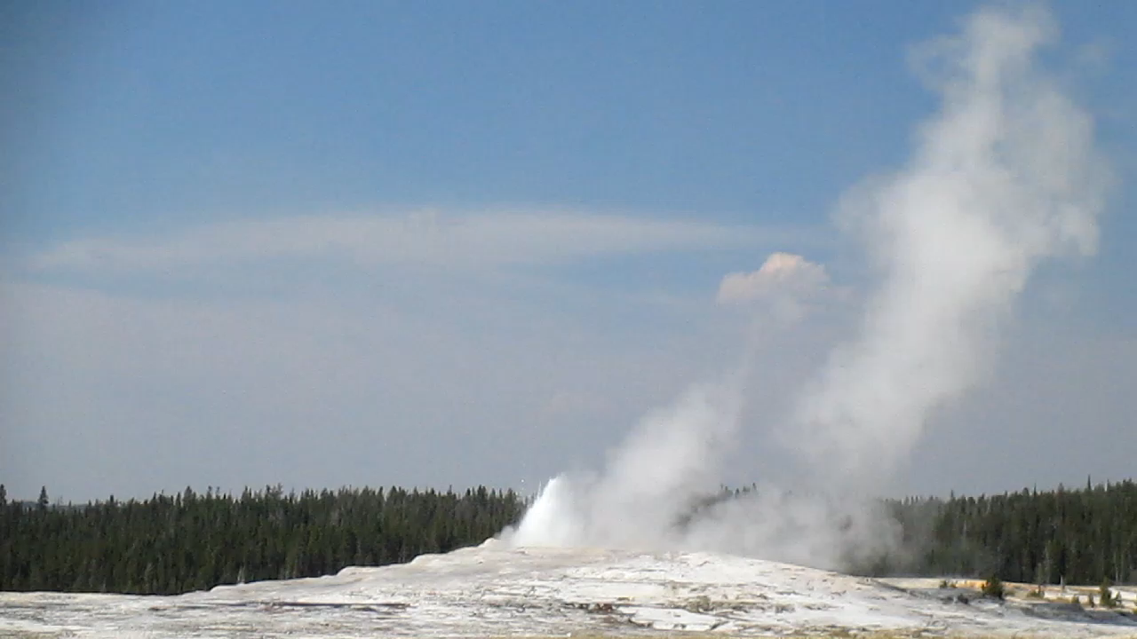
CTC 450 Sustainability-Water &Wastewater

Slide 2
Objectives
Understand the ideas of sustainability and carbon footprint, and be able to apply them to water and wastewater processes

Slide 3
Sustainability
Maintain, Support, Endure
Steady-State
Brundtland Commission of the United Nations on March 20, 1987: “sustainable development is development that meets the needs of the present without compromising the ability of future generations to meet their own needs.”
Living on the sun’s energy in real-time.

Slide 4
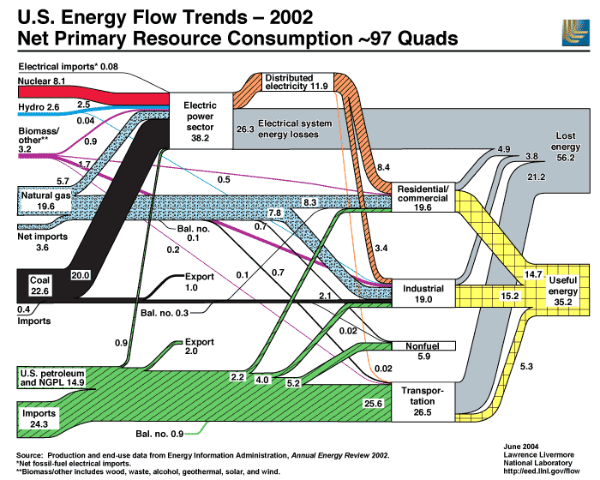

Slide 5
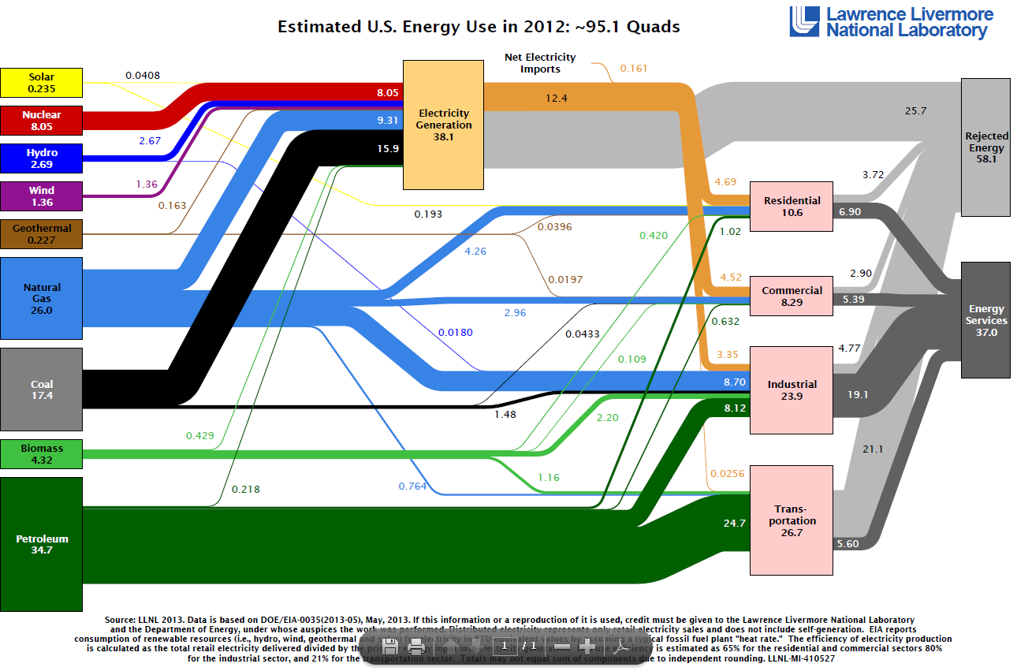

Slide 6
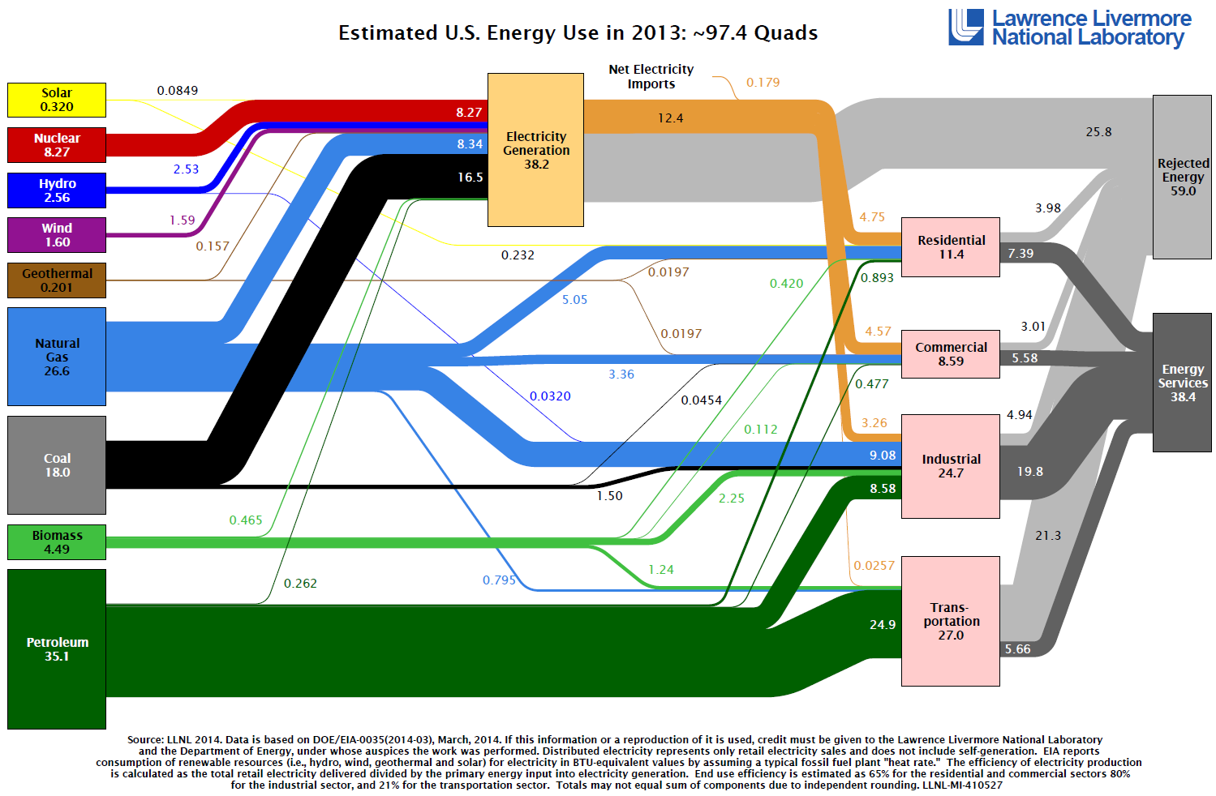

Slide 7
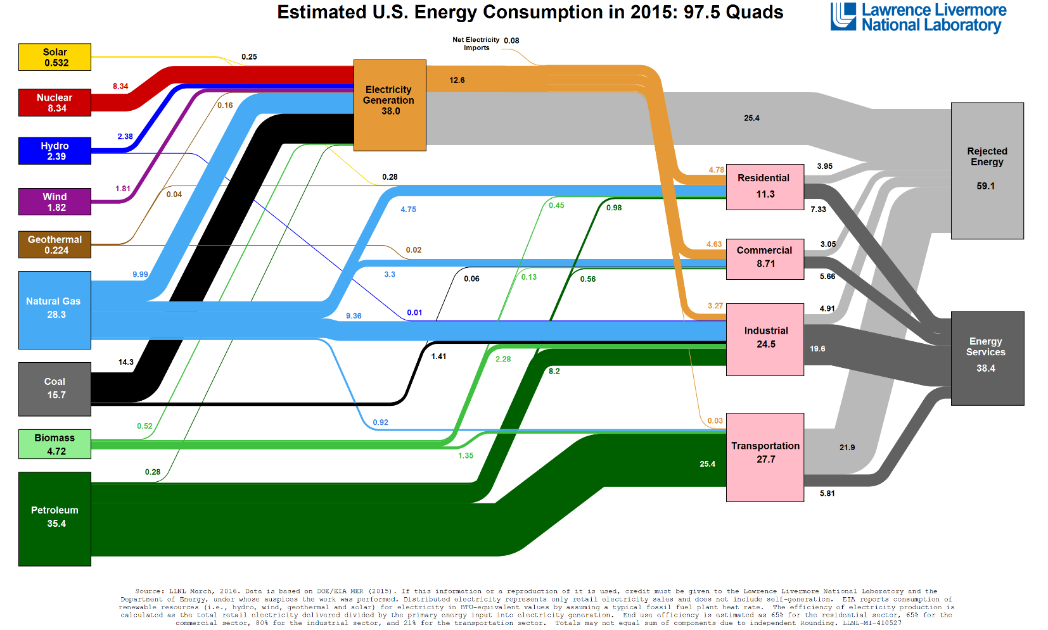
https://flowcharts.llnl.gov/

Slide 8
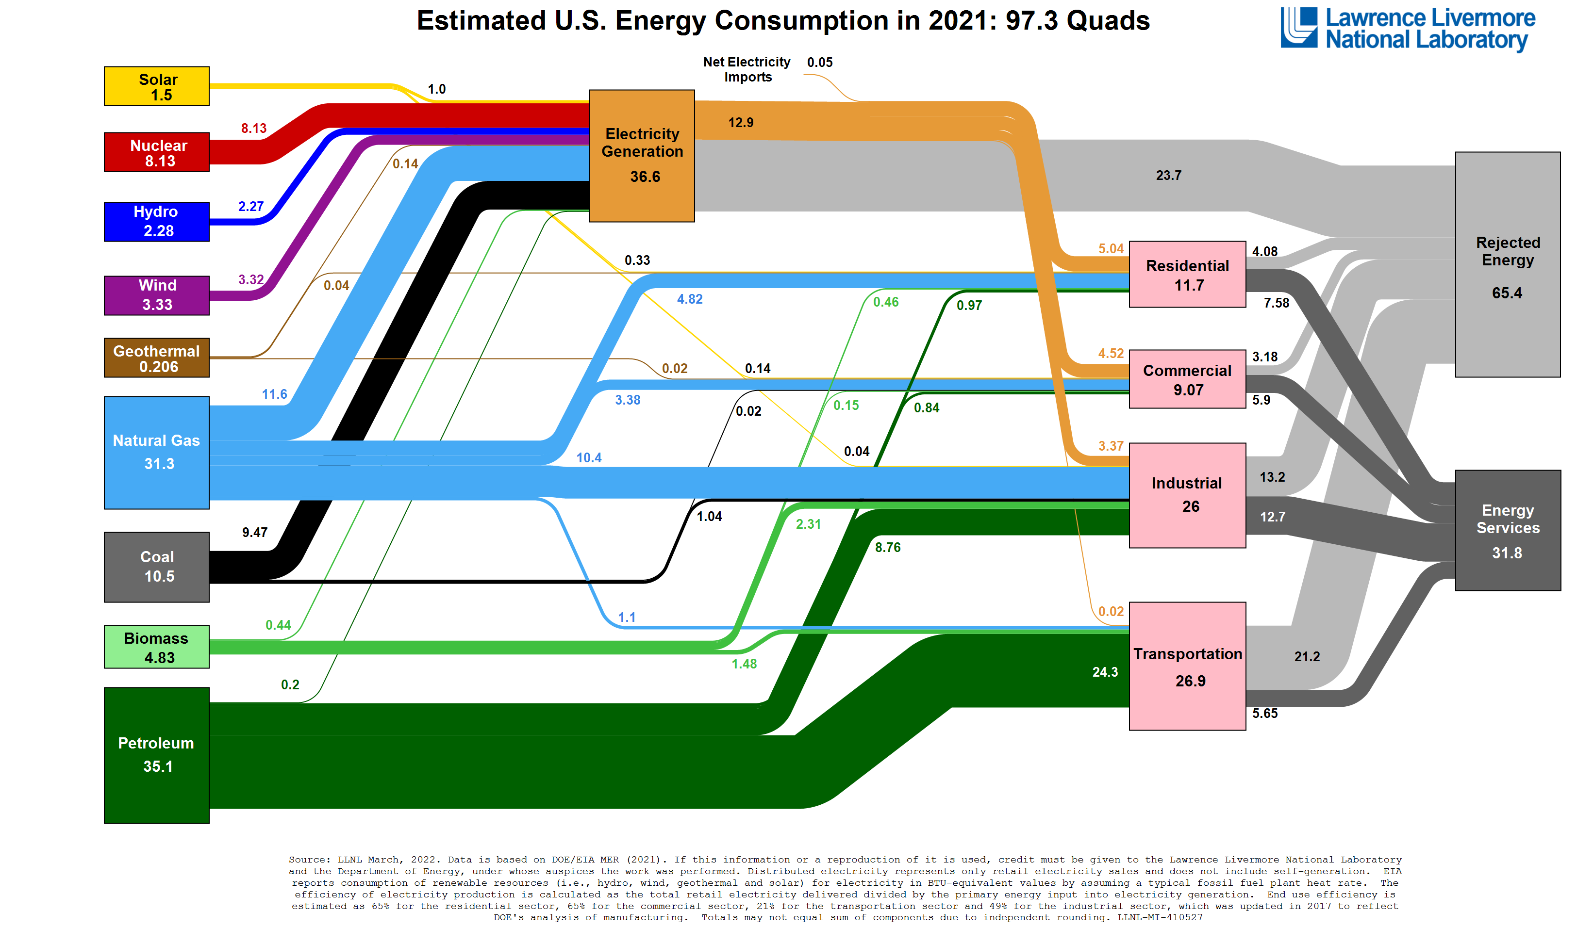

Slide 9
Summary (Petroleum)
2002: 39.2 Quads (38% domestic/62% imported)
2012: 34.7 Quads
2013: 35.1 Quads
2015: 35.4 Quads (**52% domestic/49% imported)
2021: 35.1 Quads
**In 2015: 18-19 MBPD Consumed;
9.3 MBPD Produced; 8.7 MBPD Imported

Slide 10
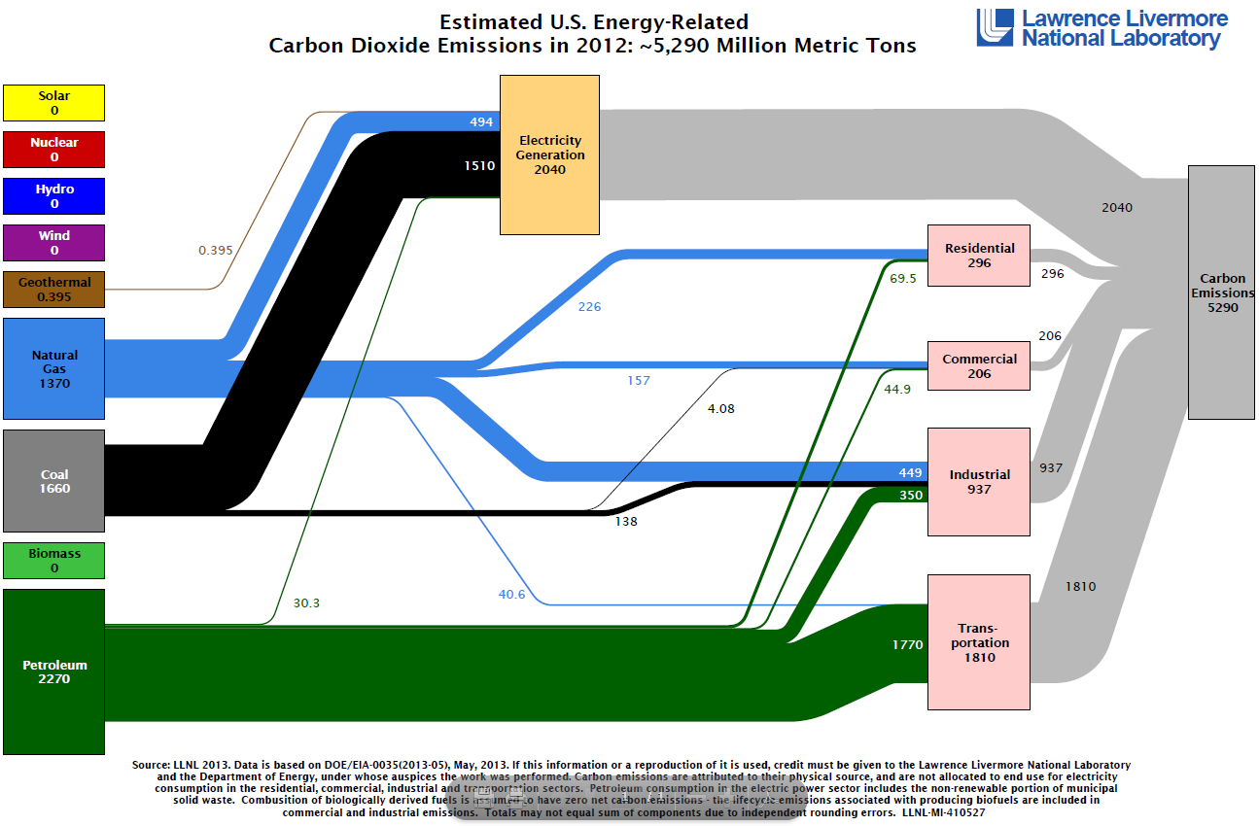

Slide 11
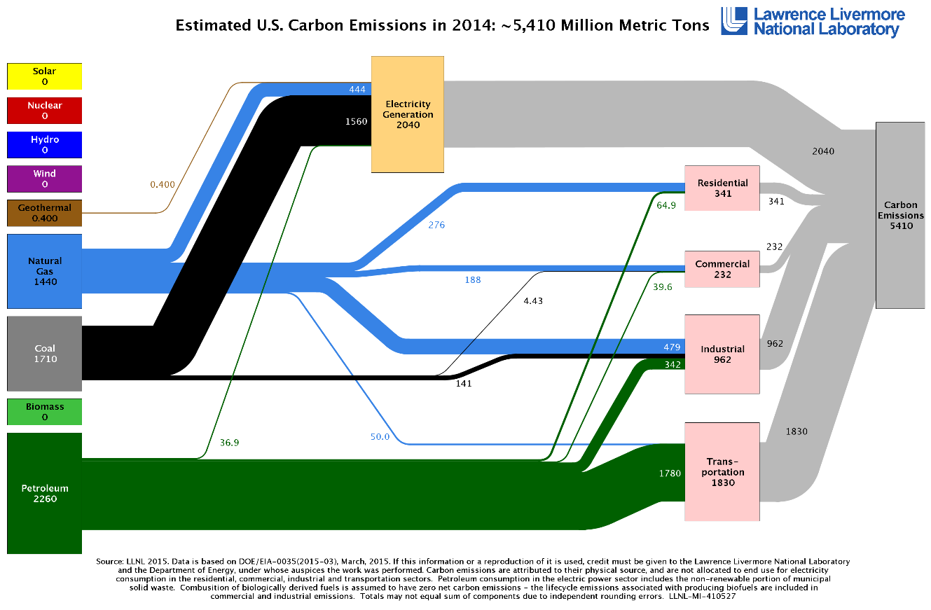

Slide 12
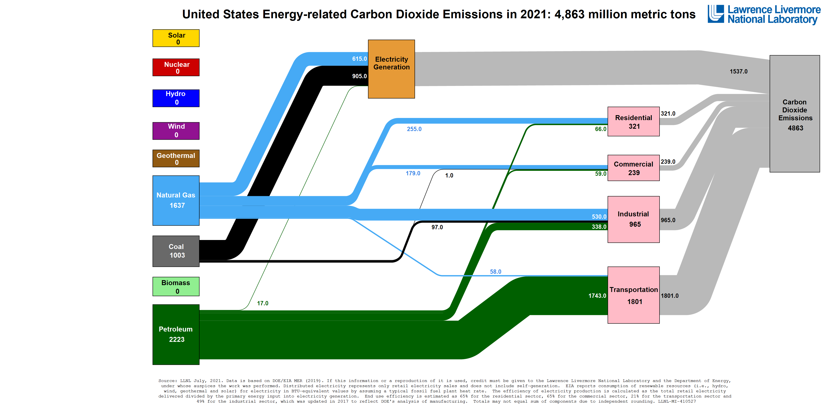

Slide 13
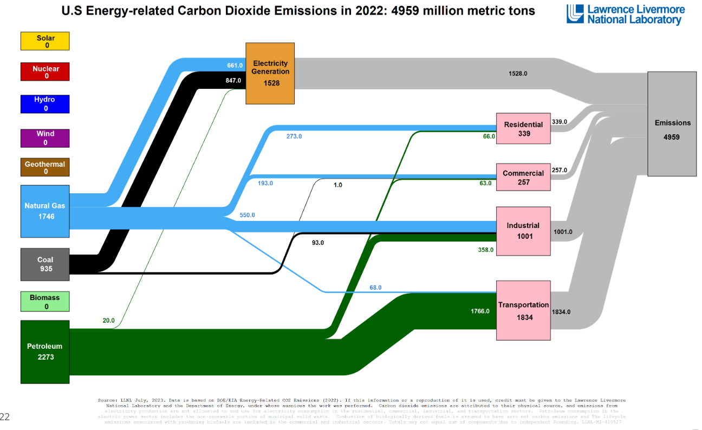

Slide 14
Greenhouse Gasses
Usually CO2 (but also CH4 and others)

Slide 15
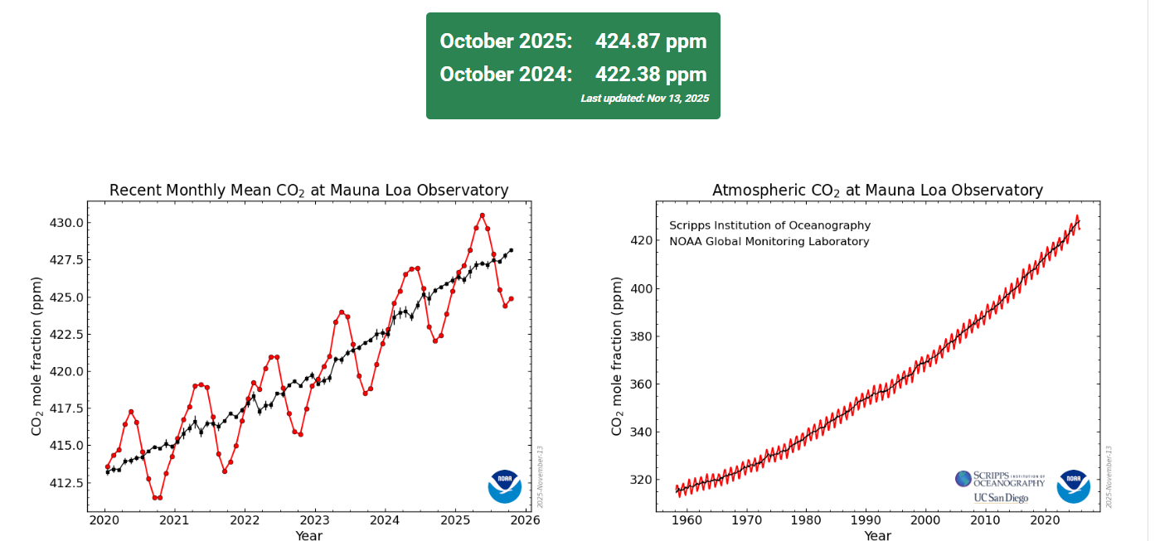
Current CO₂ Concentrations (Mauna Loa)

Slide 16
Information on Greenhouse Gas Links
Greenhouse Gas Protocol-Corporate Standards
https://ghgprotocol.org/corporate-standard
Emissions Inventory
http://www.epa.gov/climatechange/ghgemissions/usinventoryreport.html#overview

Slide 17
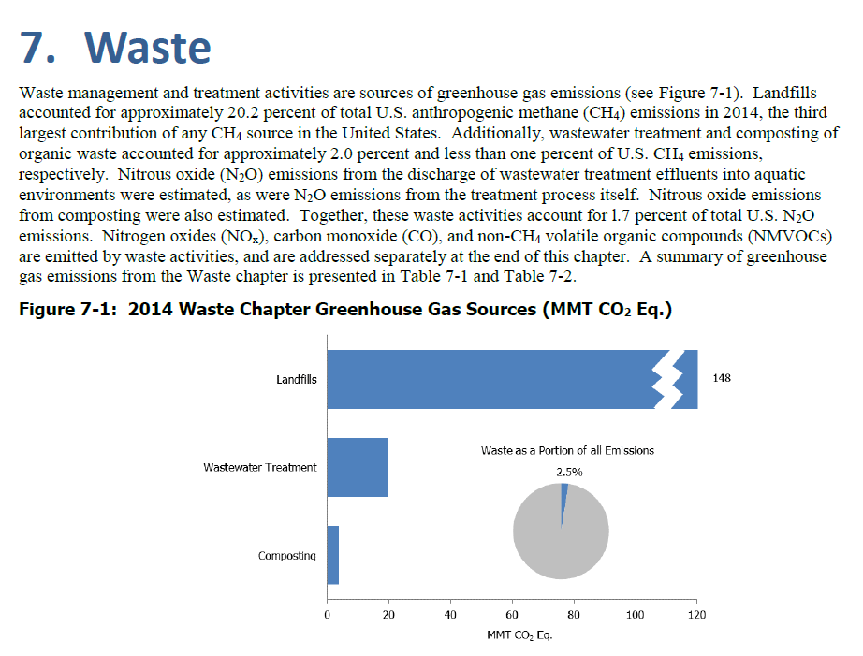
From Emissions Inventory

Slide 18
Measuring Carbon Footprint
Greenhouse Gas Protocol: A Corporate Accounting and Reporting Standard
Scope 1 (Direct Emissions)
Scope 2 (Purchases of Electricity)
Scope 3 (Misc-Employee Commuting, Materials, Waste Disposal)

Slide 19
Carbon Footprint: Water Systems
Scope 1-None
Scope 2-Significant (Electricity)
Scope 3-Minimal (Chemicals)

Slide 20
Carbon Footprint Electricity Consumption: Water Systems
Electricity Consumption:
200 kWh/MG (Low)
2,000 kWh/MG (Conventional)
35,000 KWh/MG (High)
Low (gravity, chemical disinfections, delivery-close and flat)
Conventional (river or shallow well, clarification-filtration, delivery-distributed-flat)
High (deep well or long delivery, desalination, distribution-hilly)

Slide 21
CO2 Emissions Coefficients for Electric Power (Metric Tonnes/MWh)
Old Book Appendix, page 444
0.013-Idaho, Vermont
0.111-Washington
0.275-California
0.389-New York
1.017-North Dakota
Original Source: EIA (March 2002)

Slide 22
Carbon Footprint: WW Systems
Scope 1-Significant (CH4, NOx)
Scope 2-Significant (Electricity)
Scope 3-Minimal (Chemicals)

Slide 23
Carbon Footprint Electricity Consumption: WW Systems
Electricity Consumption:
1,600 kWh/MG (Low)
3,000 kWh/MG (Conventional)
9,200 KWh/MG (High)
Low (gravity, fixed film, composting/land application, gravity discharge)
Conventional (lift at plant, activated sludge, digestion and land application, pump for discharge)
High (multiple pumping to plant, advanced treatment, pelletization, significant discharge pumping)

Slide 24
Becoming Carbon Neutral-WW
Use anaerobic digestor gas for heat and power generation (cogen)
Energy Conservation
Add renewable energy
Optimize chemicals
Manage waste (reuse; fertilizer)
Green facilities (LEED)
Manage Watershed

Slide 25
Advanced WW Treatment
Requires more energy but will allow more reuse
Analysis is needed

Slide 26
LEED-Leadership in Energy and Environmental Design
https://www.usgbc.org/leed

