Slide 1
CTC 450 Review
Waterworks Operation
  Water quality/quantity
  O&M--Hydrants, valves, avoiding cross contamination
  Detecting leaks; testing; mapping
  SCADA/Cybersecurity/Security
  Energy/water conservation
  Meet any regulatory requirements

Slide 2
Objectives
Understand the basic characteristics of wastewater streams

Slide 3
Wastewater Sources
Liquid discharge from residences, building and institutions
Storm runoff water (usually separated from WW) but sometimes combined (CSO)
  If combined, untreated wastewater enters receiving watercourse when large storms occur (first flush)

Slide 4
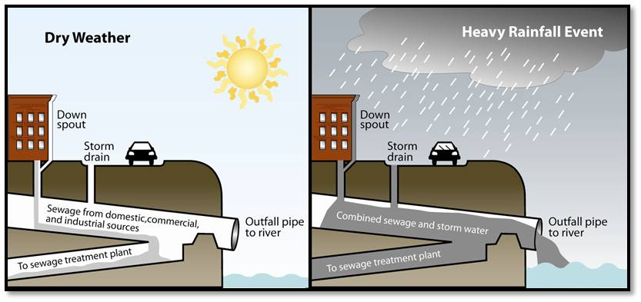
CSO-Combined Sewer Outfall

Slide 5
Domestic WW (residential)
50-250 gal per capita per day (gpcd)
Common value used is 120 gpcd
0.24# of SS per day per capita
0.20# of BOD per day per capita

Slide 6
Oneida County WPCP
Peak Capacity: 55 mgd
Serves: 106,000 people
520 gpcd
City of Utica-CSO
Old data--Major improvements the last 5 years

Slide 7
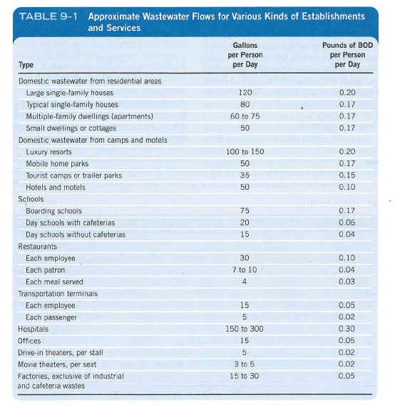
Table 9-1 from prior class book

Slide 8
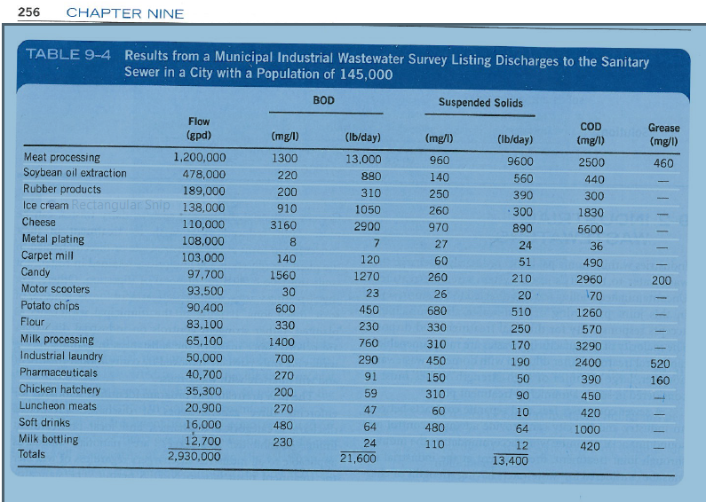
Industrial Wastewater Examples
(prior class book)

Slide 9
Typical Values (Sanitary WW) in mg/l
Parameter | Raw | After Settling | Biologically Treated
Total Solids | 800 | 680 | 530
Tot Vol Sol | 440 | 340 | 220
SS | 240 | 120 | 30
VSS | 180 | 100 | 20
BOD | 200 | 130 | 30
Inorg N | 22 | 22 | 24
Total N | 35 | 30 | 26
Sol Phos | 4 | 4 | 4
Total Phos | 7 | 6 | 5

Slide 10
Domestic Wastewater
High in nitrogen/phosphorus
Ratio needed for biological treatment (BOD/N/P)---100/5/1
Typical Settled domestic WW
  100/23/5 (BOD/N/P)
  Not all organics are biodegradable (20-40% of the BOD ends up in sludge)

Slide 11
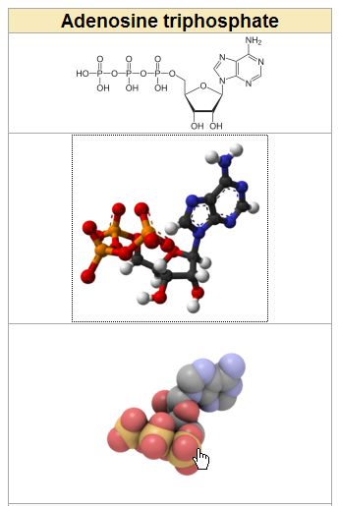
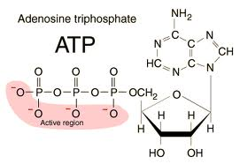
ATP/ADP
http://hyperphysics.phy-astr.gsu.edu/hbase/biology/atp.html
http://en.wikipedia.org/wiki/Adenosine_triphosphate

Slide 12
Convert concentration to weight
Sanitary ww from a residential community is 120 gpcd containing 200 mg/l BOD and 240 mg/l SS
Compute pounds of BOD and SS per capita
Hint: mg/l is equivalent to ppm

Slide 13
Example 1
BOD-Concentration to Weight (no water)
200 mg/l*120 gal/capita-day*8.34#/gal
Rewrite 200 mg/l as 200 mg/1E6 mg
= 0.20 lb per capita per day
(Compare to slide 4)

Slide 14
Example 2
SS---Concentration to Wt
240 mg/l*120 gal/capita-day*8.34#/gal
Rewrite 240 mg/l as 240 mg/1E6 mg
= 0.24 lb per capita per day
(Compare to slide 4)

Slide 15
Example: Industrial WW
Convert weight to concentration
Industrial wastewater has a total flow of 2,930,000 gpd,
BOD of 21,600#/day and
SS of 13,400#/day.
Calculate the BOD/SS concentrations

Slide 16
Example 9-2 Industrial
BOD---Wt to Concentration
21,600#/day*(1/2.93 million gal)*(1/8.34# per gal)
=.000884 #/#
=884#/million#
=884 ppm
= 884 mg/l

Slide 17
Example Industrial
SS---Wt to Concentration
13,400#/day*1/2.93million gal*1/8.34#/gal
=.000548 #/#
=548#/million#
=548 ppm
= 548 mg/l

Slide 18
Industrial WW
Usually pretreated
  Uncontaminated cooling water is sometimes discharged to the stormwater system
Characteristics dependent upon type of industry

Slide 19
Infiltration and Inflow
Groundwater can enter system through defective system components
Max. infiltration rate of 500 gpd per mile of sewer length per inch of pipe dia.
Infiltration can be significant
Inflow-planned connection of extraneous water source

Slide 20
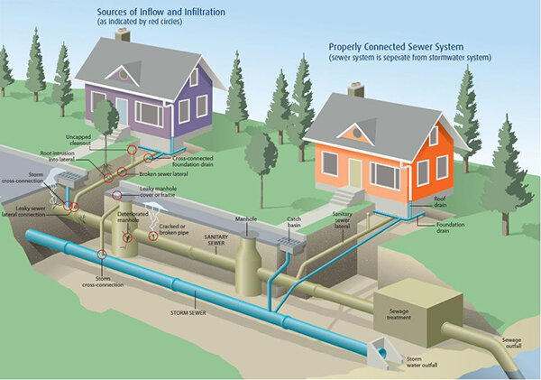
Sewer vs Stormwater Systems

Slide 21
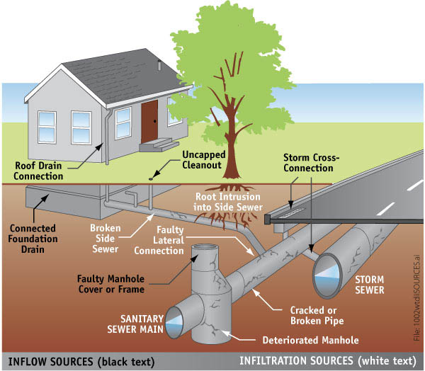
Inflow and Infiltration

Slide 22
Wastewater Flows
Flows and concentrations can vary by hour/day/month/season
Flows and concentration can vary for big versus small cities
Composite sampling is important

Slide 23
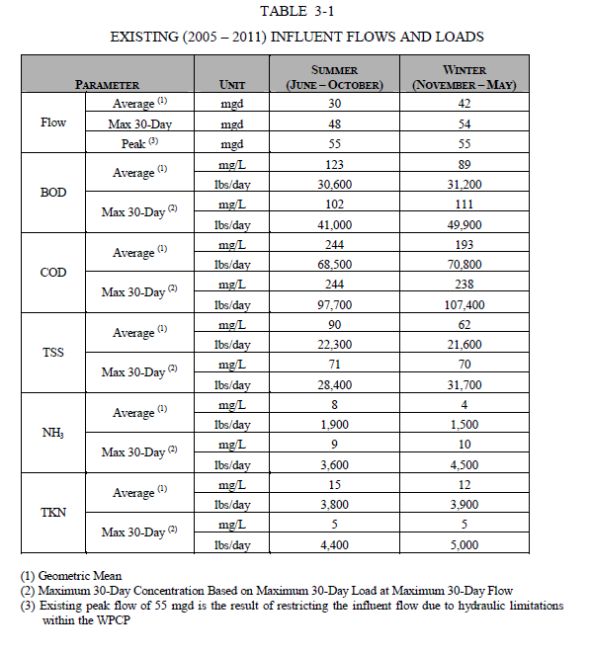
Source: WATER POLLUTION CONTROL PLANT AND SAUQUOIT CREEK PUMP STATION EVALUATION, August 2012

Slide 24
Evaluation of WW
Most common method for defining characteristics are BOD and SS
WW treatability studies are completed in a lab setting

Slide 25
Example WW Treatment-concentration in tank to mass (metric-no water)
An aeration basin with a volume of 300 m³ contains a mixed liquor suspended solids (aerating activated sludge MLSS of 2,000 mg/l. How many kg of SS are in the tank?
Note: (mg/l is equiv to g/m³ since 1000 mg=1 gram and 1000 liters=1 m³)
2,000 g/m³*300 m³
=600,000 grams
=600 kg

Slide 26
Equivalent Populations Example (1/4)
A dairy processing about 250,000 lb of milk daily produced an average of 65,100 gpd of WW with a BOD of 1400 mg/l. The principal operations are bottling of milk and making ice cream, w/ a limited production of cottage cheese. Compute the flow and BOD per 1000 # of milk received, and the equivalent populations of the daily WW discharge

Slide 27
Equivalent population example (2/4)
Calc flow per 1,000 # of milk
65,100 gal/day * 1000 # of milk / 250,000 # milk per day
=260 gallons of WW
260 gallons of wastewater are generated for every 1000# of milk

Slide 28
Equivalent Populations Example (3/4)
Calc #’s of BOD per 1,000 # of milk
(65,100 gal/day) * (1400mg/1E6mg)*(8.34#/gal) / (250,000 # milk per day)*(1000 lb)
=3 pounds of BOD per 1000 pounds of milk

Slide 29
Equivalent Populatios Example (4/4)
BOD per 1,000 # of milk & equivalents
3# of BOD generated per 1000# of milk
If an average person emits 0.2# BOD/day
BOD Equivalent = 3*/1000 gal*250 (k-gal) / .2# per person per day
BOD Equivalent = 3,750 people
If an average person generates 120 gal WW per day
Hydraulic equivalent= (65,000 gal/day) / (120 gal per person per day)
Hydraulic equivalent = 540 people

