Slide 1
CTC 450 Review
Typical WW Characteristics:
200 mg/l BOD / 240 mg/l SS
120 gpcd
0.20 # BOD/SS per capita per day
0.25 # SS per capita per day

Slide 2
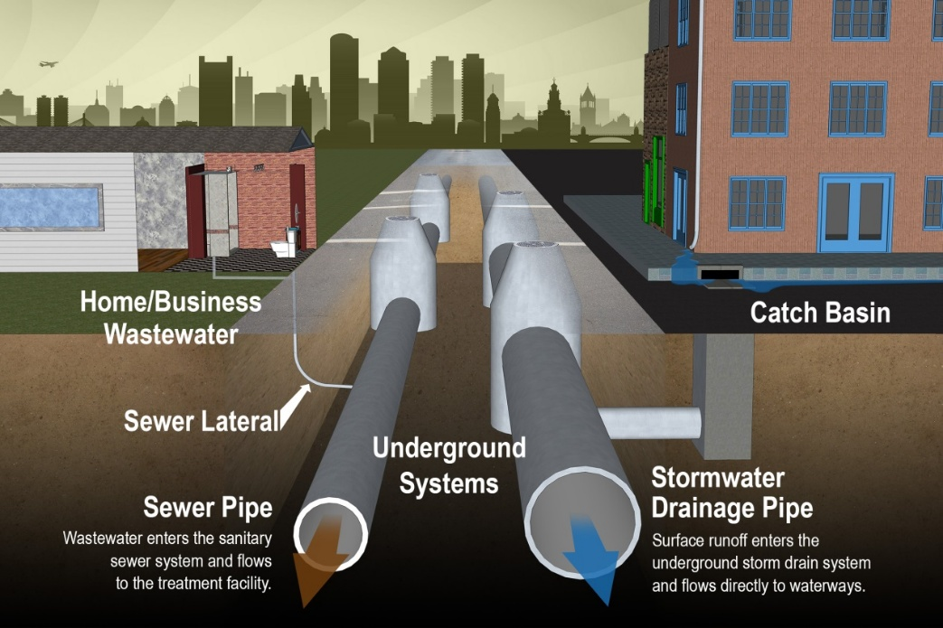
Objectives
Understand the basics of storm drainage systems
Understand the basics of sewer systems

Slide 3
Storm Sewer System
Surface waters enter system through inlets
Water is then conveyed through pipes and manholes
Quantity of runoff is determined using the rational method (Q=CIA)
Velocities designed for 3-10 fps
Often gravity flow (versus pressurized)

Slide 4
Sanitary Sewer System
Laterals collect wastewaters to branch lines which are conveyed to large mains (also called trunks or outfall sewer)
Force main has WW conveyed under pressure via pumps
Sanitary sewers are placed deep enough to prevent freezing

Slide 5
Differences between Storm/Sewer
Storm systems are designed to overflow periodically (frequency)
Sewer systems are designed to contain all the wastewater; if surcharging occurs it’s usually a result of infiltration of stormwater
Stormwater pipes are much bigger than sewer pipes

Slide 6
Example (Pipe Size Comparison)
What is the maximum population that can be served by an 8” sanitary sewer laid at minimum grade using a design flow of 400 gpcd & a flowing full velocity=2 ft/sec?
From Table 10-1(another book source) Q=310 gpm @ min. slope (full-flow)…..could use flowmaster
310 gpm / 400 gpcd (and adjust for units)
=1100 people (approx. 275 houses)

Slide 7
Pipe Size Comparison (Continued)
7
Compute the diameter of storm drain to serve the same population based on the following:
30 people/acre; C=0.4, 10-yr frequency w/ IDF curve on page 123, tc=20 min, vel=5 ft/sec
Area=37 acres
Intensity=4.2” (used IDF curve given tc and Q10)
Q=62 cfs
Assuming full-flow; Area calculation is 12.4 sq. ft
Diameter=4 ft (vs 8” diameter for sewer pipe)

Slide 8
Stormwater Management Programs
8
Designed to reduce pollutants entering local waterways (sediment, trash, metals, organics, nutrients, oil, grease)
Source Control Measures
Sweeping and cleaning
Control litter, erosion and illegal dumping
Spill, leak and overflow control
Detention ponds (reservoir-solids settle; some biological treatment)

Slide 9

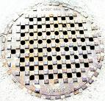
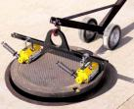
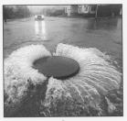
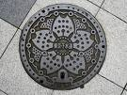
Manholes
Usually circular with an inside diameter of 4 feet
Placed at all changes in sewer grade, pipe size, or alignments changes (horiz. & vertical)
Also placed at all intersections, at the end of each line, and at distances not greater than 400 ft (<=15”) or 500 ft (>15”)

Slide 10
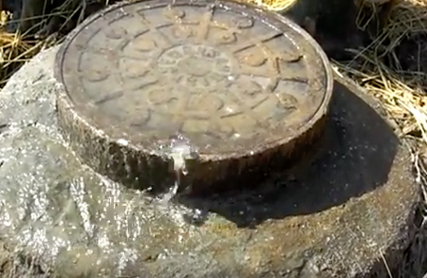
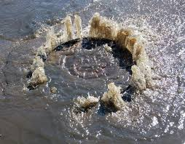
Surcharged Manholes

Slide 11
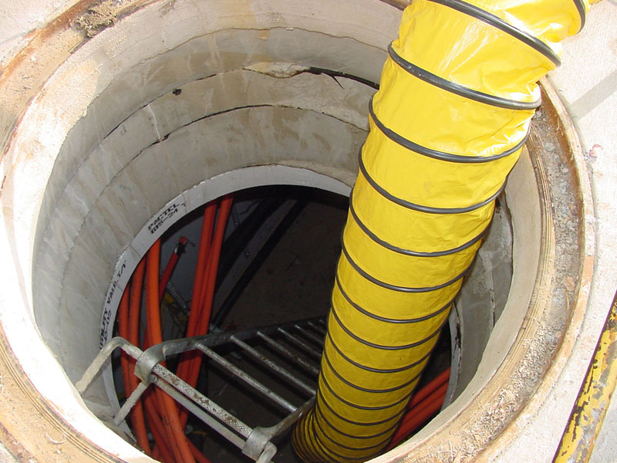
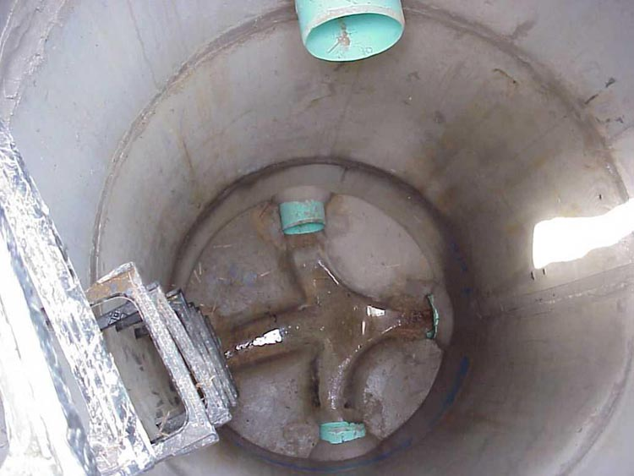
What is in the manhole?

Slide 12
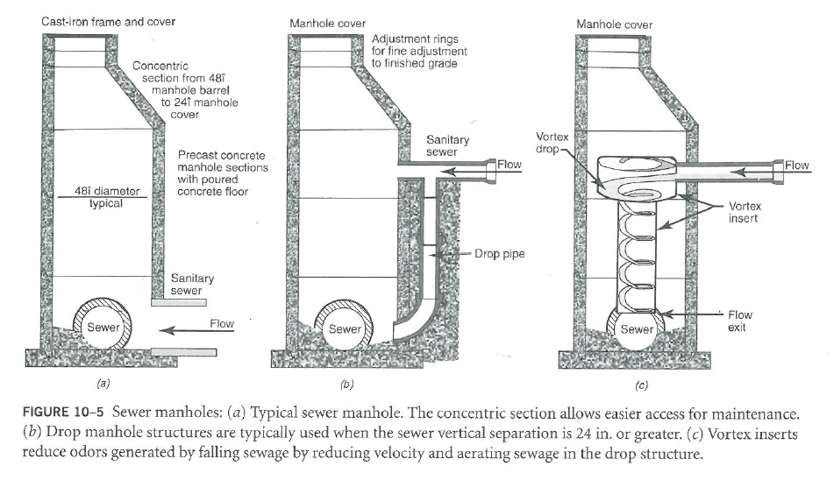
Sewer Typical/Drop/Vortex Manholes

Slide 13
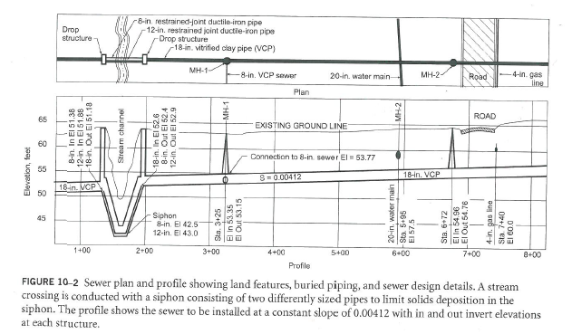
Sewer Plan and Profile
Notes:
Note that the vertical profile scale is different in x-y direction.

Slide 14
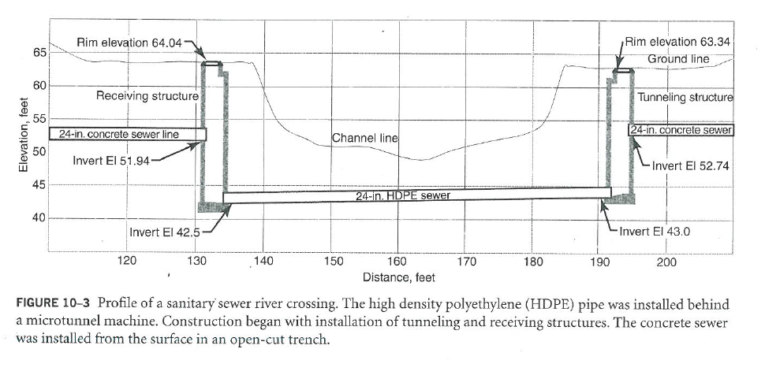
Trenches/Boring

Slide 15
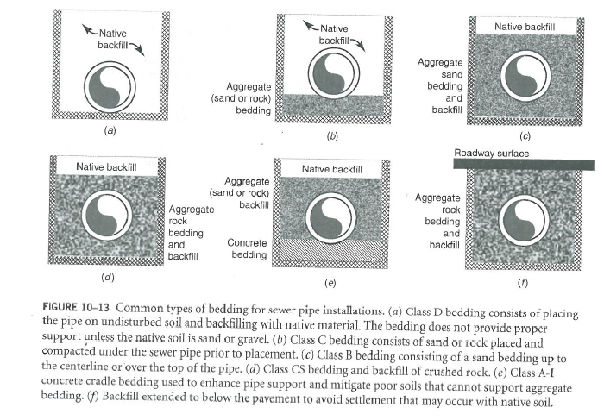
Bedding/Backfill

Slide 16
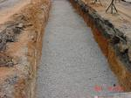

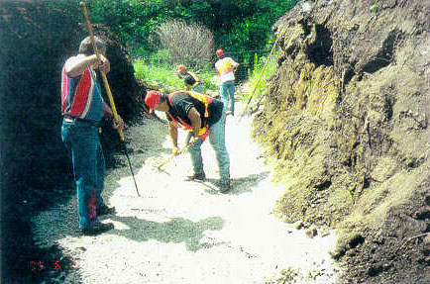
Load on Buried Pipe
Loading on pipe must be considered.

Slide 17
Compaction
Soils Quiz---no books or cell phones
Compaction (percent of maximum density)
95% for material placed in trenches when used as backfill around a pipe
85% above pipe in open areas
90% above the pipe and under roads and structures
Higher compaction limits differential compaction of trench relative to surrounding soils

Slide 18
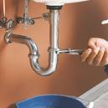
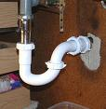

Residential Service Connections
House service pipe is connected to the collecting sewer
Traps prevent backup of sewer gases into the building interior
Building vents prevent traps from being siphoned dry

Slide 19
Sewer Pipes and Jointing
Vitrified clay, PVC, or precast concrete may be used
DIP (ductile iron pipe) is used for force mains

Slide 20
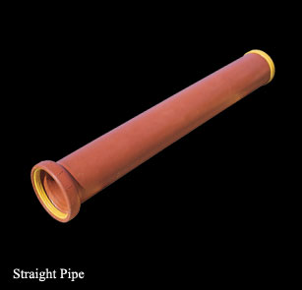
Clay Pipe

Slide 21
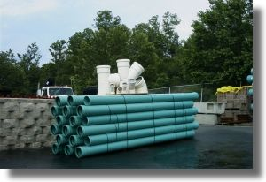
PVC Pipe

Slide 22
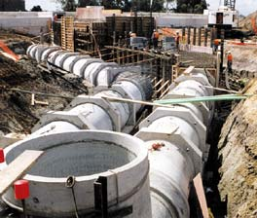
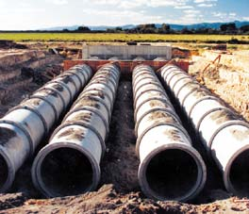
Concrete Pipe

Slide 23
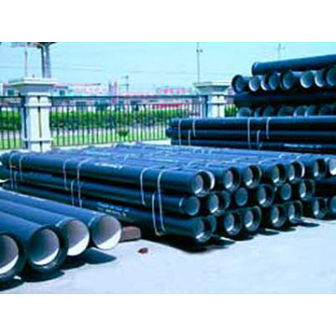
Ductile Iron Pipe

Slide 24
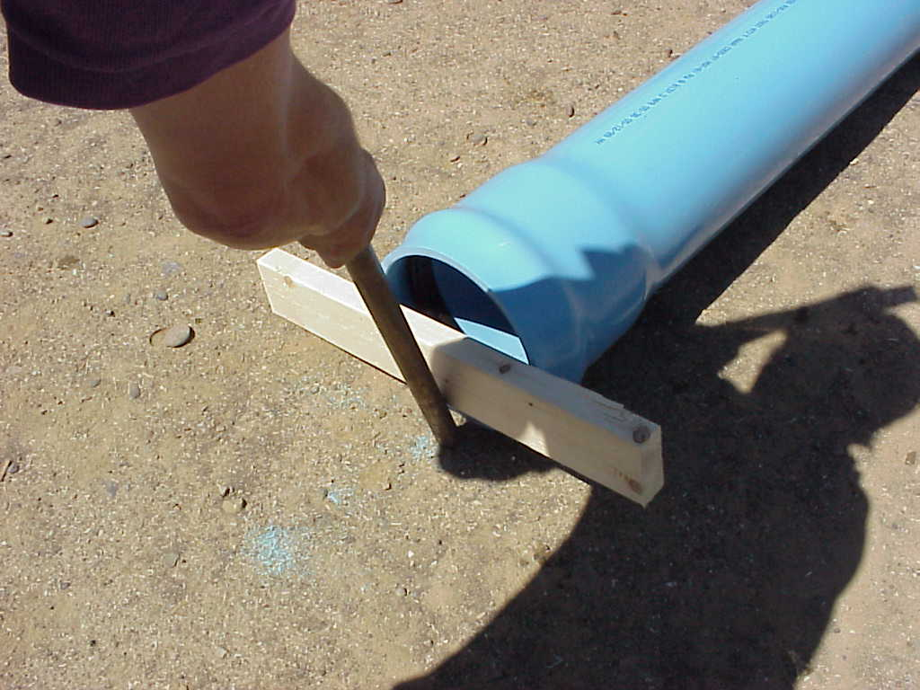
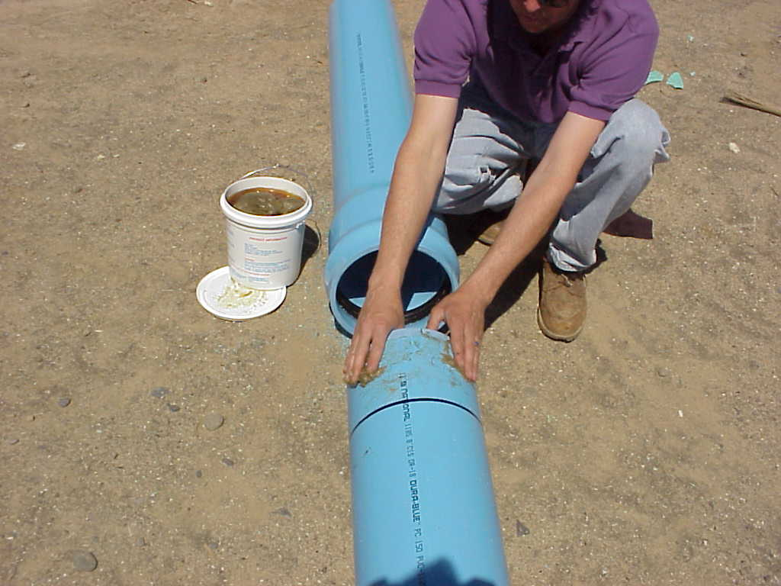
Pipe Joints

Slide 25
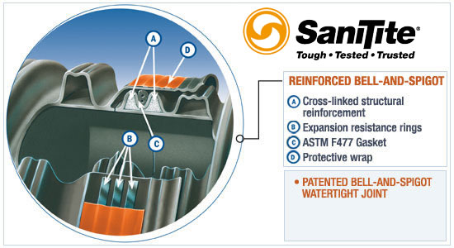
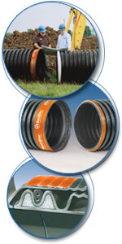
Joints

Slide 26
Sewer Installation
Equipment (usually backhoe)
Installation needs (plan/profile)
Compaction requirements
Environmental requirements
Safety requirements (open trench/shoring)
Dewatering
Field testing of placed material (then compared to Modified Proctor)

Slide 27
Sewer Testing
Monitor infiltration (before connections)
Only works if pipe is below water line
Monitor exfiltration
Used if pipe above water line
Air testing (VCP; demonstrates structural integrity)

Slide 28
Lift (Pump) Stations
Pumping stations used when gravity flow not feasible
Avoid if possible because a nonfunctional lift station means that sewage water can back up into houses/businesses
Pumps can be installed in the wet well or kept separate from the wet well

Slide 29
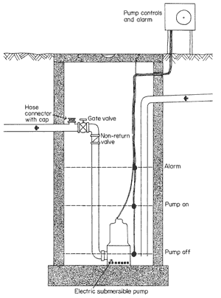
Lift Station Example

Slide 30
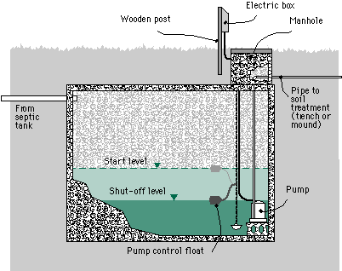
Septic Tank (Pump)

