Slide 1
CTC 450 Review
WW Sludge Processes

Slide 2
Objectives
Understand the basics with respect to operation of wastewater systems

Slide 3
Manage Life Cycle
Design
Construction
Startup
Operation
Maintenance
Repair
Replace
Don’t “run to fail”

Slide 4
Two systems
Treatment plant (small footprint)
Sewer collection system (large footprint)

Slide 5
Legislation for Discharge
NPDES-National Pollution Discharge Elimination System (SPDES)
Set up to reduce frequency and occurrence of sewer overflows and to notify public when overflows occur
EPA estimates 23,000-75,000 sanitary overflows annually

Slide 6
Capacity of WW Treatment
Evaluate overall performance of plant
Evaluate performance of individual processes within a plant

Slide 7
Plant Performance
Regulatory inspections
Ensures self-monitoring is implemented
Influent plant hydraulics
Influent plant organic loadings
Quality of effluent wastewater
Property of sludge solids
Common tests (BOD/SS/pH)
Others-coliform/chlorine residual/phosphorus, ammonium nitrogen/presence of heavy metals

Slide 8
Individual Process Performance (1/3)
Primary Sedimentation
Flow
BOD and SS of influent/effluent
Volume of sludge withdrawn
Sludge total solids content
Example-Poor sludge thickening
Hydraulic overload (not enough time to settle)
Poor operating procedure (pumping sludge at such a high rate that the water above the sludge layer is pumped out)

Slide 9
Individual Process Performance (2/3)
Secondary Treatment
BOD and SS of influent/effluent
Volume of sludge withdrawn
Sludge total solids content
Processes which can be tweaked
Air supply
Recirculation rate
Rate of sludge wasting
Optimize performance of activated sludge systems by measuring and varying DO, MLSS and F/M ratios

Slide 10
Individual Process Performance (3/3)
Sludge handling
Estimate solids capture
Don’t recycle fine solids (by recycling WW through processes that can never remove those fines---can avoid by increasing chemical conditioning when dewatering sludge)

Slide 11
Estimating Solids Capture
The performance of a centrifuge dewatering anaerobically digested sludge was evaluated to determine the capture of SS. Samples were tested as follows:
Ss (total solids-incoming sludge)
35,000 mg/l (3.5%)
Sc (total solids in cake)
280,000 mg/l (28%)
Sf (SS in centrate/filtrate)
1,200 mg/l (0.12%)

Slide 12
Solids Capture-Equation
Qs=Qf+Qc
Ms=Mf+Mc
Mass(M)=Concentration(S)*Flow(Q)
% Solids Removal=Mc/Ms (also see next slide)
% Solids Remaining=Mf/Ms
s-incoming liquid sludge
f-outgoing filtrate (centrate)
c-outgoing cake
Qf,Sf,Mf
Qs,Ss,Ms
Qc,Sc,Mc

Slide 13
Proof of Equation Mc/Ms
PROOF
Equation 12-4

Slide 14
From previous slide
Fraction of solids removed (Mc/Ms)=
[Sc*(Ss-Sf)] / [Ss*(Sc-Sf)] =
97% Removal

Slide 15
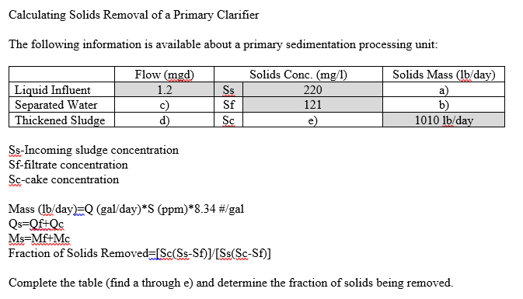
Take-Home Worksheet
Answer: 46% solids removal

Slide 16
Capacity of Sewer Collection
Infiltration/Inflow Surveys
Inspection via cameras
Regulation of Sewer Use
Sewer Charges and Revenues

Slide 17
Extraneous Inflow
Sewer surcharging results in
Overloading of plant
Overtaxing pumping stations
Costs of treating excess ww
Health hazards if untreated ww is discharged to receiving water
Historically, peaks were bypassed around the treatment plant
Current goal is to handle peaks

Slide 18
Infiltration/Inflow
Infiltration from groundwater
Overloading of plant
Overtaxing pumping stations
Increased costs of treating excess ww
Health hazards if untreated ww is discharged to receiving water
Inflow-direct connections such as roof drains

Slide 19
Reducing Peaking Problems
Evaluate magnitude of the problem
Rehabilitate existing sewer system
Extend treatment facilities

Slide 20
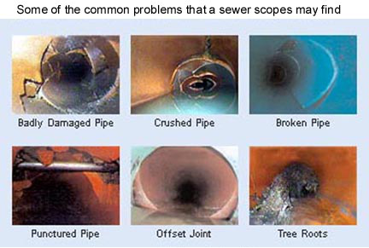
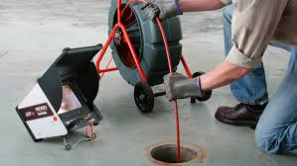
Video Inspection
Used to detect structural soundness
Service connections not plugged when no longer needed
Cross-connections with storm systems
Unauthorized drainage connections
Tree roots
Structural damage

Slide 21
Regulation of Sewer Use
Goals
Control discharges to the system
No septic tanks
Unpolluted waters to storm system
Ensure water quality standards
No hazardous wastes
Equitable customer charges
Flow measuring and sampling station for industrial users

Slide 22
Sewer Charges
Payment should be in proportion to use and benefits received
Payment often based on flow quantities with surcharges for wastewater strength

Slide 23
Service Charge
Calculate the service charge for a dairy wastewater based on the following info:
Daily flow = 150,000 gpd
Avg BOD=910 mg/l
Avg SS= 320 mg/l
Service Charge=$450 per million gallons
Surcharge of 2.38 cents per lb of excess BOD (BOD>250 mg/l)
Surcharge of 1.83 cents per lb of excess SS (SS>300 mg/l)

Slide 24
Service Charge Example 12-3
Service charge for flow = $67.50/day
$450/mg*0.15 mg/day
Service charge for excess BOD = $19.65/day
(910-250)/1E6*150,000gpd*8.34*/gal*0.0238/lb
Service charge for excess SS = $0.46/day
(320-300)/1E6*150,000gpd*8.34*/gal*0.0183/lb
Total Charge = $87.61/day

Slide 25
Management Structure
Utility info
Maintenance
Operators
Computer maintenance
SCADA systems

Slide 26
Additional Documents
Oneida County Sewer District Map
Water Pollution Control Plant and Sauquoit Creek Pump Station Evaluation
Note: These documents can be found on Brightspace

