Slide 1
CTC 450 Review
WW Collection Systems
Sewage vs Storm Systems
Types of pipes
Installation

Slide 2
Objectives
Understand basic processes for treating wastewater

Slide 3
Designing Against Disease
Designing Against Disease
http://www.tbp.org/pubs/Features/W10Bell.pdf
Who graduated at age 15 from Dartmouth Thayer’s School of Engineering?
Allen Hazen (1869-1930)
Slow sand filtration clarifies water. What else does it do?
Removes 99% of bacteria
What two design qualities are used to determine a material for filtration?
Effective size and uniformity coefficient
What percentage of the population in Chicago probably contracted typhoid in 1890-1892?
5%
Who is considered the father of sanitary engineering in America?
Hiram Mills (1836-1921)

Slide 4
WW Treatment
Combination of physical and biological processes
Processes are used to remove organics and solids (reduce BOD and SS)

Slide 5
History of Developing Processes
Imhoff tanks used originally for settling of solids
Treatment of water through gravel bed (1910)
Activated sludge (1920s)
RBC’s (1959-Germany)

Slide 6
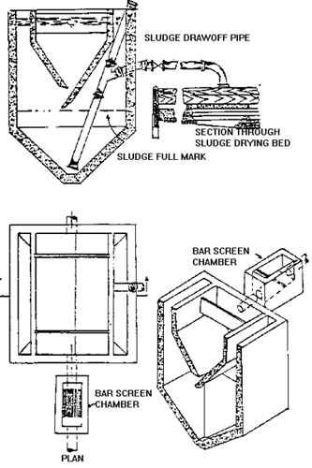
Imhoff Tank
The Imhoff tank obtained its name from its inventor, Dr. Karl Imhoff of Germany. It is a variation of the septic tank in which two chambers are provided, one above the other. The upper sedimentation or flow chamber is for settling solids and the lower chamber is for anaerobic digestion of sludge. Solids settle to the bottom of the flow chamber passing through a slot at the bottom into the lower chamber. The slot is baffled in such a manner that gas rising from the lower chamber does not interfere with the sedimentation process in the upper chamber. A gas vent, known as the scum chamber, extends from the lower compartment up to the tank surface between the outside wall of the sedimentation chamber and the Imhoff tank enclosing wall. The main advantage of this type of tank over the septic tank is that sludge is separated from the effluent, which allows for more complete settling and digestion. Operated properly, these systems are capable of removing 30 to 60 percent of the suspended matter, and from 25 to 40 percent of the BOD. www.vnh.org/ PreventiveMedicine/Chapter7/7.08.html

Slide 7
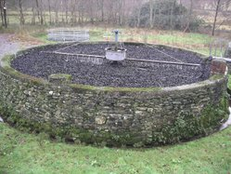
Trickling Filter

Slide 8
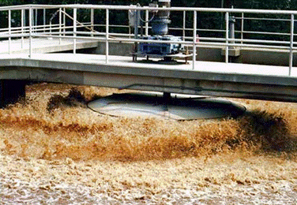
Activated Sludge (Aeration Tank
http://www.steve.gb.com/science/biotransformation.html

Slide 9
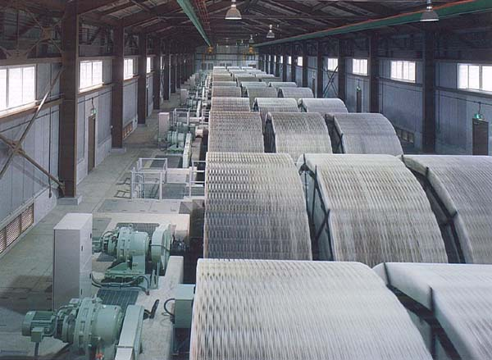
Rotating Biological Contactor
http://www.dmw.co.jp/english/temp/enban/enban-kata.html

Slide 10
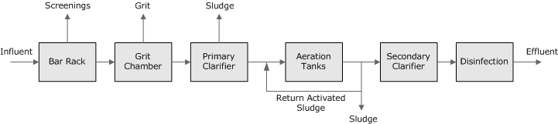
Basic Processes-Municipal
Primary Treatment
Grit chamber
Primary Settling
Secondary Treatment
Biological Treatment
Final Settling
Disinfection
Contact Basin

Slide 11
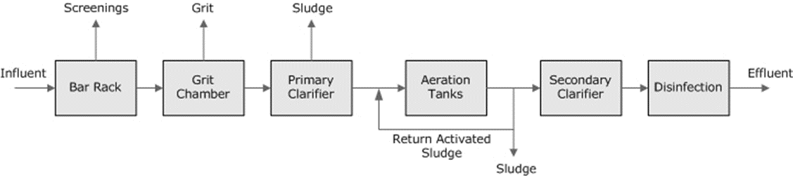
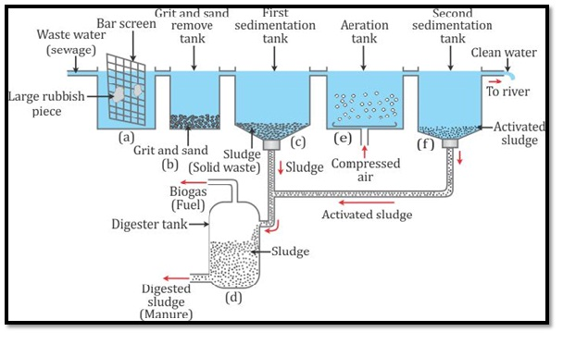
Aeration Tank

Slide 12
Basic Processes-Small
Aeration, Settling, Disinfection (no primary treatment)
Series of Stabilization Ponds

Slide 13
Solids Treatment
Solids are generated from primary settling and final settling
Solids are usually treated via sludge digesters

Slide 14
Typical Effluent Quality Standards
BOD and SS Max. monthly avg of < 30 mg/l (<.003% solids)
pH between 6 and 9
Oil and grease < 10 mg/l

Slide 15
Design Loading
Load (#’s of BOD or SS)
Flow (flow rates)
Peak hourly flow, maximum monthly flow, annual average, average dry weather, average wet weather

Slide 16
Design Criteria for Various Treatment Processes
 | Peak Hourly Flow | Max. Monthly Flow | Other
Flow measurement | X
Bar Screen | X
Pumps | X |  | Min Hourly Flow
Grit Chamber | X | X
Primary Settling |  | X
Final Settling |  | X
Disenfection | X

Slide 17
Preliminary Treatment
Flow is measured (Parshall flume)
Screening (1/2” or 1” spacing)
(with grinder or shredder-¼” size)
Grit Chamber (sand; coffee grounds)

Slide 18
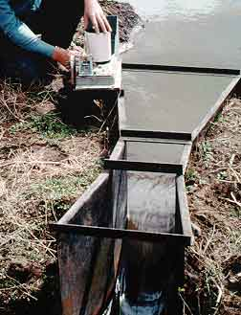
Parshall Flume
A Parshall flume is a specially shaped structure which can be installed in a channel to measure the water flow rate. The flume was developed and calibrated by Ralph Parshall at Colorado State University early in this century and has been used extensively. Although Parshall flumes are difficult devices to set and build, they are an accepted and widely used measuring device. waterknowledge.colostate.edu/ parshall.htm

Slide 19
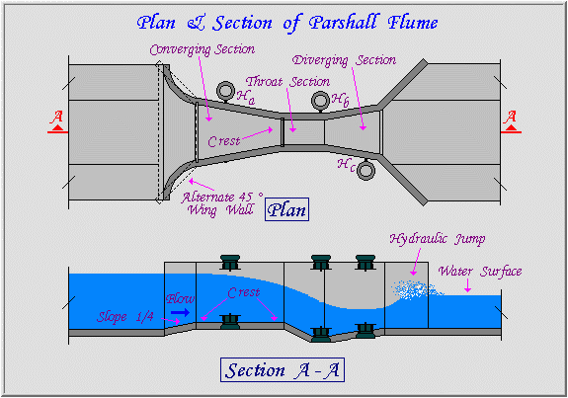
Plan and Profile-Parshall Flume
web.deu.edu.tr/atiksu/ toprak/ani4022.html

Slide 20
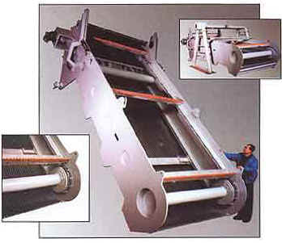
Automated Bar Screen

Slide 21
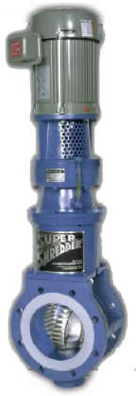
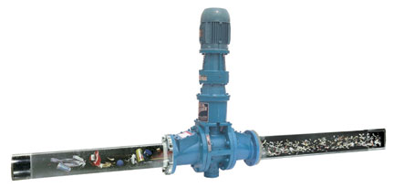
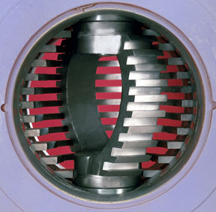
Grinders

Slide 22
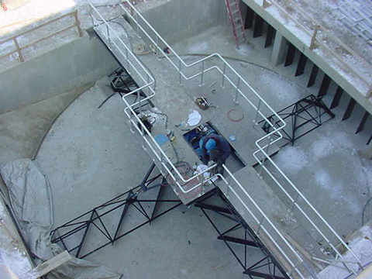
Grit Chamber

Slide 23
Other Ways to remove grit
Removal in primary clarifier
Aerated units w/ hopper bottoms
Forced vortex tanks (proprietary)

Slide 24
Grit Removal Trivia
The recommended velocity of a properly operated grit removal system is 1 foot per second.
This velocity allows the grit to settle but the majority of the organics to remain suspended.

Slide 25
Clarifiers (settling/sedimentation tanks)
Primary (before biological treatment)
Intermediate (in between biological treatments)
Final (following biological treatment)

Slide 26
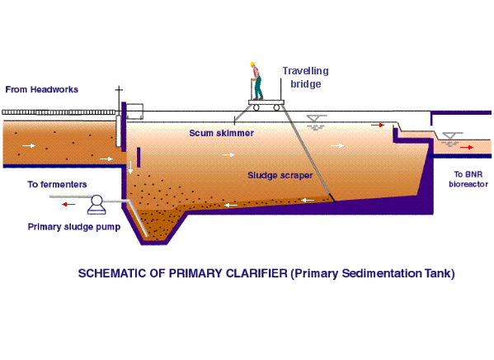
Primary Clarifier Schematic

Slide 27
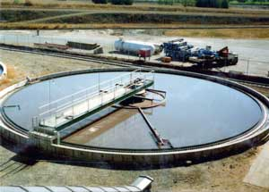
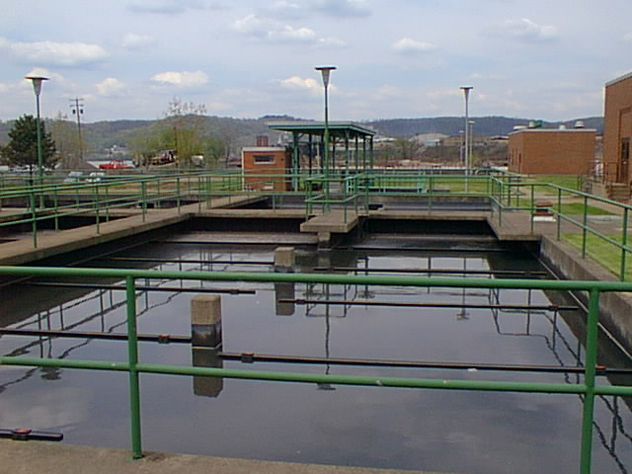
Primary Clarifiers-Shapes
www.nwlink.com
www.cityofweirton.com/ wsb/treatment.htm

Slide 28
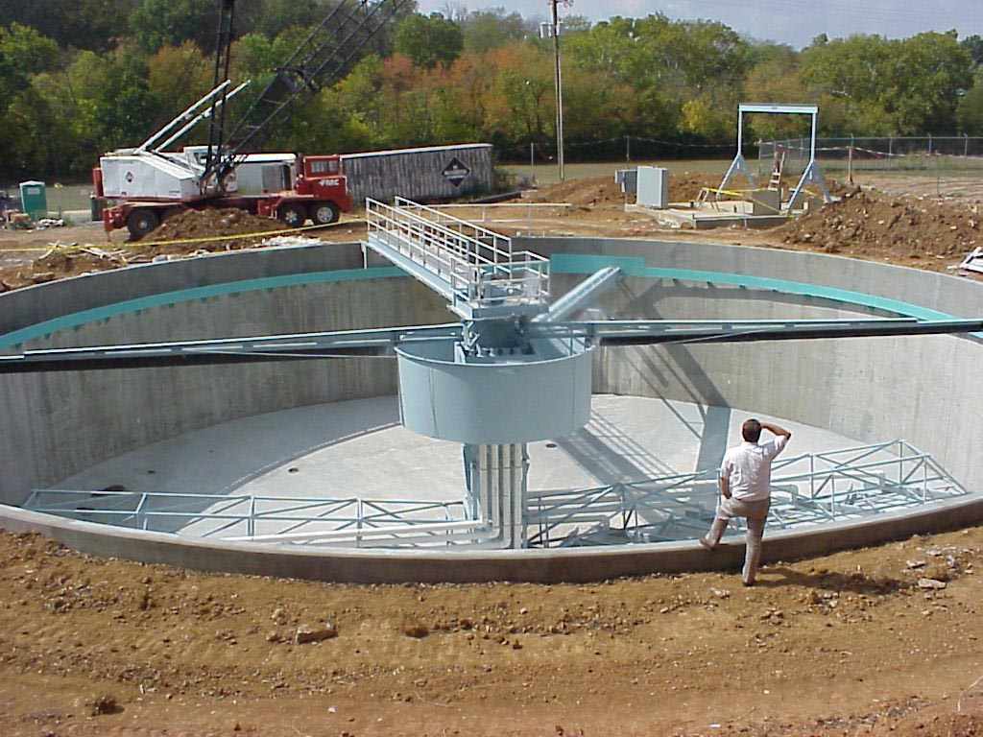
Primary Clarifier-Construction

Slide 29
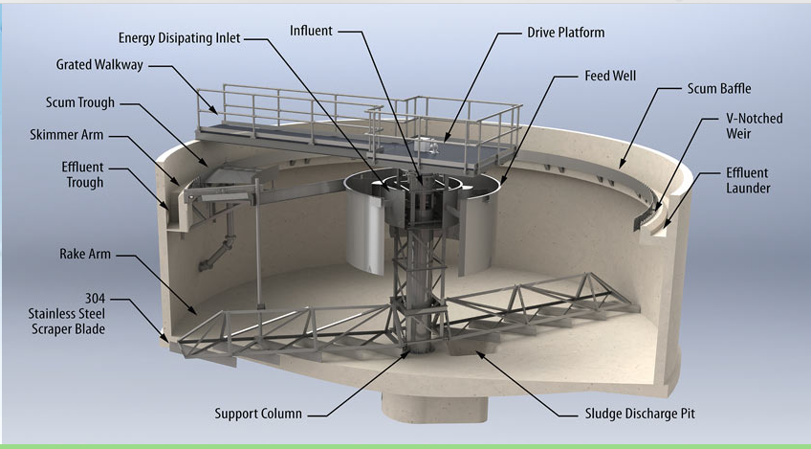
Clarifier-Rendered Image and Parts

Slide 30
Design Criteria for Primary Clarifiers
See my website-bottom of 450 schedule)
Overflow rates
Side water depth
Weir loading
Notes: Includes EPA standards and “Standards” based on a report of the WW Committee of the Great Lakes
Note: Secondary solids --- activated sludge solids are returned to the primary for removal with primary solids

Slide 31
Primary Clarifier Example

Slide 32
Description
Two primary settling tanks are 95 ft in diameter w/ a 7’ side water depth. Single effluent weirs are located on the peripheries of the tanks. For an average design flow of 10.0 mgd and peak flow of 15.4 mgd calculate the overflow rate, detention time and weir loading

Slide 33
Calculate Overflow rate
33
Surface area of 2 tanks = 14,200 ft²
Volume (7’) depth=99,400 ft³ =0.744 million gal.
Overflow rate=Q/A=704 gpd/ft²(avg design flow)
Overflow rate=1084 gpd/ft² (peak flow)
Check that values are less than design stds (average)---Okay
Average EPA 800-1200 gpd/square ft
Average “Great Lakes” Standards 1000 gpd/square ft
Check that values are less than design stds (peak)----Okay
Peak EPA 2000-3000 gpd/square ft
Average “Great Lakes” Standards 1500 gpd/square ft

Slide 34
Calculate Detention Time
34
Vol/Q=(0.744E6 gallons/10 mgd)*24 hr/day
=1.8 hours (average design flow)
Note: Can also use H/Vo (depth of water/overflow rate—but remembering V/Q is easier for me)

Slide 35
Calculate Weir Loading
35
Weir length for 2 tanks = 2*pi*D=2*pi*95 ft=597 ft
Weir loading = Q/weir length= 10E6 gpd/597 ft
=16,750 gpd/ft (check standards---see below)
Okay per EPA standards (10,000-40,000 gpd/ft) but not for “Great Lake” standards (10,000 gpd/ft)
Could add a 2nd set of weirs to get to 8,400 gpd/ft

Slide 36
Check Side Water Depth
36
Side Water Depth = 7’
Not okay per EPA standards (10-13 ft)
Okay per “Water Works” standards (7’)

Slide 37
Intermediate Clarifier
37
Sometimes used for 2-stage secondary treatment processes:
Between 2 trickling filters
Between trickling filter and activated sludge
Typical Values:
Overflow rate 600-800 gpd/sq ft
Minimum water depth should be 10 ft
Weir loading:
10,000 to 20,000 gpd/linear ft

Slide 38
Final or Secondary Clarifiers
There are differences in sludge characteristics between trickling filters and activated sludge:
Design of final clarifiers following trickling filters is similar to design of primary clarifiers
Design of clarifiers following activated sludge systems must take into account the reduced settleability.
Deeper
Lower overflow rate
Longer weir length

Slide 39
Final Clarifiers-After TF vs After AS
Settles Readily
Less buoyant
Depth – a few inches
Sludge is removed less frequently
Tank not as deep
Hard to Settle
Lighter, more buoyant
Depth – 1 to 2 feet
Rapid, uniform sludge withdrawal is ideal
Tank is usually deeper

Slide 40

Final (Secondary) Clarifier Example

Slide 41
Description
41
Determine the recommended size of two new circular secondary clarifiers for an activated sludge system w/ a design flow of 20,000 m³/day with a peak hourly flow of 32,000 m³/day. Use maximum overflow rates of 33 m³/m²-day at design monthly flow and 66 m³/m²-day at peak hourly flow.

Slide 42
Calculate Required Surface Area & Tank Diameter
Design Monthly Flow
Required Surface area = Design flow Rate/Maximum Overflow Rate
=20,000/2*33=303 square meters
Assuming 2 tanks, calculate the diameter=19.6 meters
42

Slide 43
Check Peak Overflow Rate
43
Peak Flow
Required Surface area = Peak flow Rate/Maximum Overflow Rate
=32,000/2*66=242 square meters
Assuming 2 tanks, calculate the diameter=17.6 meters
Use worst case: Diameter must be 19.6 meters

Slide 44
Example 11-2 Check Weir Loading
44
Assuming the inboard weir channel is set on a diameter of 20 meters
Weir loading=Q/weir length
=32,000/(pi*19.6 m*2 tanks)=260 m³/m²-day
(Maximum is 125 to 250; design is just over maximum)

Slide 45
Side Water Depth
45
The recommended side water depth for a tank diameter between 50 and 100 feet is 11 ft (reference was prior book)

Slide 46
Review Question
46
What are two types of solids effectively removed by primary clarifiers?
A. Floatable and settleable
B. Floatable and dissolved
C. Dissolved and colloidal
D. Suspended and organic

Slide 47
Review Questions
47
What are the differences between a primary, intermediate and final clarifier?
What can be used to measure the incoming flow rate?

