Slide 1
CTC 450 Review
Preliminary & Primary Treatment
Measure flow
Bar Screen
Grit chamber (if needed)
Primary Settling (Primary Clarifier)
Various Calculations (detention time, overflow rate, weir loading rate)----check against Standards

Slide 2
Objectives
Understand basic processes of biological (secondary) treatment:
trickling filter, activate sludge, rotating biological contactors

Slide 3
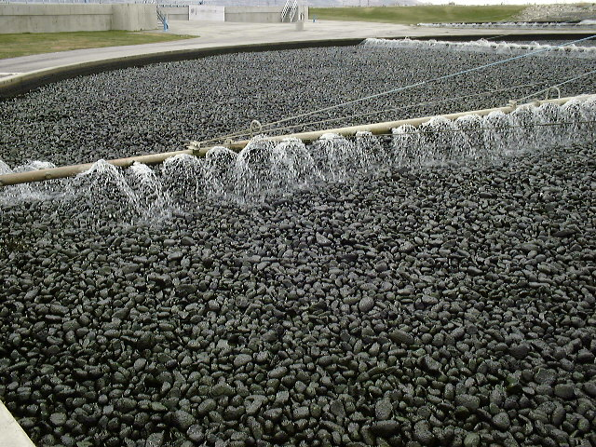
Trickling Filter (Stone Media)

Slide 4
Stone-Media Trickling Filters 1/2
Major components
Rotary distributor
Underdrain system
Filter media (5-7’ depth)
Most common media is crushed rock, slag or field stone (3-5” in dia.)
Media must be durable, insoluble and resistant to spalling

Slide 5
Stone-Media Trickling Filters 2/2
Some ww is recycled to the filter
Two-stage consists of 2 filters in series (with or w/o an intermediate clarifier)
Second filter is less efficient since food concentration is less
BOD removal is influenced by temp.

Slide 6
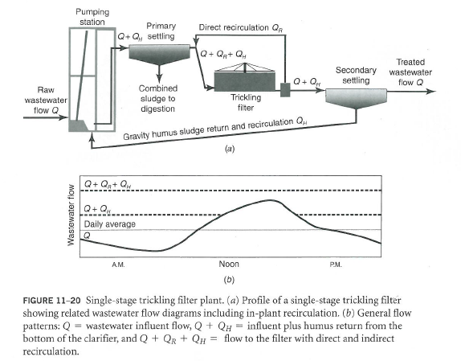
Recirculation

Slide 7
Recirculation Ratio (R) for Trickling Filter
R = Qr divided by Q
Where:
Qr=recirculation flow
Q=incoming wastewater flow
R can be less than 1 or greater than 1

Slide 8
Trickling Filter Calculations
BOD loading (settled WW BOD/volume of filter media)
Hydraulic Loading ((Q+Qr)/filter surface area)
Recirculation Ratio (Qr/Q)
Standards for Trickling filter;-high stage-(not “two-stage” ):
Recirculation Ratio (0.5-3)
BOD Loading: 30-90#/1000 cubic ft/day (or 1300-3900#/acre-ft/day) Hydraulic Loading: 10-30 million gallons/acre-day (or 0.16-0.48 gpm/sq ft)

Slide 9
Biological Towers
Plastic media is used
High percentage of voids
High surface area per unit of volume
Uniform media (random or modular)
Light weight
Chemical resistance
Can treat high-strength wastewaters

Slide 10
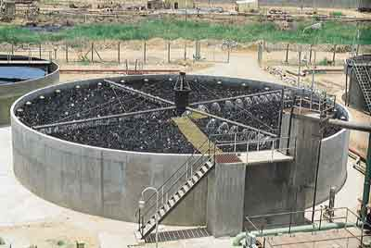
Image of Biological Tower
Plastic media - Trickling filter at Madras Refineries Ltd, Chennai -http://www.paramountlimited.com/wwtpfotoct15a.htm

Slide 11
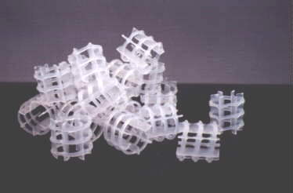
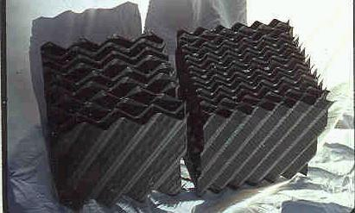
Biological Tower Media
www.aquacare.de/produkte/ filtermat/e_riesel.htm
http://www.engr.psu.edu/ce/enve/images/XF-media.JPG

Slide 12
Biological Tower
Theoretical removal rates get complex and are based on soluble BOD
Packing configuration impacts residence time, which is related to hydraulic loading and filter depth
Another complication is that effluent from the tower is recirculated

Slide 13
Biological Tower Recirculation
Sp is soluble BOD of primary effluent before dilution w/ recirculated flow
So is soluble BOD of tower influent after dilution w/ recirculated flow
Se is soluble BOD of tower effluent
Equations (not in your current book) can be used to calculate the efficiency of a biological tower (w/ random packing). Efficiency =Se/Sp

Slide 14
Example Calc’s Biological Tower
Flow is 1.6 mgd
Primary Clarifier/Biological Tower/Secondary Clarifier
Single Stage Biological Tower:
Diameter = 70’
Media Depth = 7’
Primary Effluent has a soluble BOD of 100 mg/l
Water temp is 15C (59F)
Constants for random plastic media are:
n=0.44
k₂₀=0.0023
A_{s}=35 square ft per cubic foot
Calculate the effluent soluble BOD assuming indirect recirculation to the wet well of 560 gpm

Slide 15
Combine filters/activated sludge
Biological tower can be used before activated sludge
Analyzing the process is difficult

Slide 16
Filter/Tower Problems
Odor
Effluent quality
Cold weather
Flies
Snails

Slide 17
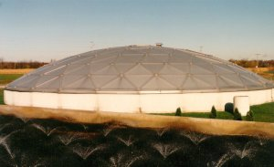
Covers
Odor Control
Limits heat loss
http://www.cityoflaporte.com/wwtp/secondary.htm

Slide 18
Activated Sludge
Liquid suspension of microorganisms (mixed liquor)
MLSS-mixed liquor suspended solids
Aerobic process

Slide 19
Activated Sludge Settleability
Depends on food-to-microorganism ratio and sludge age
High MLSS concentrations and extended times encourage endogenous growth
Endogenous growth-microorganisms are starved and rapidly utilize the food source

Slide 20
Aeration (Activated Sludge) Calculations
F/M ratio (page 253 of class book)
BOD Load
Sludge Age (Mean Cell Residence Time-MCRT)
Sludge Volume Index (SVI) (page 254)
Percent Removal of BOD/TSS
Detention Times (Volume/Q)

Slide 21
Sludge Volume Index (SVI)
SVI(ml/g)=Settled Sludge Volume (ml/L)*1000/MLSS (mg/l)
If SVI<80: Settles fast but supernate may be cloudy
If SVI=100-200: Typical for activated sludge
If SVI>250: Floc settles slowly
Reference: http://www.tpomag.com/editorial/2010/03/what-the-heck-is-svi

Slide 22
Activated Sludge Calculations
Covered in asynchronous folder
Wastewater Operator Tests (show all work and units)

Slide 23
Membrane Biological Reactor (MBR)
Activated-sludge followed by a tank w/ microfiltrate membranes (instead of a secondary clarifier)
Solids-liquid separation is by filtration versus gravity settling
Can remove 98% of SS and 100% of non-soluble BOD

Slide 24
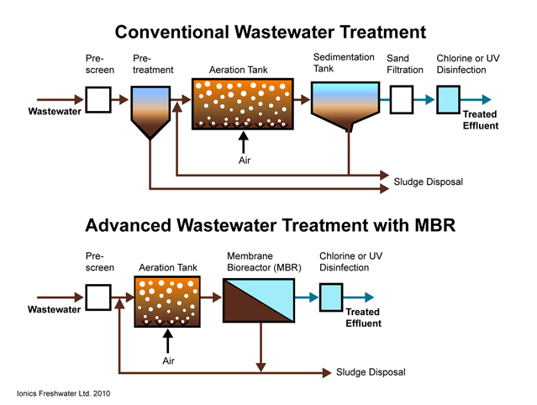
Sedimentation Tank with Advanced MBR

Slide 25
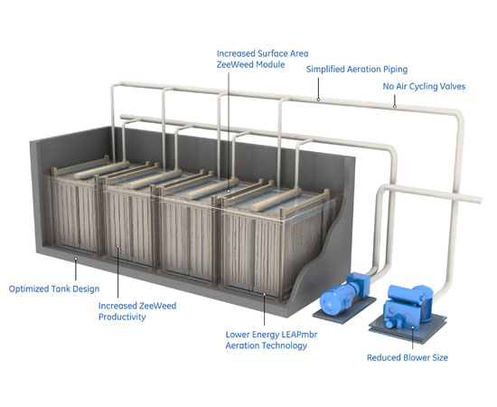
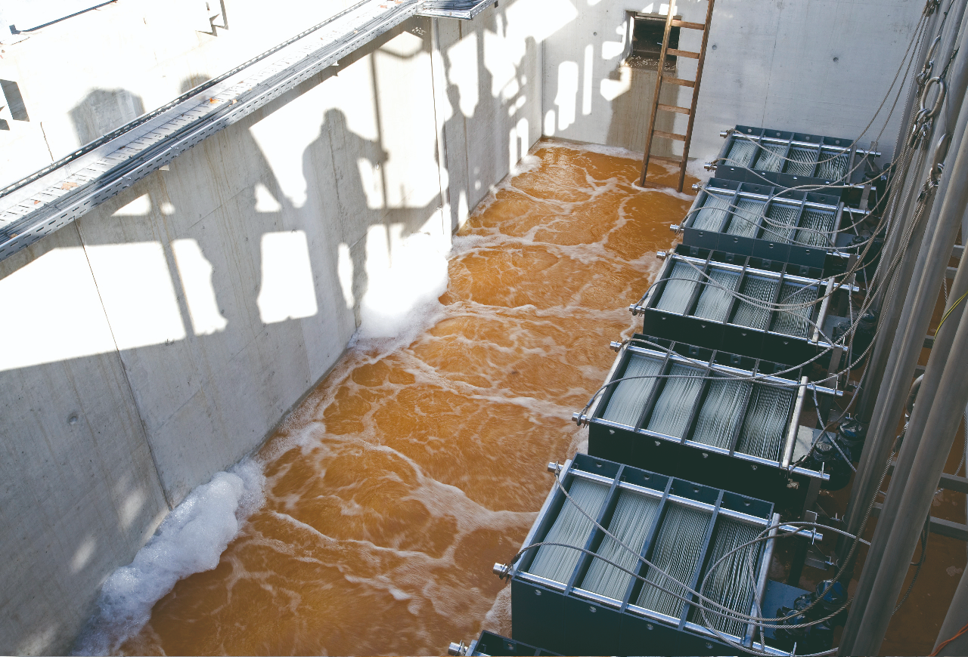
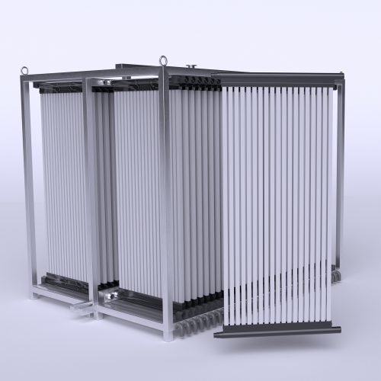
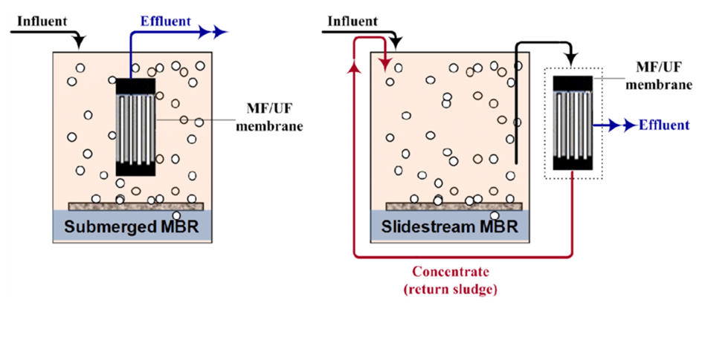
MBR pictures
picture of membrane

Slide 26
MBR Advantages/Disadvantages
High-quality effluent
Small size
High operating cost (membrane replacement)
Increased energy costs (pumps)

Slide 27
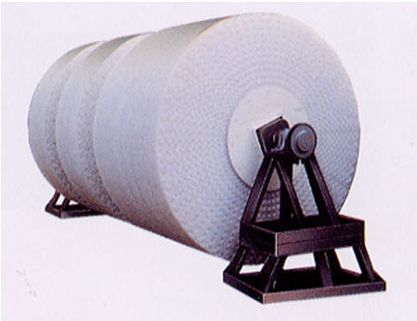
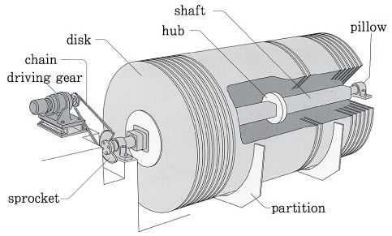
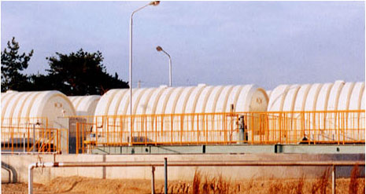
RBC
40% submerged
Four stages often used (each with separate tanks)
Plug flow
http://nett21.gec.jp/JSIM_DATA/WATER/WATER_1/html/Doc_204.html

Slide 28
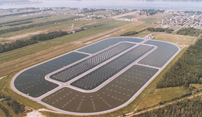
Stabilization Ponds (lagoons)
Used in rural areas (7% of population)
Used as polishing ponds (tertiary treatment)
Can be facultative, aerated or anaerobic
www.sequencertech.com

Slide 29
Disinfection
Chlorine added by rapid initial mixing in a contacting basin
UV (hypochlorite used as standby)

Slide 30
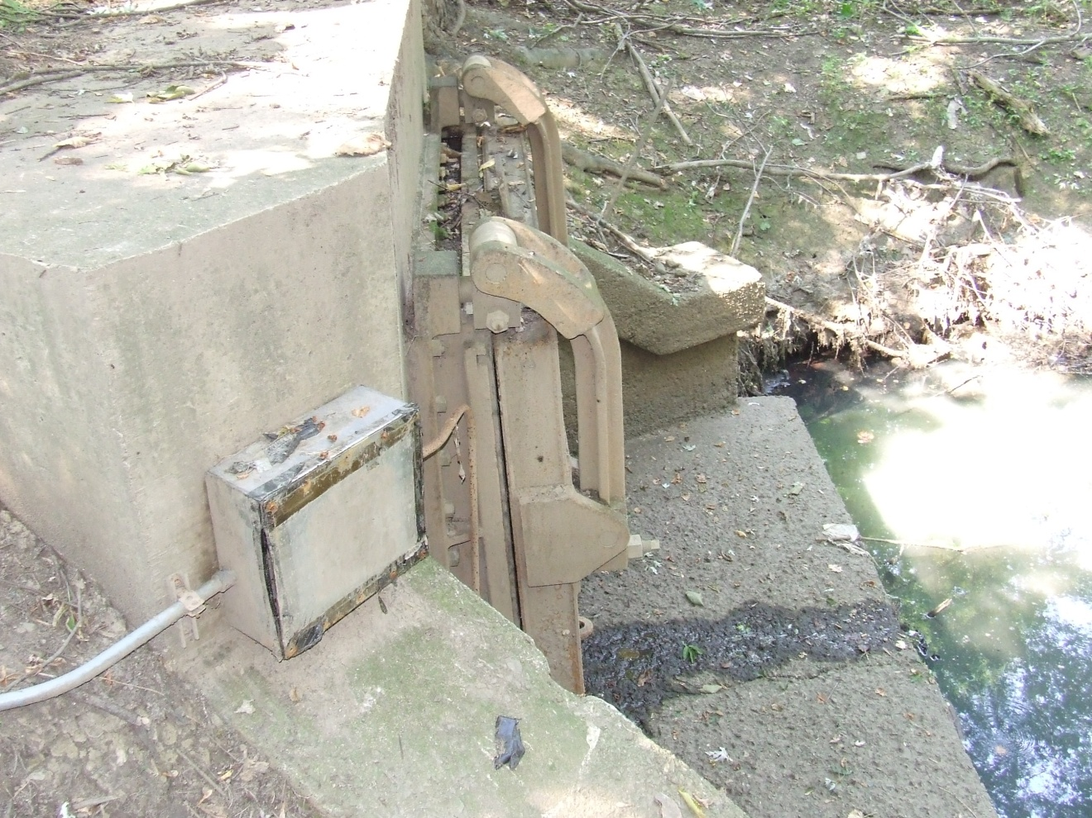
Outfall-Railroad Interceptor

Slide 31
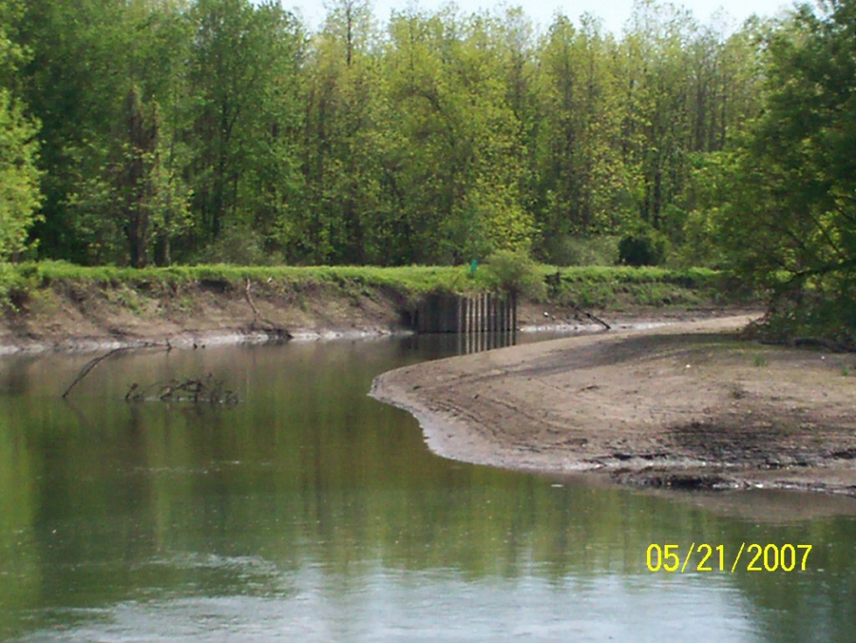
Outfall-Grace Creek

Slide 32
Private Systems
25% of homes not connected to a municipal system
Septic tank and drainfield (absorption field)
EPA (2002): Onsite Wastewater Treatment and Disposal Systems | US EPA

Slide 33
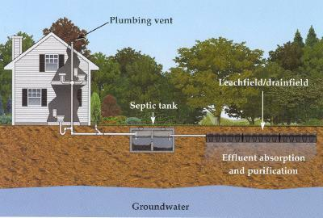
Typical Septic Tank and Leachfield

