Slide 1
CTC 450 Review
Secondary Treatment
  Trickling Filters
  Biological Towers
  Activated Sludge
  RBC
  Lagoons
  Septic Tanks

Slide 2
Objectives
Understand basic processes of sludge treatment

Slide 3
Sludge Characteristics
5,000 gal of sludge per 1 million gallons treated
4-5% solids
  (activated sludge; 0.5 to 1.5%)
Must be stabilized, dewatered and disposed of
Sludge facility costs are approximately 1/3 of total investment

Slide 4
Characteristics
Sludge from primary settling is anaerobic, odorous, easily thickened, and easily dewatered
Sludge from aerated systems is odor-free, but difficult to dewater

Slide 5
Sludge Pumps
Positive displacement pumps
Can control pumping rate

Slide 6
Sludge Treatment
Thicken
Digest
  Aerobic
  Anaerobic
Dewater
Dispose

Slide 7
Thicken
Gravity Settling
Dissolved air flotation (DAF)
Gravity Belt
Centrifuge

Slide 8
Gravity Thickening
Circular settling tanks
Overflow returned to head of plant
Sludge removed from the bottom
Normal unit load: 6-12# of solids per ft² per day
Treated wastewater (ferric chloride) is sometimes added to
  Reduce Odor
  Wash out fine SS
Typically 80-95% of solids are captured

Slide 9
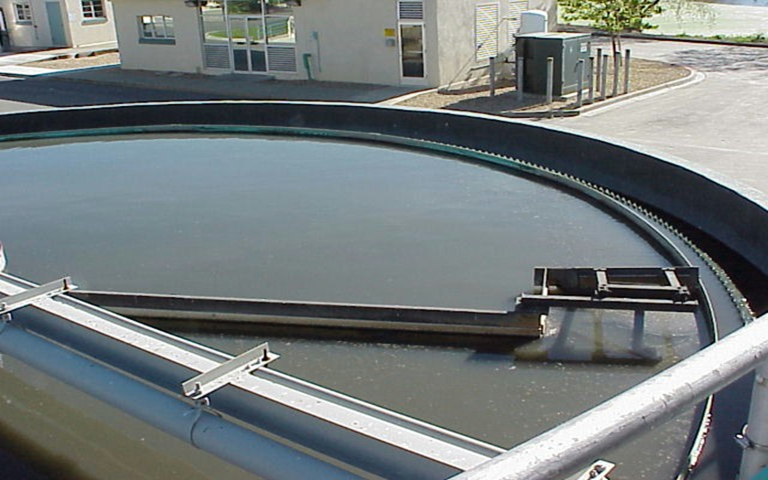
Sludge Thickener
The Sludge Thickener is another settling tank which further separates solids from the liquid. The sludge from the bottom of the thickener is sent to the Primary Digester. The overflow of water from the thickener is sent back to the Clarifiers.

Slide 10
Disadvange of Gravity Thickening
Doesn’t work well for activated sludge
Better processes for activated sludge:
  Dissolved air flotation (DAF)
  Gravity belt
  Centrifuge

Slide 11
Dissolved Air Flotation
Outflow 4% solids
85% solids recovery rate
Polymers/flocculants may be added
Practical loading rates:
  2 to 4 # of solids per square ft per hr

Slide 12
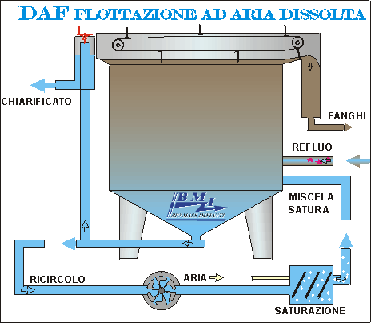
Dissolved Air Flotation http://www.biomassimpianti.it/images/impianti-dis/daf-proc.gif

Slide 13
Gravity Belt Thickeners
Polymers added
Sludge sprayed onto permeable belt
Dewatered sludge falls into a hopper
High pressure water used to clean belt
Speed of belt can be controlled
90-98% solids capture rate
Practical loading rates:
  100 to 250 gpm per meter of belt width

Slide 14
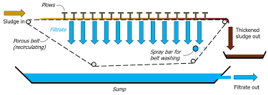
Gravity Belt Thickening
https://www.sludgeprocessing.com/sludge-thickening/gravity-belt-thickening/

Slide 15
Centrifuge
400-600 gpm
Thickened sludge of 4-8%

Slide 16
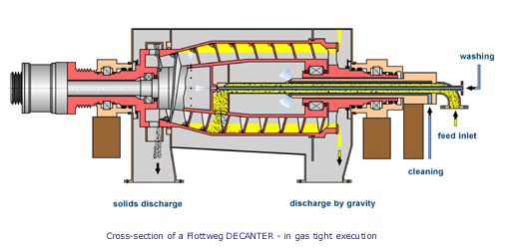
Centrifuge Thickening www.sgconsulting.co.za/. ../Decanters.htm
Mode of operation
The essential part of the decanter is the rotating part which consists of a cylindrical/conical bowl with a conveyor scroll inside which rotates at a differential speed. The rotating part is driven by electric motors via belt transmission. Feed enters the bowl through a central feed pipe. Through ports in the scroll body, feed passes into the bowl where separation by centrifugal force takes place. In a decanter, the product is separated into a liquid phase and a solids phase. The discharge of the separated liquid can be under pressure or by gravity. The separated solids are conveyed by the scroll to the conical end of the bowl and are discharged. Decanters can also be configured for gas tight operation as may be required for toxic or explosive materials.
Notes:
Mode of operation
The essential part of the decanter is the rotating part which consists of a cylindrical/conical bowl with a conveyor scroll inside which rotates at a differential speed. The rotating part is driven by electric motors via belt transmission. Feed enters the bowl through a central feed pipe. Through ports in the scroll body, feed passes into the bowl where separation by centrifugal force takes place. In a decanter, the product is separated into a liquid phase and a solids phase. The discharge of the separated liquid can be under pressure or by gravity. The separated solids are conveyed by the scroll to the conical end of the bowl and are discharged. Decanters can also be configured for gas tight operation as may be required for toxic or explosive materials.
Mode of operation
The essential part of the decanter is the rotating part which consists of a cylindrical/conical bowl with a conveyor scroll inside which rotates at a differential speed. The rotating part is driven by electric motors via belt transmission. Feed enters the bowl through a central feed pipe. Through ports in the scroll body, feed passes into the bowl where separation by centrifugal force takes place. In a decanter, the product is separated into a liquid phase and a solids phase. The discharge of the separated liquid can be under pressure or by gravity. The separated solids are conveyed by the scroll to the conical end of the bowl and are discharged. Decanters can also be configured for gas tight operation as may be required for toxic or explosive materials.
Mode of operation
The essential part of the decanter is the rotating part which consists of a cylindrical/conical bowl with a conveyor scroll inside which rotates at a differential speed. The rotating part is driven by electric motors via belt transmission. Feed enters the bowl through a central feed pipe. Through ports in the scroll body, feed passes into the bowl where separation by centrifugal force takes place. In a decanter, the product is separated into a liquid phase and a solids phase. The discharge of the separated liquid can be under pressure or by gravity. The separated solids are conveyed by the scroll to the conical end of the bowl and are discharged. Decanters can also be configured for gas tight operation as may be required for toxic or explosive materials.
Mode of operation
The essential part of the decanter is the rotating part which consists of a cylindrical/conical bowl with a conveyor scroll inside which rotates at a differential speed. The rotating part is driven by electric motors via belt transmission. Feed enters the bowl through a central feed pipe. Through ports in the scroll body, feed passes into the bowl where separation by centrifugal force takes place. In a decanter, the product is separated into a liquid phase and a solids phase. The discharge of the separated liquid can be under pressure or by gravity. The separated solids are conveyed by the scroll to the conical end of the bowl and are discharged. Decanters can also be configured for gas tight operation as may be required for toxic or explosive materials.

Slide 17
2. Sludge Digestion
Convert sludge so that it can be rapidly dewatered
Anaerobic Digestors
  Single Stage
  Two-Stage
Aerobic Digestors

Slide 18
Aerobic
Developed specifically for activated sludge processes w/o primary clarifiers
Aerated via diffused or mechanical aerators

Slide 19
Anaerobic
Single stage
  Fixed cover
  Floating cover
Two-stage
  Biological Stabilization
  Gravity Thickening

Slide 20
3. Dewatering
Pressure filtration – various types
Centrifuge
Drying beds
Composting

Slide 21
Pressure Filtration
Belt Filter Press
  More popular
  Available in small sizes
  Belts which pass over a series of rollers
Plate-and-Frame Press
  Used for chemical sludges
  Produces very compact and dry cake
Screw Press
  Auger screw within a metal screen

Slide 22
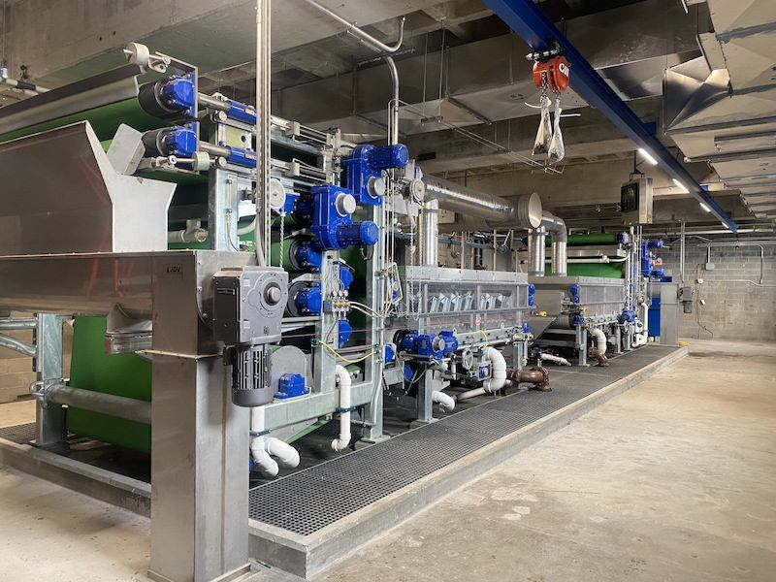
Belt Press https://www.tpomag.com/online_exclusives/2024/04/odor-control-featured-on-new-belt-press_sc_000dj

Slide 23
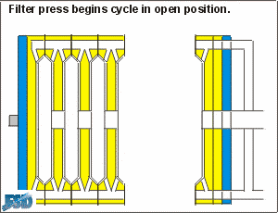
Plate and Frame Press www.asmfab.com

Slide 24
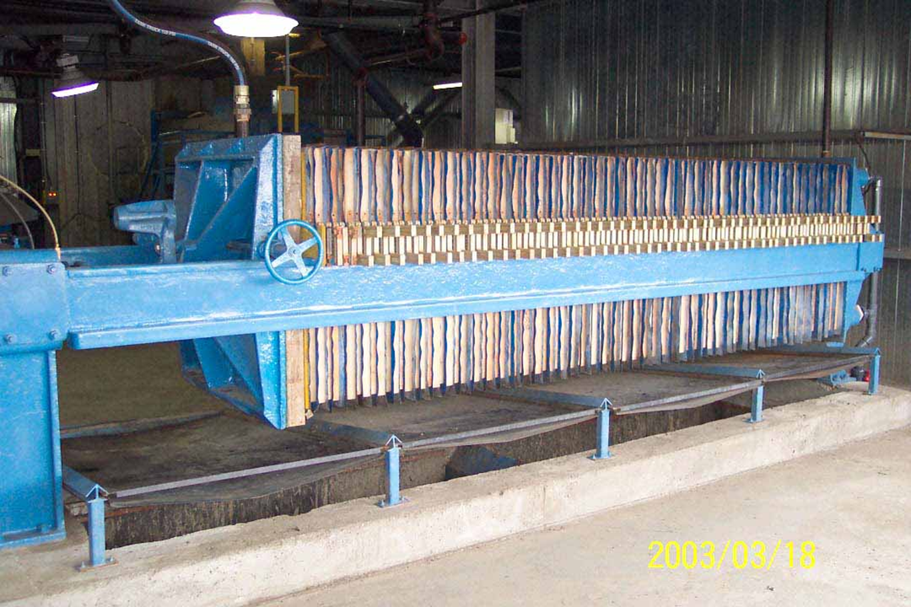
Filter Press

Slide 25
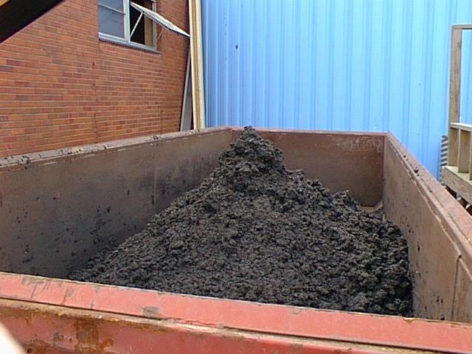
Biosolids
To Landfill
http://www.cityofweirton.com/wsb/sludge.jpg

Slide 26
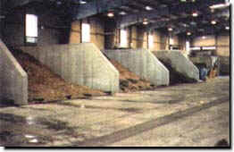
Composting Sludge
Aerated Static Pile Composting - sludge cake from the belt filter presses is transferred by conveyors, blended with a bulking agent (wood chips or wood ash) to reduce its moisture content; increase porosity and facilitate materials handling; and is then placed in one of 12 concrete bins. Each bin is loaded to form a pile which is aerated by blowers and perforated piping to enhance aerobic decomposition and stabilization of the sludge.
Curing and Storage Area - after the sludge/bulking agent mixture is allowed to actively compost for 14 to 21 days, the material is subsequently stockpiled in the storage areas adjacent to the Composting Building, where it is allowed to cure for an additional time before it is transported offsite for final disposal. The end product may be marketed for beneficial use such as landscaping or conditioning poor quality soils.

Slide 27
Sludge Odor Control
Odors (hydrogen sulfide, organic compounds)
  Adsorption (activated carbon)
  Biological system (wood chips or soil)
  Wet scrubbers

Slide 28
4. Sludge disposal
Agricultural land application
Landfill
Incineration

Slide 29
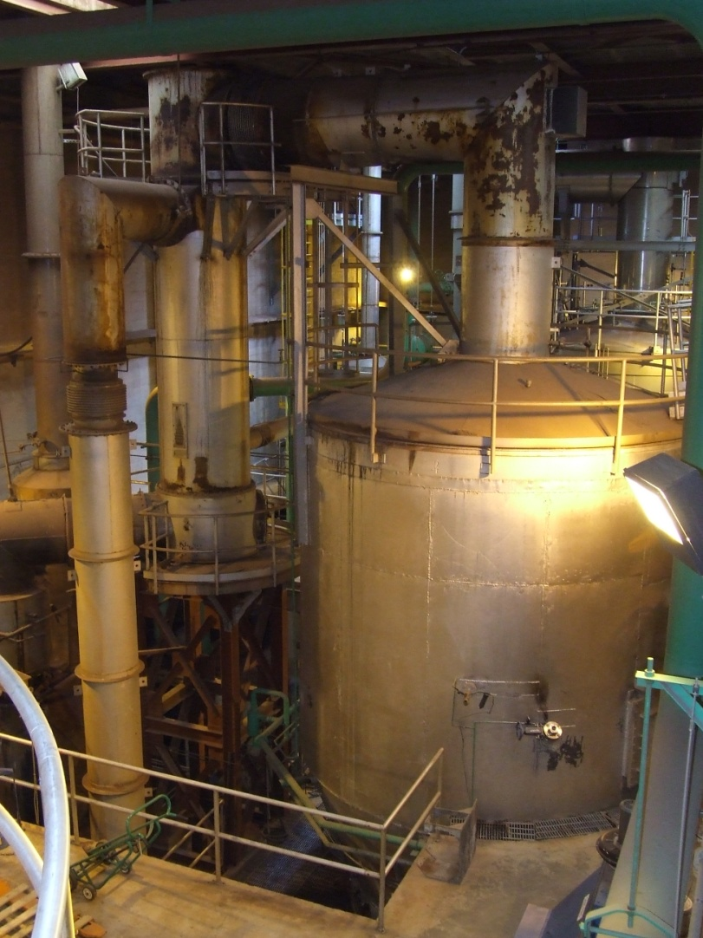
Incinerator-Fluidized Bed

Slide 30
Regulatory Requirements
40 CFR Part 503 (1993-CWA)
Encouraged recycling via land application versus disposal in a landfill or incineration
Survivability of pathogens is a concern
  Class B (not considered pathogen-free)
  Class A (pathogens below detectable limits)

Slide 31
PFAS?
The per-and polyfluorinated substances (PFAS) were previously referred to as perfluorochemicals (PFCs). PFAS are a group of chemicals used to make fluoropolymer coatings and products that resist heat, oil, stains, grease, and water. Fluoropolymer coatings can be used in such varied products as clothing, furniture, adhesives, food packaging, heat-resistant non-stick cooking surfaces, and the insulation of electrical wire. Many chemicals in this group, including perfluorooctane sulfonic acid (PFOS) and perfluorooctanoic acid (PFOA), have been a concern because they do not break down in the environment, can move through soils and contaminate drinking water sources, and they build up (bioaccumulate) in fish and wildlife. PFAS have been found in rivers and lakes and in many types of animals on land and in the water.
https://www.cdc.gov/biomonitoring/PFAS_FactSheet.html

