Slide 1
CTC 450 Review
Water Quality Regulations

Slide 2
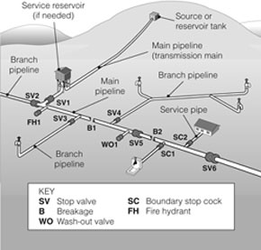
CTC 450
Water Distribution Systems

Slide 3
Objectives
Water & pressure requirements
Basics of providing water for fire protection requirements
Layouts of water distribution systems
Basics of well construction and intake structures
Basic types of pipes and valves

Slide 4
Water Quantity
Daily consumption varies widely
  600 gpd per metered service including residential, commercial and industrial customers
  100-200 gpd per capita (80-150 gpd for residential)
  40 gpd per capita (using high-efficiency plumbing)
Consumption also varies by season/day/hour
Design of water systems must account for variation in municipal water consumption and water needed for fighting fires

Slide 5
MVWA https://www.mvwa.us/
18.2 mgd average
126,250 people
144 gpcd (c-capita)

Slide 6
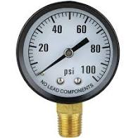
Water Pressure
Distribution system (65-75 psi)
Residential service connection (40 psi)
Maximum pressure is 150 psi
Pressures >100 psi are undesirable
  more breaks, greater leaks, undue stress

Slide 7
Needed Fire Flow (NFF)
Rate of water flow required for fire fighting to confine a major fire to the building within a block or other group complex with minimal loss.
Insurance Services Office (ISO)
  Guide for Determination of Needed Fire Flow

Slide 8
NFF Calculation
Based on construction, occupancy, exposure and communication of each building in a building complex.
The fire protection system must be completed and in place prior to enclosing structures/buildings. Also the water system must be separate than the potable system and is not metered.

Slide 9
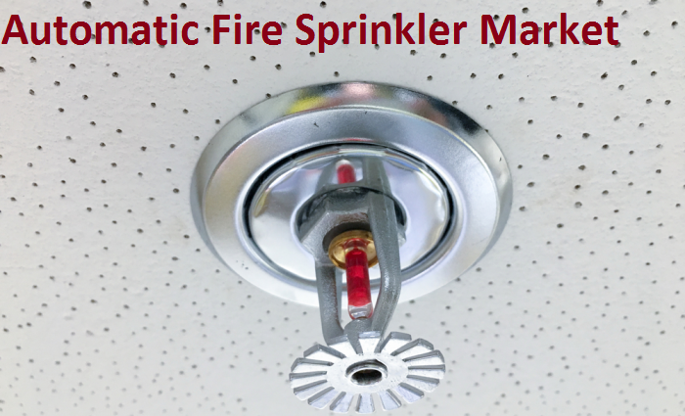

Practical Limits
Flow range could be 500 gpm (minimum) to 3500 gpm
Automatic sprinklers are effective and minimize flows that must be required

Slide 10
Water Supply Capacity
Gravity system is preferable (more reliable)
Storage is used to equalize pumping rates and provide water for firefighting
Pumping systems should be designed for reliability (electrical supply should be provided by 2 separate lines from different directions)

Slide 11
Distribution System
Systems should be made redundant by interconnecting pipes into loops.
Valves should be placed to allow repairs with minimal disruption to surrounding
Fire hydrants should be installed at locations convenient for the fire department

Slide 12
Sources of Water
Well Construction via drilling-hydraulic rotary or cable-tool percussion
http://www.thewaterexperts.com/goodsservices.htm
http://en.wikipedia.org/wiki/Drilling_rig#Cable_tool_drilling
Surface-Water Intakes (rivers, lakes or reservoirs)

Slide 13
Piping Network
Networks consist of storage reservoirs, main, booster pumping stations, fire hydrants and service lines
Provide redundancy via grids and loops

Slide 14
Service Connections
Corporation Stop connection from the distribution main (can be connected while the main is pressurized and in service)
Installation
http://www.freeed.net/sweethaven/BldgConst/Plumbing01/lessonmain.asp?iNum=fra0204

Slide 15
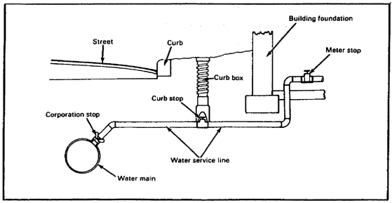
Water Main in Street to Private Building Supply

Slide 16
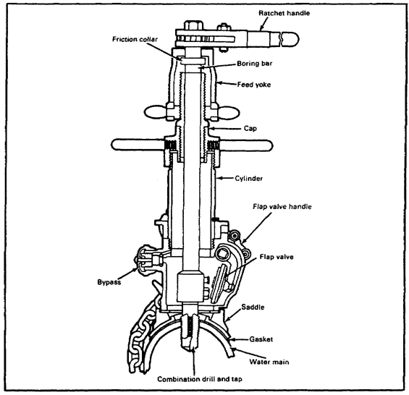
Corporation Stop

Slide 17
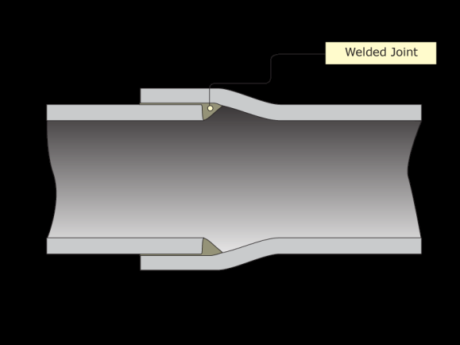


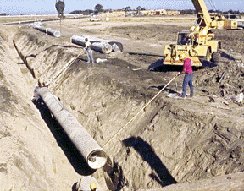
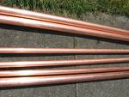

Kinds of Pipe
Bell and Spigot
Ductile iron
Plastic (HDPE/PVC)
Concrete
Steel
Residential (copper or plastic)

Slide 18
Pipe Strength
Different pipes have different sizes and thicknesses
Must use correct pipe to handle trench depth, bedding type, and live loads
Must place pipe below the frost line to prevent freezing/breakage

Slide 19

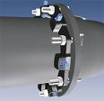



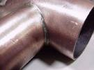
Joints
Compression
Mechanical
Flanged
Solvent
Soldered

Slide 20
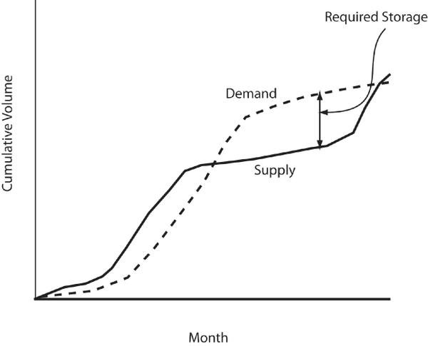
Distribution Storage
Use consumption curves to determine storage needed

Slide 21

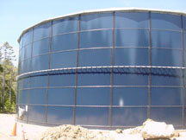
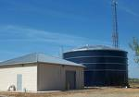
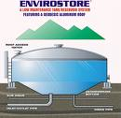
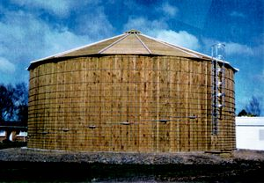



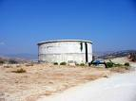
Water Storage

Slide 22
Valves
Gate/Butterfly/Swing
Check (flow in one direction)
Automatic
Pressure-Reducing Valves
Solenoid

Slide 23
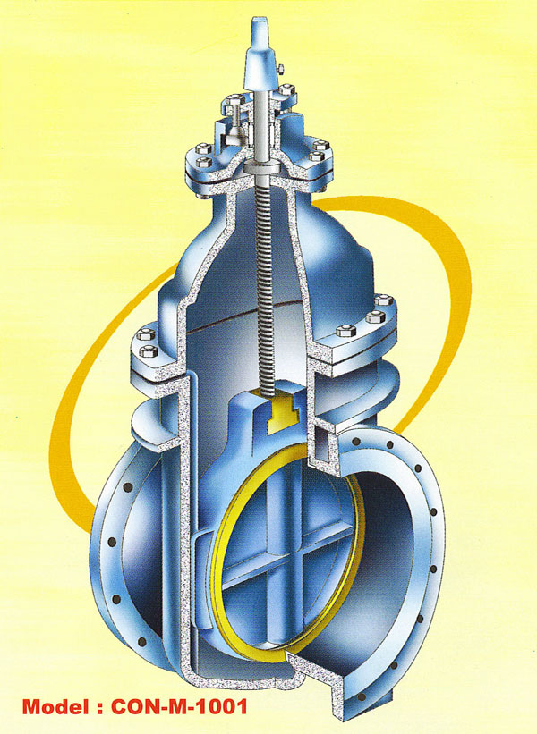
Gate Valve

Slide 24
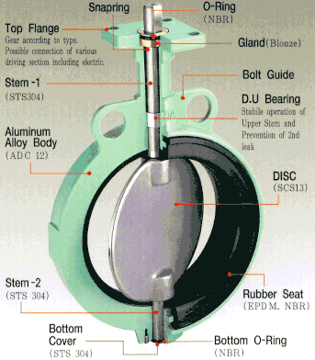
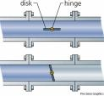
Butterfly Valve

Slide 25
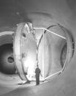
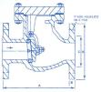
Swing Valve

Slide 26
Other Valves
Check Valve (permits water flow in only one direction)
Pressure Reducing Valve (lowers pressure)
Altitude Valves (controls flow into and out of a storage tank)
Solenoid Pilot Valve (controls valve via electric current)
Air release Valve

Slide 27

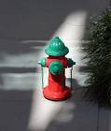

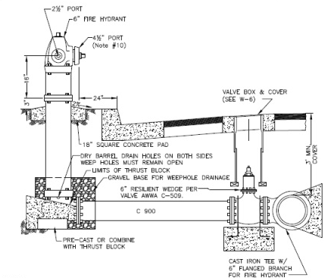
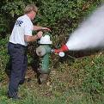

Fire Hydrants

Slide 28
Evaluating Distribution Systems
Quantity
Supply + storage must meet current daily demands (& future anticipated demands 10 years in the future
  Reservoirs should have 30-day storage capacity
  Wells should not “mine” water

Slide 29
Evaluating Distribution Systems
Intake Capacity
Intake structures
  must be designed large enough to handle demand
  Must be reliable

Slide 30
Evaluating Distribution Systems
Pumping Capacity
Pumps (should be reliable)
  From source to water treatment plant
  From water treatment plant clear-well to distribution
  Booster pumping stations

Slide 31
Evaluating Distribution Systems
Piping Network
Design life 40-50 years (actual 50-100)
Large mains -12”
Submains-6” or 8”

Slide 32
Review Questions
What is the yearly average consumption of water per person per day?
What does NFF stand for?
What does gpcd stand for?
What does MVWA stand for?
What is a corporation stop?
How does a check valve operate?

