Slide 1
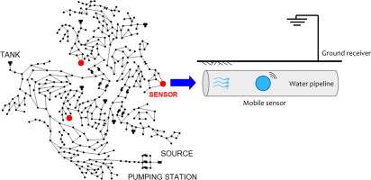
CTC 450 Review
Water Quality (SPDES/SWPPP/NOI)
Water Distribution Systems

Slide 2
Objectives
Describe the basic processes for treating groundwater and surface water
Calculate chemical coagulation detention times for both completely mixed and plug-flow reactors

Slide 3
Water Treatment Objective
Provide water that is chemically and microbiologically safe for human consumption.
  Domestic Use (free from apparent turbidity, color, odor or objectionable taste)
  Industrial Use (may be more stringent; decrease hardness to prevent scale deposits)

Slide 4
Primary Processes
Presedimentation
Chemical clarification (coagulation, sedimentation and filtration)
Precipitation Softening
Disinfection
Fluoridation
Chlorination

Slide 5
Processing Requirements
Groundwater from wells is usually easily processed (may only need disinfection and fluoridation)
River water usually requires the most processing (much variation)
Water from lakes/reservoirs is usually in-between

Slide 6
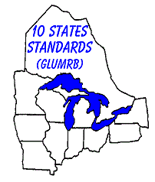

Current Standards
  Homework/Tests: Given configurations and flow data calculate existing parameters and compare to standards provided for this class.
  2022-Current
  Archived (2012/2007/1990/1980)
  Ref: https://www.health.state.mn.us/communities/environment/water/tenstates/standards.html
  Note: for this class use standards found here- https://people.sunypoly.edu/~barans/classes/ctc450/pdf/CTC%20450%20W_WW%20Standards.docx.pdf

Slide 7
Presedimentation
Used to settle out heavy solids from muddy river water prior to chemical flocculation/sedimentation.
Detention time should be greater than or equal to 3 hours.

Slide 8
Mixing and Flocculation Sedimentation
Rapid mixing of chemicals with raw water
Flocculation
Sedimentation (settling tank)

Slide 9



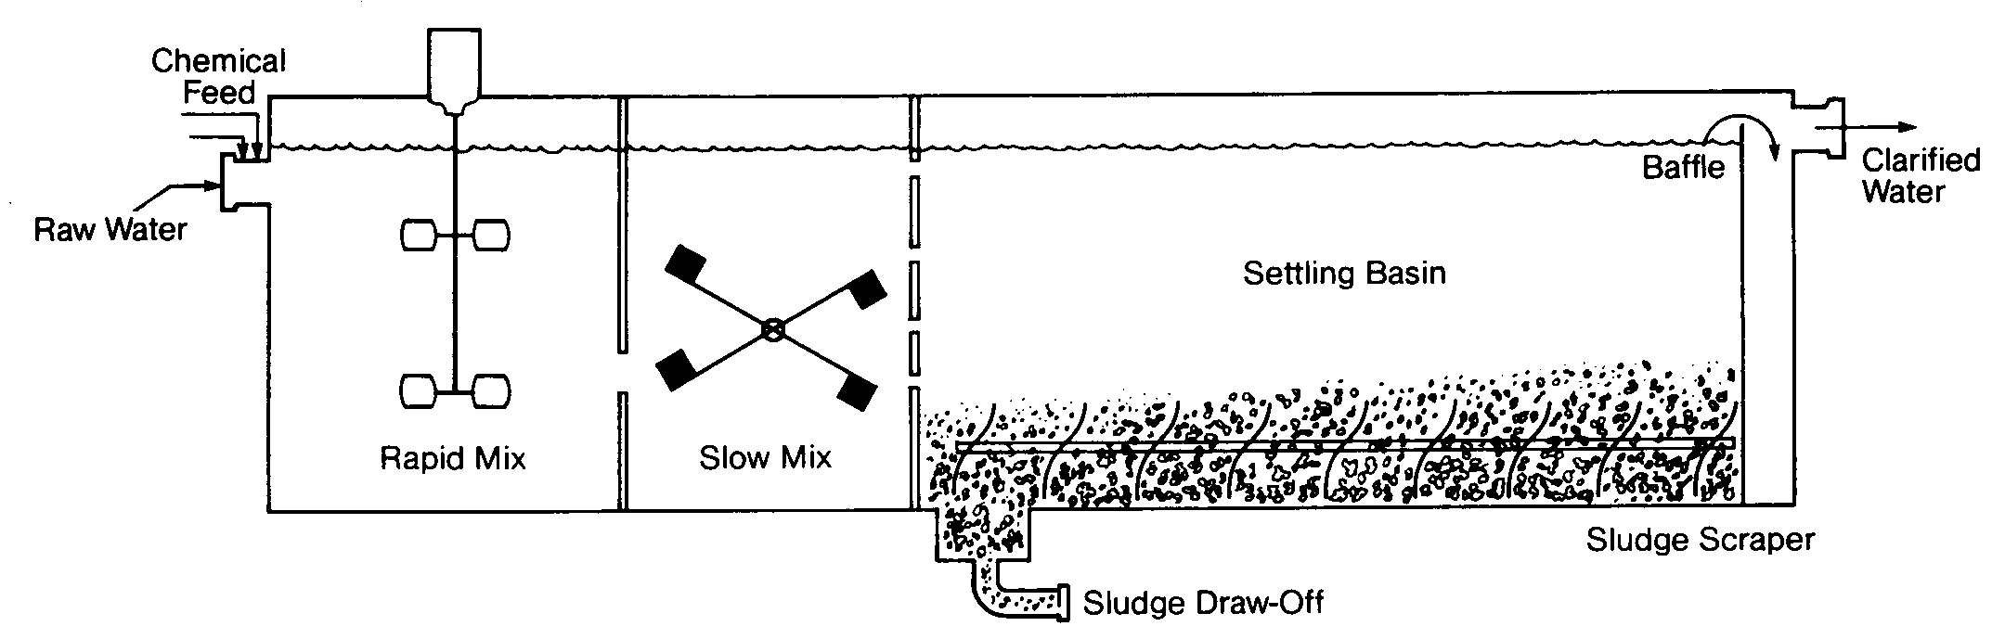
Water Treatment Process

Slide 10
Water Works Standards
Rapid Mixing
  Detention time for rapid mixing<30 seconds

Slide 11
Water Works Standards
Flocculation
  Design inlets/outlets to prevent short-circuiting and floc destruction
  Detention time for floc formation >=30 minutes
  Flow-through velocity shall be 0.5 to 1.5 ft/min
  Flocculation/sedimentation basins shall be as close together as possible
  Reduce turbulence at bends and changes in direction

Slide 12
Sedimentation
Removal of particulates, chemical floc and precipitates through gravity settling
Most are designed as upflow clarifiers where water rises vertically and solids settle to tank bottom where they are removed mechanically
Water enters the bottom and exits the top through a weir

Slide 13
Water Works Standards
Sedimentation
  Detention time >=4 hours
  Max. horizontal velocity is 0.5 ft/min
  Max weir loading is 20,000 gpd/ft of weir length
  Overflow rate in range of 500-800 gpd/sq ft
  Overflow rate (upflow velocity)

Slide 14
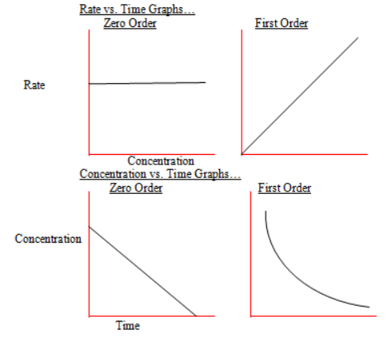
Reaction Rates
Zero-order: Rate of reaction is not dependent on concentration
First-order: Rate is dependent upon concentration of the reactant (the higher the concentration the faster the rate).
First-order is most common in W&WW processes

Slide 15
Zero Order
C=C_{o}-k*t (y-intercept=?) (slope=?)
Where:
C=Concentration of a reactant at any time t (mg/l)
C_{o}=Initial concentration of reactant (mg/l)
k=Reaction-rate constant (per day)
t=Elapsed time (days)

Slide 16
First Order
C=C_{o}e^{-kt}
Where:
C=Concentration of a reactant at any time t (mg/l)
C_{o}=Initial concentration of reactant (mg/l)
k=Reaction-rate constant (per day)
t=Elapsed time (days)

Slide 17
Detention Time
Completely Mixed; First Order
t=(1/k)*((Co/Ct)-1)
t=time
k=rate constant (ideally obtained by lab experiments)
Co=initial concentration
Ct=concentration @ time t
Note: t and k must have consistent units

Slide 18
Detention Time
Plug Flow; First Order
t=(1/k)*(ln of Co/Ct)
Where t=time
k=rate constant
Co=initial concentration
Ct=concentration @ time t
Note: t and k must have consistent units

Slide 19
Detention Times
Problem Statement: Based on lab studies, the rate constant for a chemical coagulation reaction was found to be first-order kinetics with a k equal to 75 per day. Calculate detention times required for completely mixed and plug flow reactors for an 80% reduction. Given
Co=200 mg/l then Ct=? (40 mg/l for 80% reduction)

Slide 20
Detention Time-Completely Mixed
20
t=(1/k)*(Co/Ct-1)
t=(day/75*1440 minutes/day)*(200/40-1)
t=77 min
Note: the detention time (Vol/Q) must be at least 77 minutes to obtain an 80% reduction in concentration
Notes:
20

Slide 21
Detention Times-Plug Flow
21
t=(1/k)*(ln of Co/Ct)
t=(1440/75)*(ln of 200/40)
t=31 min
Note: the detention time (Vol/Q) must be at least 31 minutes to obtain an 80% reduction in concentration
Notes:
21

Slide 22
Sedimentation Tank
22
Each half of an in-line treatment plant has the following sized units:
Rapid Mixing Chamber: 855 ft3
Flocculation Tank: 140’ wide; 58’ long; 14.5’ liquid depth
Sedimentation Tank: 140’ wide; 280’ long; 17’ liquid depth
Weir Length: 1,260’
Design Flow: 40 mgd (assume 40 mgd per half of in-line treatment); Total flow to plant would be 80 mgd
Compare values to waterworks standards
Notes:
22

Slide 23
Sedimentation
(Check Detention Times)
23
Calculate other flow units given 40mgd:
  27,800 gpm
  5,348,000 cubic ft/day
  3,710 cubic ft/minute
Determine Rapid Mixing Detention Time
  V/Q=855/3710*60=14 seconds (Std<30 seconds; okay)
Determine Floc Tank Detention Time
  V/Q=[(140*58*14.5)]/3710=32 minutes (Std>30 minutes; okay)
Determine Sed Tank Detention Time
  V/Q=[(140*280*17)]/3710=180 min=3 hr (Std>4 hours; not okay)
Notes:
23

Slide 24
Sedimentation (check other standards)
Check Sed Tank Horizontal Velocity:
  V=Q/A=3710/(140*17)=1.6 ft/min (Std<0.5 ft/min; not okay)
Check Weir Loading
  Q/L=40 mgd/1260 ft=32,000 gpd/ft (Std<20,000 gpd/ft; not okay)
Check overflow rate
  Q/surface area= 40 mgd/(140*280’)=1020 gpd/sq ft (Std 500-800 gpd/sq ft; not okay)

Slide 25
Ballasted Flocculation
Ballast (heavy substance-microsand) is used to enhance flocculation and sedimentation.
ACTIFLO(trademark)---polymer/microsand is added which reduces floc/settling times by a factor of 6 or more.
Example Project in Colorado using Ballasted Flocculation/Sedimentation (skip 1st/last page)

Slide 26
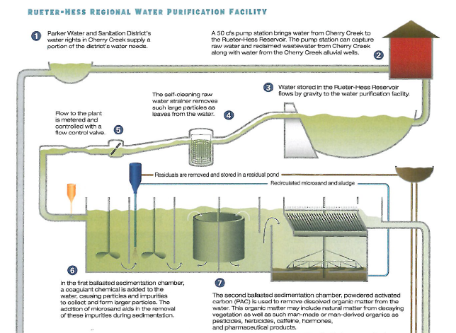
Water Purification Facility 1/2

Slide 27
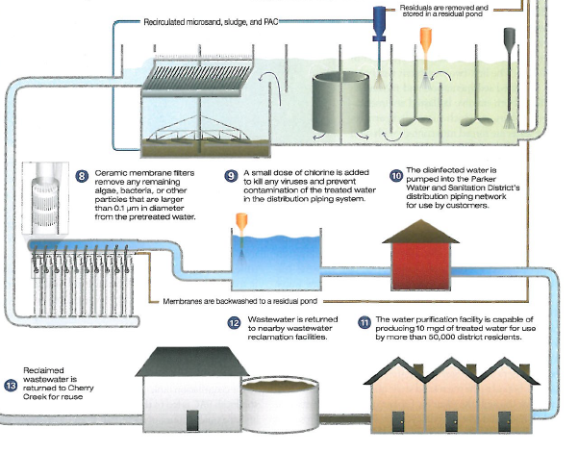
Water Purification Facility 2/2

Slide 28
Flocculator-Clarifiers
Also known as solids contact units
Combines mixing, flocculation and sedimentation in a single tank
Advantages are less footprint and less cost
Disadvantage is less operating flexibility

Slide 29
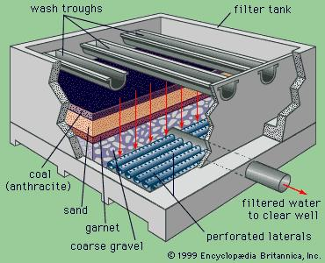
Filtration
Removes nonsettleable solids
Usually consists of graded gravel and filter media (sand and anthracite)
Backwashing is used to clean the filter (mechanical or air agitation may also be used)

Slide 30
Filtration Media
Complex reactions including straining, flocculation and sedimentation
Best to use the entire filter depth (not just the top few inches, which clogs the filter quickly)

Slide 31
Filter Underdrain
Pipe laterals with orifices or nozzles
Vitrified tile block
Plastic dual-lateral block
Plastic nozzles

Slide 32
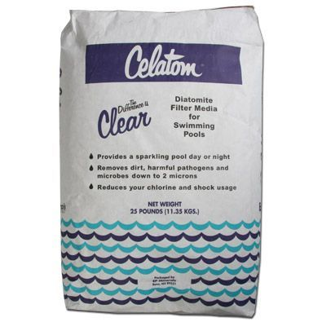
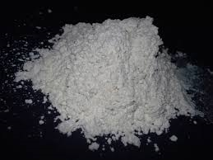
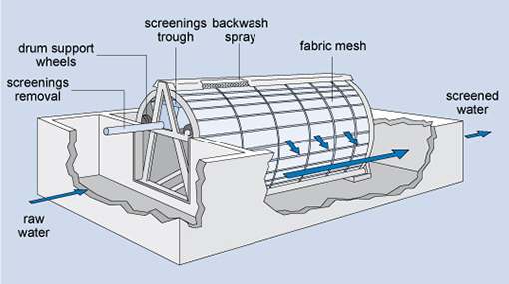
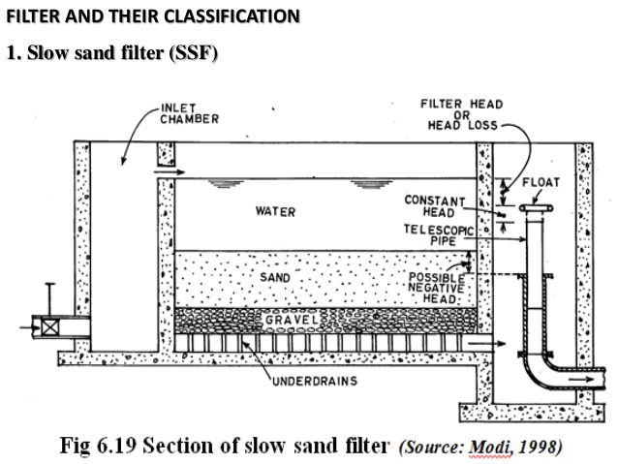
Other Filter Types
Diatomaceous earth (small application)
Microstrainers
Slow sand filters

Slide 33
Filtration Example
A filter unit is 15 ft by 30 ft. After filtering 2.50-million gallons in a 24-hr period, the filter is backwashed at a rate of 15 gpm/square ft for 12 minutes.
Compute the average filtration rate and the quantity and percentage of treated water used in backwashing.

Slide 34
Filtration Example
Answers
Surface Area of filter unit = 450 ft²
Filtration rate= Q/A= 3.9 gpm/ft²
Quantity of wash water=15gpm/ft² *12 min*450 = 81,000 gal
Wash water/treated water= 81,000/2.5E^6 = 3.2%

Slide 35
Chemical Feeders
Applies chemicals at a constant rate
Liquid or dry
Apply a specific volume or a specific weight
Volumetric dry feeders are simpler but a little less accurate

Slide 36
Coagulants
Most common is alum (aluminum sulfate)
Less common are other aluminum-based coagulants and those based on iron
Synthetic polymers are sometimes used to aid coagulation

Slide 37
Taste & Odor Control
Specific to each site
Aeration
Carbon adsorption
Potassium permanganate
Manganese zeolite process
Water softening

Slide 38
Precipitation Softening
Hardness in water is caused by Ca and Mg ions
Softening uses lime and soda ash
Split treatment is sometimes used to avoid wasting lime

Slide 39
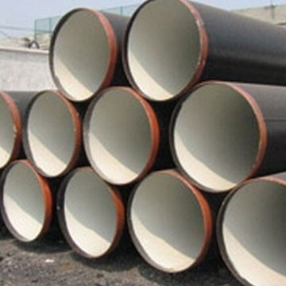
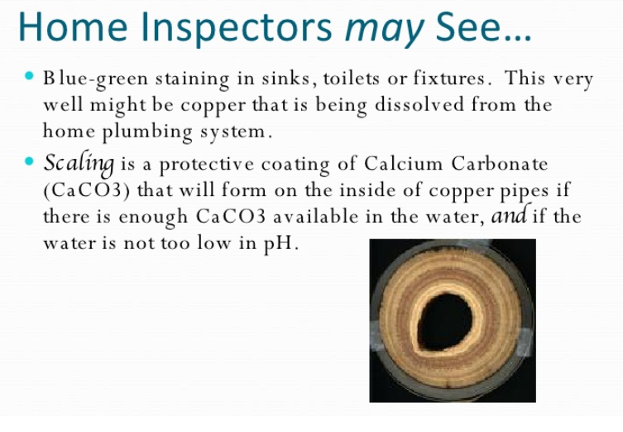
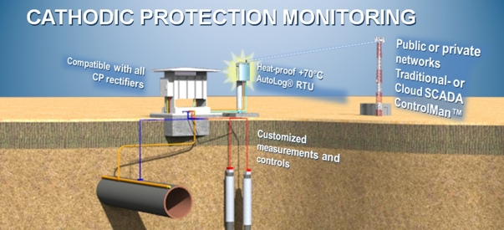
Avoid Corrosion by:
using cement mortar inside of pipe
forming a protective film of calcium carbonate
cathodic protection

Slide 40
Waste Streams
Sludge from the settling tank (after chemical coagulation or softening processes)
Wash water from backwashing filters
Treatments
  Pipe to municipal sewer
  Discharge to lagoon
  Process for disposal to landfill

