Slide 1
CTC 450 Review
Advanced WW Treatment
Removal of nitrogen
Removal of phosphorus
Complete removal of pathogens
Removal of other toxics

Slide 2
Objectives
Understand the basics with respect to reusing wastewater

Slide 3
Reuse
Reuse is defined as direct application of treated WW for agricultural and urban irrigation, industrial reuse, groundwater recharge, and others
Discharging WW to a receiving water that is ultimately used downstream for a water source is not considered reuse (dilution/separation in time and space)

Slide 4
Water Reuse - Functions
Treated effluent is used as a water resource for beneficial purposes
Effluent is kept out of streams, lakes and beaches

Slide 5
Water Reuse – Main Concerns
Reliable treatment of WW
Protection of public health
Public acceptance

Slide 6
Matter of Economics
Water reuse may be less costly:
Use N/P for irrigation instead of providing tertiary processes to prevent eutrophication
Water shortages – a future possibility (CA/AZ/FL)

Slide 7
Potential Drawbacks
Pathogens via physical contact or aerosols
Public perception

Slide 8
Water Statistics
Recycled WW
983 MGD (1995)
2% of total wastewater release (41,000 mgd)
CA/AZ/FL account for majority

Slide 9
Water Quality Effluent Stds
Dependent upon reuse application
Agricultural irrigation (restricted-with respect to human activity)
fodder,fiber,seed crops
Agricultural irrigation (unrestricted)
processed food, food eaten raw
Urban irrigation (restricted)
Golf courses, cemeteries, highway medians
Urban irrigation (unrestricted)
Parks, playgrounds, residences, comml landscaping

Slide 10
Advantages/Disadvantages of Agricultural Irrigation
Already contains nutrients and soil amendments
Agricultural areas may be nearby
Money for cash crops
In arid regions, ww may be the only source of water
Nitrate - groundwater
Heavy metals - soils
Pathogens - farm workers

Slide 11
Agricultural Irrigation
Storage required to balance supply/demand

Slide 12
Design of Irrigation Systems
Balance water to determine storage requirements
Balance nitrogen to prevent migration (do not want a buildup of nitrogen)

Slide 13
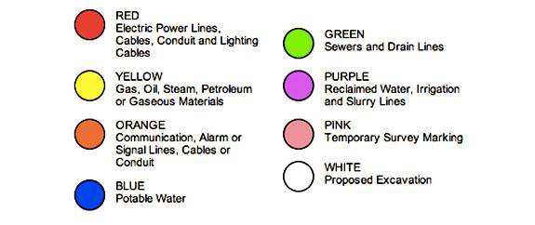
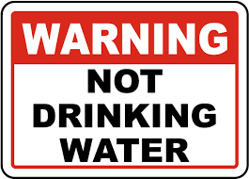
Urban Irrigation
Cross-connections prohibited
Color-code pipes
Warning signs
Reuse water pipes 3’ below potable water

Slide 14
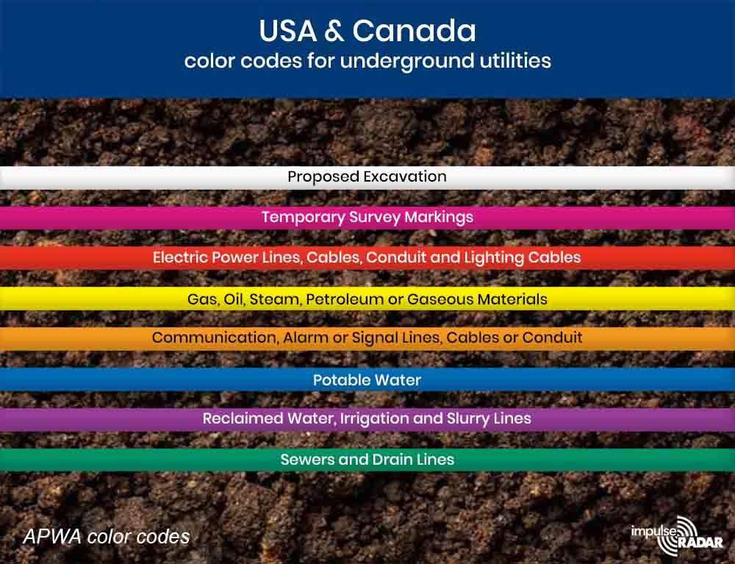
Underground Utilities

Slide 15
Groundwater Recharge
Surface infiltration (surface spreading)
Direct injection
Issues
Fate of particulates
Fate of bacteria/viruses
Fate of dissolved organic/inorganic constituents (particularly toxics)

Slide 16
Groundwater Recharge-Standards
US federal requirements/standards have not been established
Currently regulated by state agencies

Slide 17
Storage Issues
Need for storage
Type (open or closed)
Discharge requirements
Problems:
Odors, loss of chlorine residual, low DO
Temperature stratification, bird/rodents
Algal blooms, regrowth of microorganisma

Slide 18
Agricultural Irrigation-Example Tallahassee, FL
2000 acres;
16 pivot irrigators
irrigators controlled by computer
low-drift nozzles
Vegetation-canola, corn, sorghum, grass
Monitoring wells
Capacity-23 mgd
Four parallel treatment plants

Slide 19
Residential Lawn Watering El Dorado Hills, CA
Dual plumbed distribution system
66 mg reservoir
Drip irrigators-no restriction times
Spray irrigators-restricted to 9pm-6am
Back-up: potable lake water
Plant doesn’t meet required water quality
System can’t meet peak irrigation demands

Slide 20
Urban Reuse St. Petersburg, FL
Irrigation of parks, school, golf courses, comm’l and residential irrigation
Some water injected into deep-well system
Effluent requirements:
SS-5 mg/l (in practice 1-3 mgl/l)
Chlorine residual-1 mg/l after 15 min (in practice 4 mg/l)

Slide 21
Industrial Reuse Los Medanos Energy Center, CA
WW treatment plant provided recycled water to the energy center
Water is used for the heat recovery steam generator make-up and water for the evaporative cooling system
Treatment processes:
Dual-media, ultra- and activated carbon filtration for TOC removal
Antiscalant chemical added for evaporative system
Reverse osmosis for evaporative cooling

Slide 22
Final Exam Problems
Water Processing-Clarifier following Coagulation (25 pts)
Wastewater Processing-Trickling Filter (25 pts)
Wastewater Processing-Clarifier (25 pts)
Solids Mass Balance (25 pts)

Slide 23
Final Exam Review
Open book/open notes/
Can use computer/cell phone for electronic book
No old tests
Show all work
Know the standards
Don’t forget units
Conversions-concentration to mass

