Slide 1
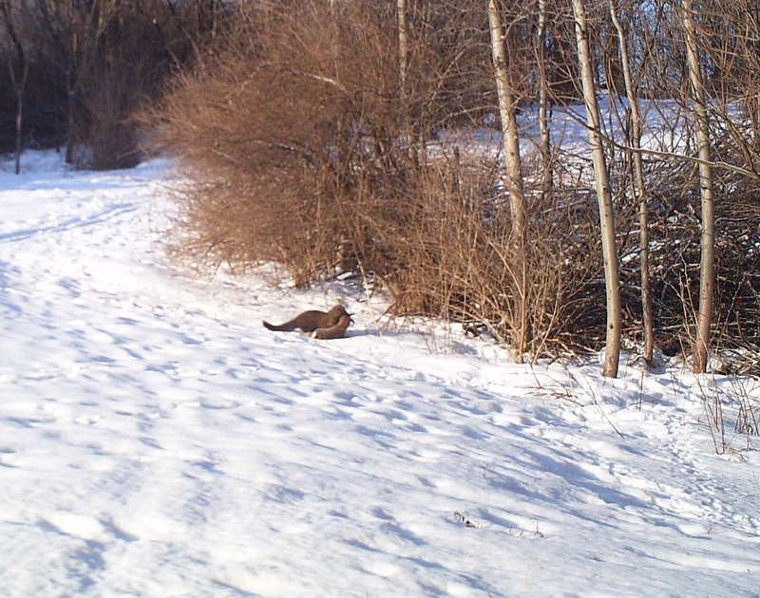
CTC 450 Review
Water Processes

Slide 2
Objectives
Understand the basics with respect to operation of waterworks

Slide 3
Operational Requirements
To maintain a system in working order (and avoid as much as possible any failures) ……..
you must know as much as possible about the overall system

Slide 4
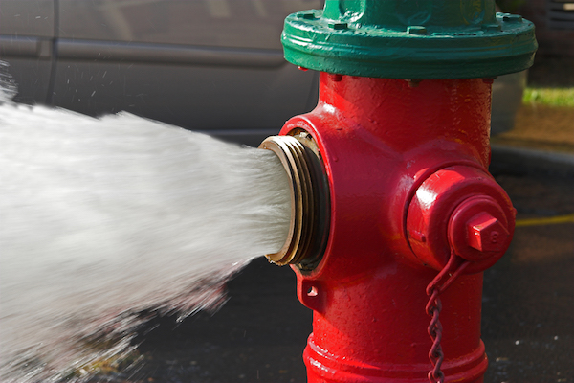
Fire Hydrants
Restrict usage for street cleaning & construction
After use, check operation
Periodic inspections
Maintain a stock of repair parts
Drainage essential in cold climates

Slide 5
Fire Hydrants (4 ways they break)
Blunt force trauma (cars)
Cold weather
Valves cranked too hard
Unofficial use (children/contractors)

Slide 6
Valves
Installed to isolate sections of pipe
Provide periodic inspection and maintenance
Must know where they’re at to use them (good mapping; don’t pave over)
Repair or replace if needed

Slide 7
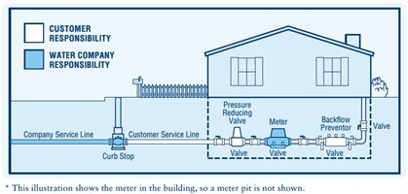
Service Connections
Service pipe from the main (corporation stop)
Usual minimum service pipe diameter is ¾”
Curb box/stop (valve to turn off water to building)

Slide 8
Tapping Mains
Wet tap—pipe is tapped while in use

Slide 9
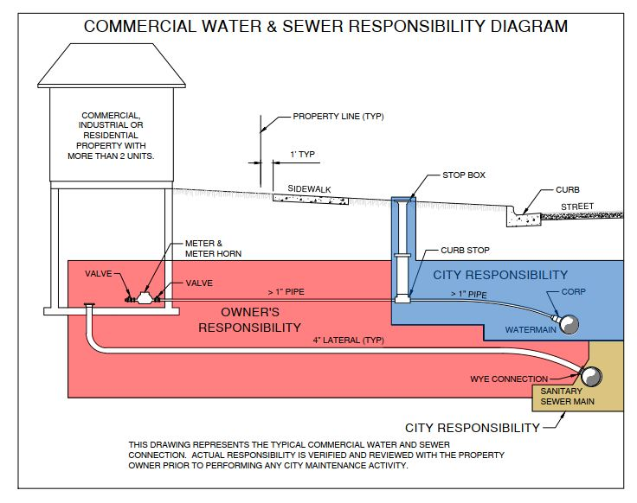
Example of Responsibility

Slide 10
Cross Connection, Backflow Preventers and Meters
Inspect areas of potential high hazard (hospitals, mortuaries, industries, irrigation systems, etc)
Meters must be repaired or replaced if not working correctly

Slide 11
Pipeline Installation
Mains installed at a depth to prevent freezing
Compacting backfill and trench design/installation increases pipe support
Water/sewer lines should be separated at least 10’ horizontally and water should be 18” higher than sewer

Slide 12
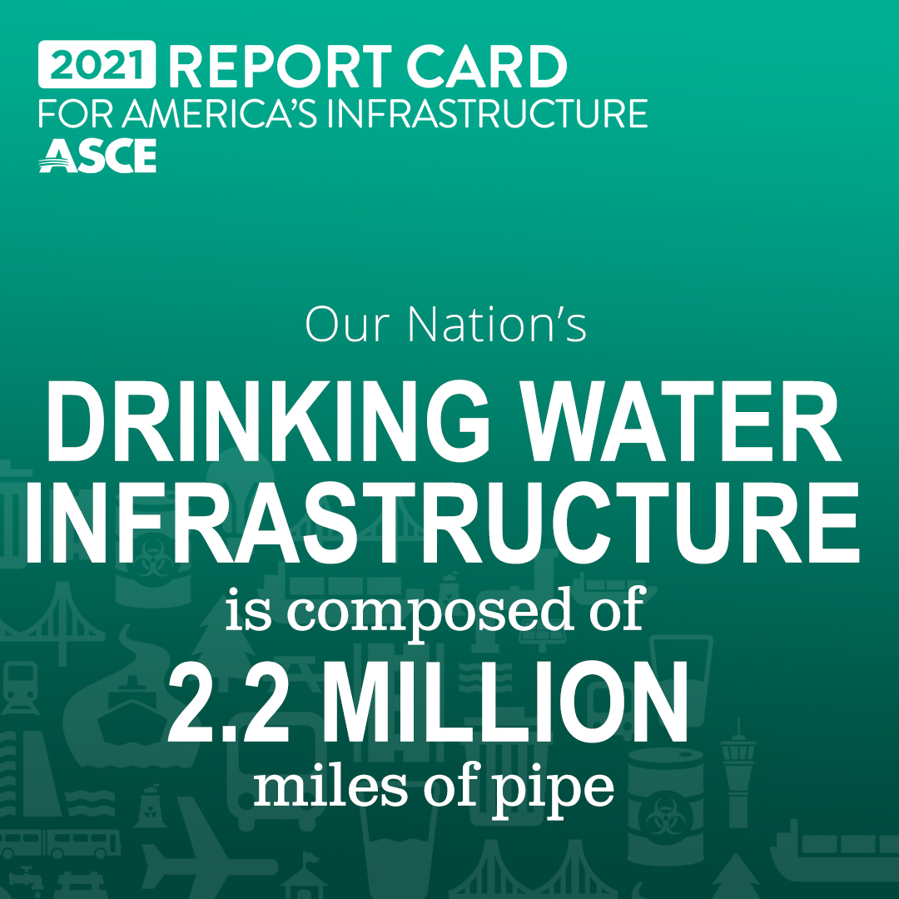
Pressure Testing
There is always some leakage
Leakage tests are performed and compared to a standard

Slide 13
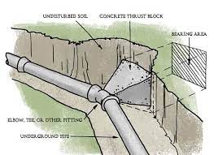
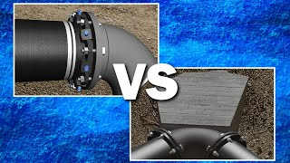
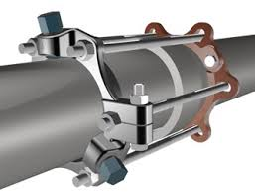
Thrust Restraints (pressure/velocity)
Use some type of restraint (concrete thrust block/joint restraint) to anchor pipelines at:
-dead ends
-bends
-changes in horizontal/vertical directions

Slide 14
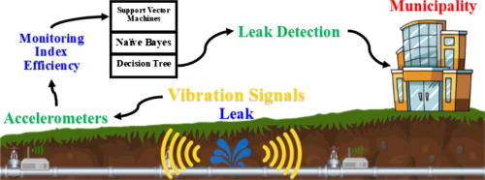
Leak Detection
Find small leaks before they become large
Can use sound wave detectors to detect leaks
Can fix small leaks by fitting a cover over the pipe

Slide 15
Distribution Testing
Fire Flow Tests
Hydrant Tests (pressure and flow)
Minimum 20 psi @ designated fire flow
Dechlorinate water (vitamin C) if discharged to storm system
Flow and pressure testing to calibrate computer models

Slide 16
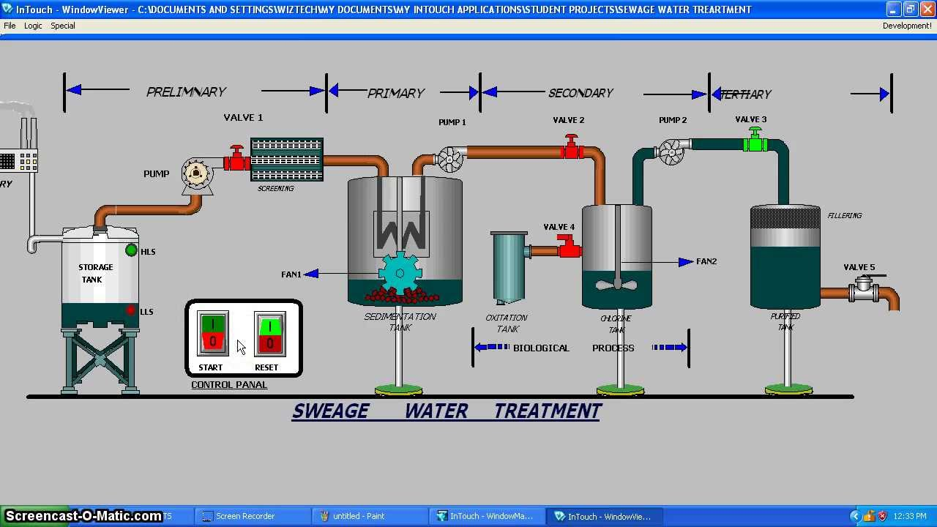
Water Treatment Process Control
Highly automated with dial-in capabilities
SCADA systems (supervisory control and data acquisition)

Slide 17
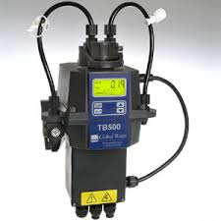
Water Quality Control
Some lab tests are on-line (turbidity)
Some tests are done on-site
Some tests are sent out

Slide 18
Sanitary Survey
Review of system to identify all areas that represent a risk to water quality and delivery

Slide 19
Recordkeeping
Efficient management depends on detailed recordkeeping
Water quality
Water quantity
Plant operation data
Chemicals added
Annual reports
Public notification

Slide 20
Water Conservation
Public education
Installation of high-efficiency plumbing fixtures
Tampa-77.2 gpcd to 38.9 gpcd
Institute water rates/meters (discourage lawn watering)
Fix leaks

Slide 21
Energy Conservation
Pumps major use of energy
Must understand rate schedule of utility
Can replace motors with high-efficiency motors

Slide 22
Water Rates
Must charge enough to cover costs
Usually charged by class (residential, commercial, or industrial)

Slide 23
Security
SCADA systems should be secure
Fire protection
Prevention from contamination and ability to determine contamination
Barriers around perimeter
Use of card keys, cameras, and strict protocols

Slide 24
Rehabilitation
240,000 water main breaks per year
Have a plan for water main breaks (parts/tools/equipment)

Slide 25
Cleaning
Periodically remove sediment (dead-end branches)
Buildup on pipes can occur-reduces hydraulics capacity (maintain proper pH; use scraper/cutting tools).

Slide 26
MVWA (MVW.US)
All kinds of information can be found on website of local water authorities

