Slide 1
CTC/MTC 374 Review
Measures of Merit
PW/FW/AW: >0
IRR/ERR > MARR
B/C (SIR): >1
PBP/CW---not equivalent to above (use as secondary measure)

Slide 2
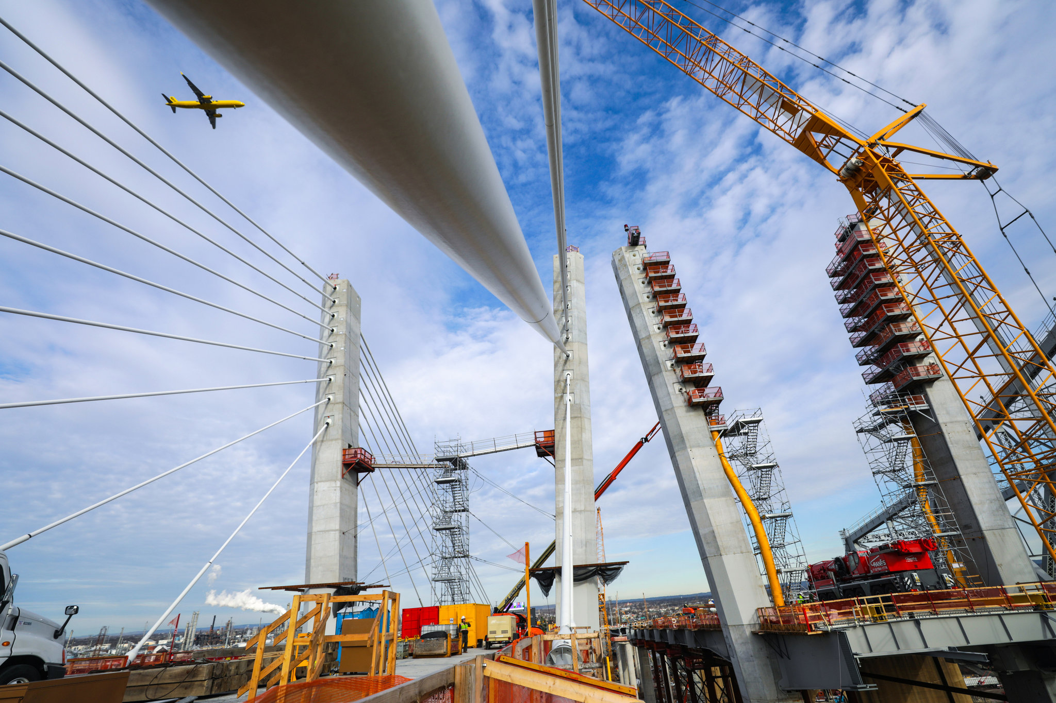
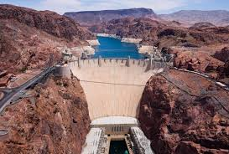
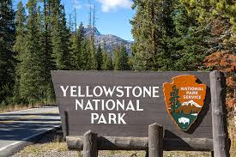
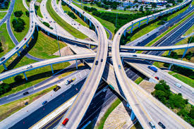
Public Projects (B/C)

Slide 3
Objectives
Why is B/C used?
How public projects differ from private projects
Pitfalls of using B/C ratio

Slide 4
Types of Public Projects
Cultural development (education, historic, recreation)
Economic Services (transportation, power generation)
Natural Resources (pollution and flood control, wildfire management.
Protection (military, police, fire)

Slide 5
Differences from Private Sector
Big initial costs (millions)
Long Lives
Multiple-uses (lake-recreation, flood control, irrigation, power generation)
Difficult to always define cash flow (value of aesthetics?)

Slide 6
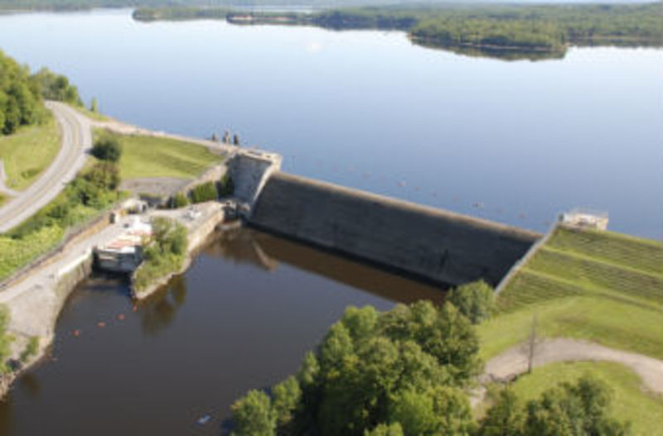
Multiple Uses:
Hinckley Reservoir
Fishing/boating in lake
Water supply (130,000 people; 18 mgd); https://www.mvwa.us/
Barge Canal
NYPA Hydropower (Gregory B. Jarvis Plan-9 MW-30,791 MWH per year) https://www.nypa.gov/Power/Generation/All-Generating-Facilities/Gregory-B-Jarvis-Hydropower-Dam-Relicensing
West Canada Creek(fish/wildlife/recreation)

Slide 7
Evaluation—B/C
Standard is the B/C (benefit/cost) ratio
Flood Control Act of 1936-Benefits must exceed Costs

Slide 8
B/C Ratio
Benefits-Public benefits associated w/ the project
Costs-Government costs associated w/ the project
Disbenefits-Unfavorable consequences to the public associated with the project (often hard to quantify-benefits are often offset by equal disbenefits—example: benefits results in fewer damages but also results in less business to fix those damages)

Slide 9
B/C Ratio Example
Alternatives | Initial Cost | Annualized Costs (initial, O&M) | Annualized Public Costs*
Route A | $417,000 | $677,000 | $16,973,000
Route B | $1,023,000 | $1,243,000 | $13,605,000
Route C | $1,734,000 | $2,103,000 | $12,678,000
Public benefits (reduced accidents, reduced time of travel, reduced operating costs)
*Spending extra money lowers the public costs (acts as a benefit)

Slide 10
?? Ratio from Annualized Costs?
No defined benefits so how do you determine a B/C ratio?
Spending extra money does lower total public costs
Use the Incremental Method (which we used for ranking alternatives- incremental method)

Slide 11
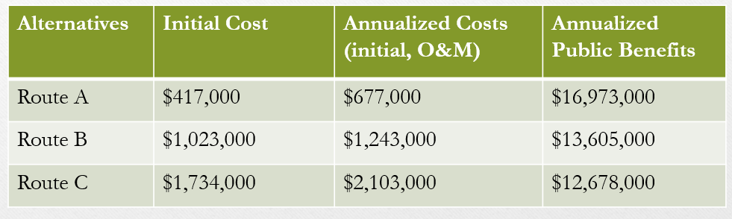
Compare B and A
Incremental benefits: $3,368,000 per year
(16,973K-13,605K)
Incremental Costs: $566,000 per year
(1,243K-677K)
B/C (of B-A) = 5.95 (>1) Prefer B over A

Slide 12
Compare C and B (C-B)
Incremental benefits: $927,000 per year
(13,605K-12,678K)
Incremental Costs: $860,00 per year
(2.103K-1.243K)
B/C (of C-B) = 1.08 (>1) Prefer C over B

Slide 13
Annual Worth Method
Alternatives | Total Costs | Annualized Costs (initial, O&M) | Annualized Public Benefits
Route A | $17,650,000 | $677,000 | $16,973,000
Route B | $14,848,000 | $1,243,000 | $13,605,000
Route C | $14,781,000 | $2,103,000 | $12,678,000
Prefer C over B and B over A (same as B/C but less confusing)

Slide 14
Considerations
1. Pt of View (individual/govt. agency/local, regional or nation)?
2. Choosing MARR (use $0, govt rate for borrowed money, or rate that private investors use?)
3. B/C (how far do you go?—short-term benefits to local economy, secondary benefits?)
4. Overcounting (don’t count twice)
5. Unequal lives? (salvage values for public works projects?)

Slide 15
Without and With User Fee
(10,000 people get $3 worth of public benefit; public cost is $20K)
B/C=($3*10,000) / $20,000 = 1.5
B-C = $30,000-$20,000 = $10,000 per year
Charge $1.50—therefore net benefit is now $1.50
Govt Cost is reduced to $5,000 (20K-15K)
B/C=(1.5*10,000)/$5,000=3
B-C=$15,000-$5,000= $10,000 per year

Slide 16
Multiple-Use Projects
Project | PW Costs (millions) | PW Benefits (million) | B/C | B-C
Irrigation | $14.5 | $25 | 1.72 | $10.5
Flood Control | $9 | $6 | 0.67 | -$3
Irrigation & Flood Control | $18.5 | $31 | 1.68 | $12.5

Slide 17
Considerations
Don’t rank B/C (must use incremental method or B-C)
Benefits/Costs must be determined objectively (no game playing)
Reliability, performance, availability, maintainability may be more important (Defense/Space Systems)

