Slide 1
CTC/MTC 374 Review
Methods for determining whether an alternative is feasible or not
Establishing MARR
Net cash flows

Slide 2
Feasibility
Initial investment $84,000
Net Annual Revenue is $18,000
Salvage value=$0
Study period=6 years
MARR=18%
Using PW, is this project feasible?

Slide 3
Answer
PW = -$84K+$18K(P/A_{18,6})
PW = -$84K+$18K(3.4976)
PW = -$84K +$62,957
PW = -$21,043
PW is negative; not feasible

Slide 4
Feasibility
Initial investment $10,000
Annual Receipts = $8,000
Annual Expenses = $4,000
Salvage value= -$1000 (negative value means you must pay to dispose asset)
Study period=5 years
MARR=15%
Using FW, is this project feasible?

Slide 5
Answer
FW = -$10K(F/P_{15,5} )+$4K(F/A_{15,5}) -$1K
FW = -$10K(2.0114)+$4K(6.7424) -$1K
FW = -$20,114 +$26,967 -$1K
FW = +$5,853
FW is positive; project is feasible

Slide 6
Feasibility
Initial investment $50,000
Annual Receipts = $20,000
Annual Expenses = $5,000
Salvage value= $0
Study period=5 years
MARR=20%
Using AW, is this project feasible?

Slide 7
Answer
AW = -$50K(A/P_{20,5} )+$15K
AW = -$50K(.3344)+$15K
AW = -$16,720 +$15K
AW = -$1,720
AW is negative; project is not feasible

Slide 8
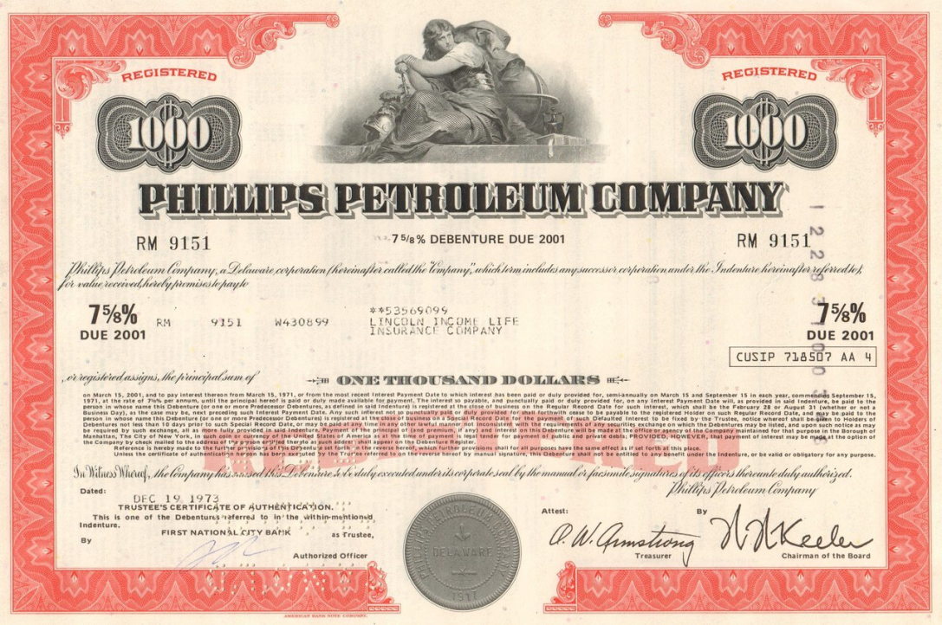
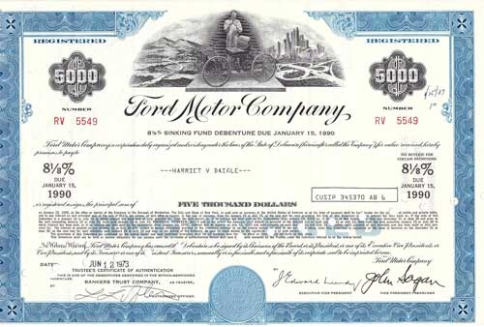
CTC/MTC 374
Bonds

Slide 9
Objectives
Know why bonds are issued
Know how bonds work
Solve bond problems (PW)
Optional (purchase/selling price to meet some goal)

Slide 10
Bonds – Why are they issued?
Government agencies/private firms issue bonds as a way to raise capital ($)
Roads, bridges, water & ww plants are very expensive
Govt. Agencies often use bonds to pay for infrastructure
Private Companies also issue bonds

Slide 11
Bonds – How they Work
XYZ company issues $5 million worth of bonds
Brokerage firms split into smaller units ($1000, $5000) and sell to individual investors

Slide 12
Bond-Face Value
The stated value on the individual bond is the face, or par value (Ex $1000)
The face value is paid back after a specified length of time (5, 10, 20 years)

Slide 13
Bonds
Issuing unit is obligated to redeem the bond at par value at maturity.
Issuing unit must specify a bond rate on the par value between the date of issuance and date of maturity

Slide 14


Slide 15
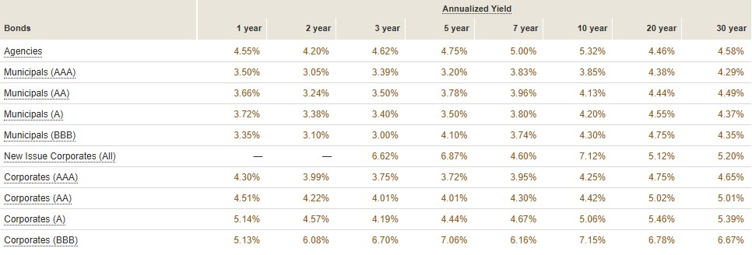
Date 10/1/2024

Slide 16
Bond Rate
Examples of Bond Rates:
10%/yr payable quarterly
9-½%/yr payable semiannually
6%/yr payable annually
The bond rate always applies to the par value

Slide 17
Example
7-year treasury note
Face (par) value =$1000
Interest rate 9 3/8% payable semiannually
Earned interest of $46.90 every 6 months
After 7 years, received $1000

Slide 18
PW of Bond Purchase
The present worth of a bond:
PW= I (P/A i,n) + V(P/F i,n)
where I is the interest received each period,
V is the face (or par value), i is the actual yield rate and n is the number of payments received.
Note: I does not change; it is fixed by the initial bond parameters.

Slide 19
PW of Bond – Link to FE Problem (see next 2 slides)
https://highered.mheducation.com/sites/0072432349/student_view0/solving_fe_problems.html

Slide 20
PW of Bond Purchase - 1/2 see https://highered.mheducation.com/sites/0072432349/student_view0/solving_fe_problems.html#
A municipal bond with a face value of $10,000 will mature 15 years from now. The bond interest rate is 6% per year, payable quarterly. At an interest rate of 16% per year compounded quarterly what is the present worth?
I=V*(b/c)=$10,000*(6%/4)
I=$10,000*1.5% per quarter compounded quarterly
I=$150 (Does not change!!)

Slide 21
PW of Bond Purchase-2/2 see https://highered.mheducation.com/sites/0072432349/student_view0/solving_fe_problems.html#
PW= I (P/A i,n) + V(P/F i,n)
PW=$150 (P/A 4%,60)+10K(P/F 4%,60)
PW=$4,345

Slide 22
PW of Bond – Modification What if i was equal to 6% per year compounded quarterly? (same i as the bond payments?)
I is still $150 per quarter (never changes)
PW=150 (P/A 1.5%,60)+10K (P/F 1,5%, 60)
PW=150 (39.3803)+10K (.4093)
PW=$5907+$4093
PW=$10,000 (same as the face value value)

Slide 23
Bond Complications (1/3)
Bonds are not complicated if the bond is bought at the date of issuance and held to the date of maturity
Bonds do get complicated when they are bought and/or sold between the date of issuance and the date of maturity
Because (outside) interest rates (i) fluctuate bonds (if not purchased new) are not usually sold at par value

Slide 24
Bond Complications (2/3)
If you previously bought a $1000 bond paying 9% and a new $1000 bond is paying 4% you wouldn’t typically sell your bond unless you got more than $1000.
Likewise, if you sell a $1000 bond paying 2% and a new $1000 bond is paying 4% no one will buy your bond unless you sell it for less than $1000

Slide 25
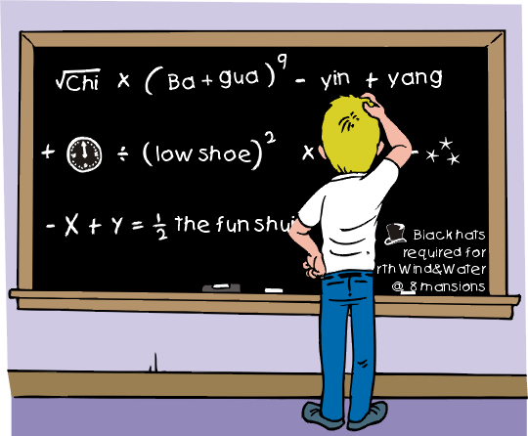
Bond Complications 3/3
Interest rates fluctuate
Selling or buying bonds between the date of issuance and date of maturity for something other than the par value changes the actual yield rate you receive.

Slide 26
Solving Problems when bonds are not new
How to determine a purchase or selling price (if not purchased and/or sold between issuance and date of maturity)
How to determine a yield (if not purchased and/or sold between issuance and date of maturity).

Slide 27
Bond Equation P=V*r(P/A_{i,n})+F(P/F_{i,n})
P=purchase price of bond
F=sales price of a bond
V=par (or face) value of a bond
r=bond rate per interest period (some books use b)
i=yield rate per interest period (same as bond rate if bought at date of issuance and held to date of maturity; if not you often need to calculate this)
A=V*r=interest payment received (my previous example and some books use I)

Slide 28
Hints
P (purchase price) may or may not equal the par value. If the bond was bought at the date of issuance then the purchase price = par value
F (sales price) may or may not equal the par value. If the bond is held to maturity then the sales price = par value
3 Possibilities:
P=F=par (easiest type of problem)
P=par and F different
P different and F=par

Slide 29
Bond Problem Types
Find sales price (F)
Find purchase price (P)
Find yield rate (i)—always hard to do by hand (similar to IRR)

Slide 30
Find sales price (F)
Find the selling price of a bond (F) if you want to sell it before it matures and you want a desired yield i

Slide 31
Find purchase price (P)
Determine the purchase price of a bond (P) so that you can make a desired yield i for the future

Slide 32
Find effective yield (i)
Determine the effective yield (i) for a bond if it wasn’t bought and/or redeemed at par value

Slide 33
Find F example
An individual purchased a $1000, 8% semi-annual bond for $1050 3 years ago and is considering selling it. How much should be asked for the bond in order to earn a yield rate of 6% compounded semiannually (3% per semi comp. semi)?

Slide 34
Find F example
P=$1050 (bond wasn’t bought at date of issuance)
F=?
V=$1000
r=4% per semi comp. semi (bond rate)
i=3% per semi comp. semi (desired rate rate)
n=6 semi’s (r,i & n periods must match)
A=V*r=$40 (this doesn’t ever change)

Slide 35
Find F example
F = $995
If owner of bond can sell it for at least $995 then the owner effectively earns 6% per year compounded semiannually

Slide 36
Find P example
If a $1000, 12% semiannual bond is purchased, held for 3 years and redeemed at par value, what must the purchase price have been in order for the bond to be preferred over investing at 14% compounded semiannually?

Slide 37
Find P example
P=? (bond wasn’t bought at date of issuance)
F=$1000 (bond held to maturity)
V=$1000
r=6% per semi comp. semi
i=7% per semi comp. semi
n=6 semi’s (r,i & n periods must match)
A=V*r=$60

Slide 38
Find P example
P = $952.29
If an investor can buy the bond for $952 and hold it to maturity then the owner effectively receives 14% per year compounded semiannually.

Slide 39
Find i example
If a $1000, 12% quarterly bond is purchased for $1020 and sold 3 years later for $950:
a) What was the quarterly yield?
b) What was the effective annual return?

Slide 40
Find i example
P=$1020 (bond wasn’t bought at date of issuance)
F=$950 (bond wasn’t held to maturity)
V=$1000
r=3% per qtr. comp. qtr.
i=?% per qtr. comp. qtr.
i_{eff}-?% per yr. comp. yearly
n=12 qtrs. (r,i & n periods must match)
A=V*r=$30

Slide 41
Find i example
P=Vr(P/A_{i,n})+F(P/F_{i,n})
$1020=$30(P/A_{i,12})+$950(P/F_{i,12})
By trial and error:
i = 2.444% per qtr. comp. qtr.
i_{eff} = (1+i)^{n}-1 = (1.0244)⁴-1 =
i_{eff}=10.12 %

Slide 42
Additional Bond Problem 1
Mr. Investor wishes to purchase a $10,000 bond which has a fixed nominal interest rate of 8% per year, payable quarterly. What should he pay for the bond to earn 10% per year compounded quarterly?
Answer (Find P = $8,908)

Slide 43
Additional Bond Problem 2
A bond with a face value of $5,000 pays interest of 8% per year. The bond will be redeemed at par value at the end of its 20-year life. If the bond is purchased now for $4,600, what annual yield would the buyer receive?
Answer (Find i = 8.9% per year compounded yearly)

Slide 44
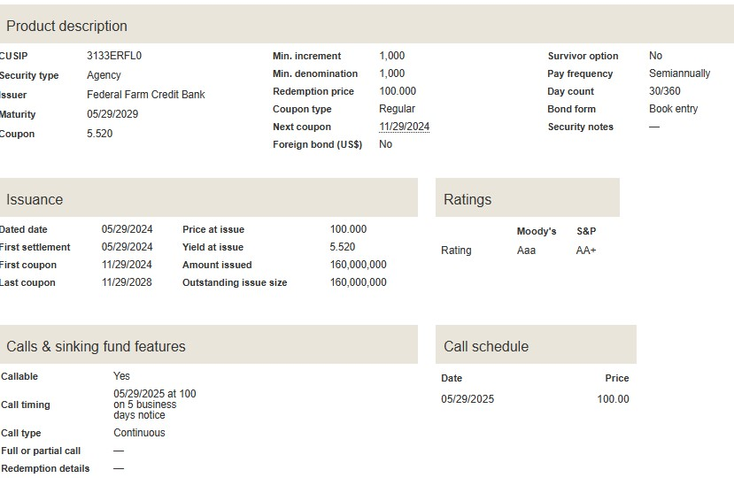
Currently calculations are done for you—new bond example

Slide 45
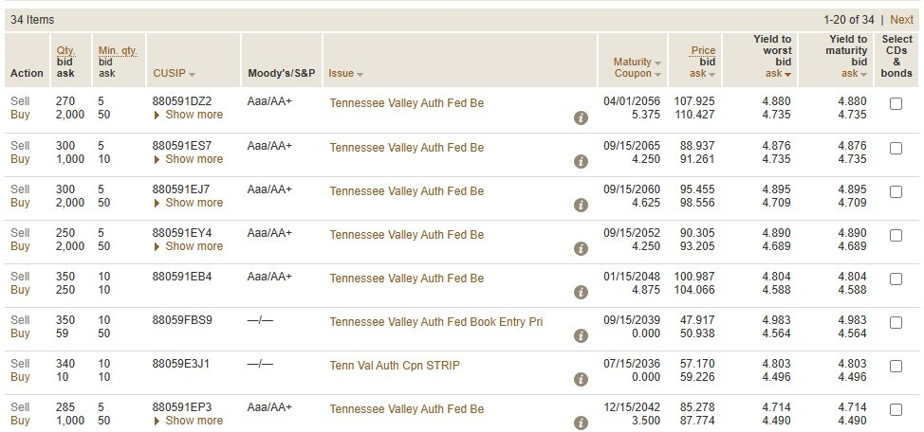
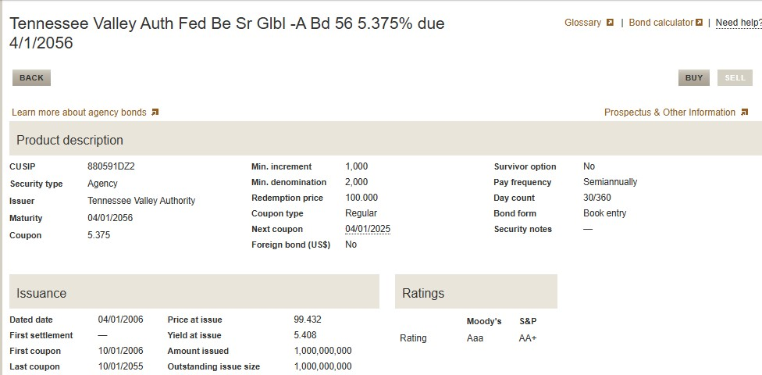
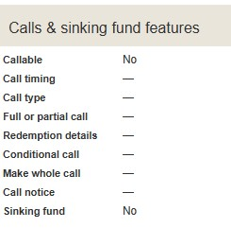
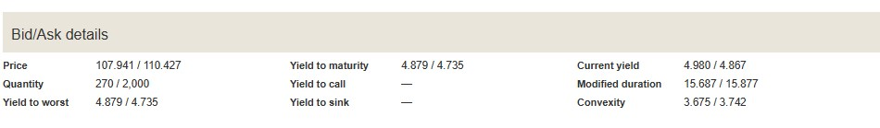

Slide 46
Next lecture
Comparing Alternatives

