Slide 1
374 Review
Replacement Analysis
  Insider View
    Keep old or buy new
  Outsider View (preferred)
    Buy old or buy new

Slide 2
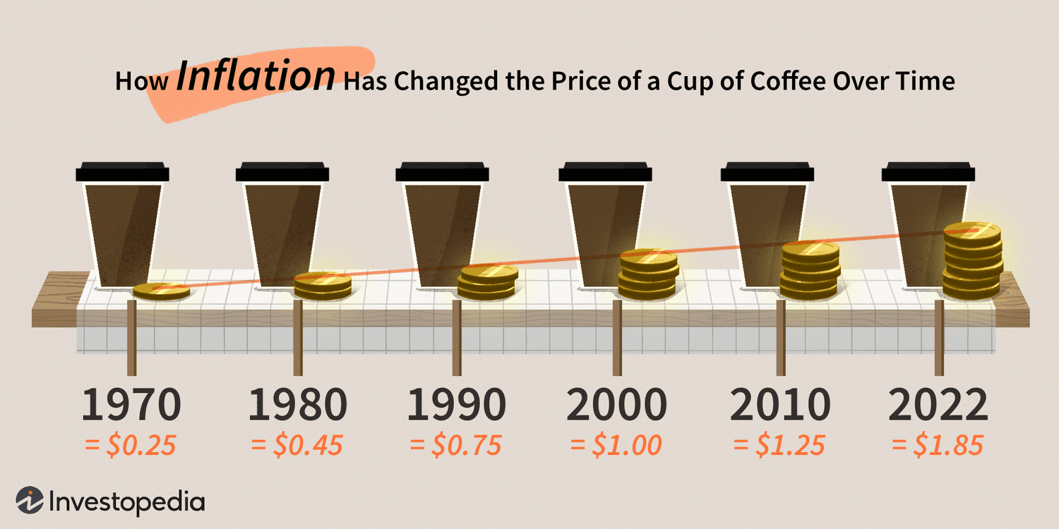
Inflation

Slide 3
Objectives
Ability to account for inflation
Understand the difference between constant-value (today’s dollars) and future dollars (inflated or then-current dollars)

Slide 4
Inflation
Prices change over time
Inflation-an increase in the average price paid for goods and services
Can affect economic comparison of alternatives

Slide 5
Deflation
Deflation—prices decrease over time
Inflation is much more common than deflation!

Slide 6
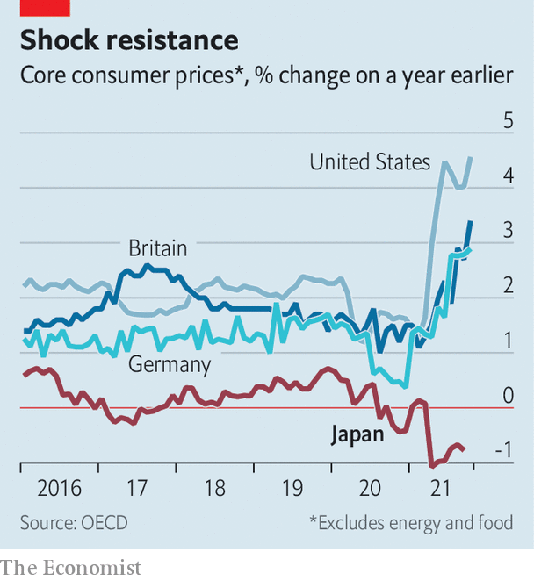
Consumer Price Changes

Slide 7
Measures of Inflation
CPI (consumer price index)
  Avg annual rate from ’82 to ’94 was 3.33%
  Avg annual rate from ’94 to ’04 was 2.45%
CPI FAQ https://www.bls.gov/cpi/questions-and-answers.htm
PPI (producer price index)
PPI FAQ https://www.bls.gov/ppi/ppifaq.htm
Source: Bureau of Labor Statistics; US Dept. of Labor

Slide 8
Actual Dollars (A$)
The # of dollars associated w/ a cash flow as of the time it occurs
Other names:
  Nominal
  Current
  Then-current
  Inflated $

Slide 9
Real Dollars (R$)
Dollars expressed in terms of the same purchasing power relative to a particular time
Also called constant dollars

Slide 10
Example (A$ and R$)
Investor wishes to retire in the year 2050 (25 years) with savings of $1,000,000 (2025 spending power)
Assuming the inflation rate is 3.75% what are the actual and real dollar values for 2025 and 2050?
1E6(1.0375)^25
 | A$ (actual or inflated dollars) | R$ (same purchasing power
2025 | $1,000K | $1,000K
2050 | $2,510K | $1,000K

Slide 11
Three Different Rates of Importance
Real (or inflation-free) rate (i)
  Rate paid for use of capital
  Doesn’t include inflation
  Represents an actual increase in purchasing power
  Also called inflation-free interest rate
Inflation rate (f)
  Represents the rate of change in the value of currency
  Usually positive but can be negative (deflation)
Combined (market) interest rate (i_{f})
  Adjusted rate that takes inflation into account
  Accounts for i and f
Relationship between (i, f, and i_{f})
  i_{f}=i+f+(i*f)

Slide 12
Relationship between (i, f, i_{f})
  i_{f}=i+f+(i*f)
  Example of combined rate (I-bonds)
  http://www.treasurydirect.gov/indiv/research/indepth/ibonds/res_ibonds_iratesandterms.htm
  https://treasurydirect.gov/files/savings-bonds/i-bond-rate-chart.pdf

Slide 13
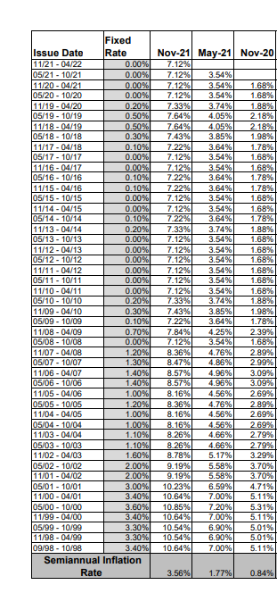

Slide 14
Salary Purchasing Power Example
Salary data for 4 years (based on a 4% salary raise) is as follows:
$45,000
$46,800
$48,672
$50,619

Slide 15
Salary Purchasing Power
Real $ salary data (base year is 1st year) for 4 years (based on a 6% inflation rate) is as follows:
$45,000
$46,800 (P/F6,1)=$44,151
$48,672 (P/F6,2)=$43,318
$50,619 (P/F6,3)=$42,500

Slide 16
Salary Increase Lesson?

Slide 17
Rules for Economic Analysis
2 Methods
Express all cash flows in Actual $ and use the combined interest rate (i_{f})----accounts for inflation and use of capital
OR
Express all cash flows in terms of Real $ and use the real interest rate (i)---doesn’t include inflation

Slide 18
Using Actual Dollars
Actual dollars change for some items (salaries, materials)
Actual dollars don’t change for items fixed by contract (interest charges, lease fees, depreciation)

Slide 19
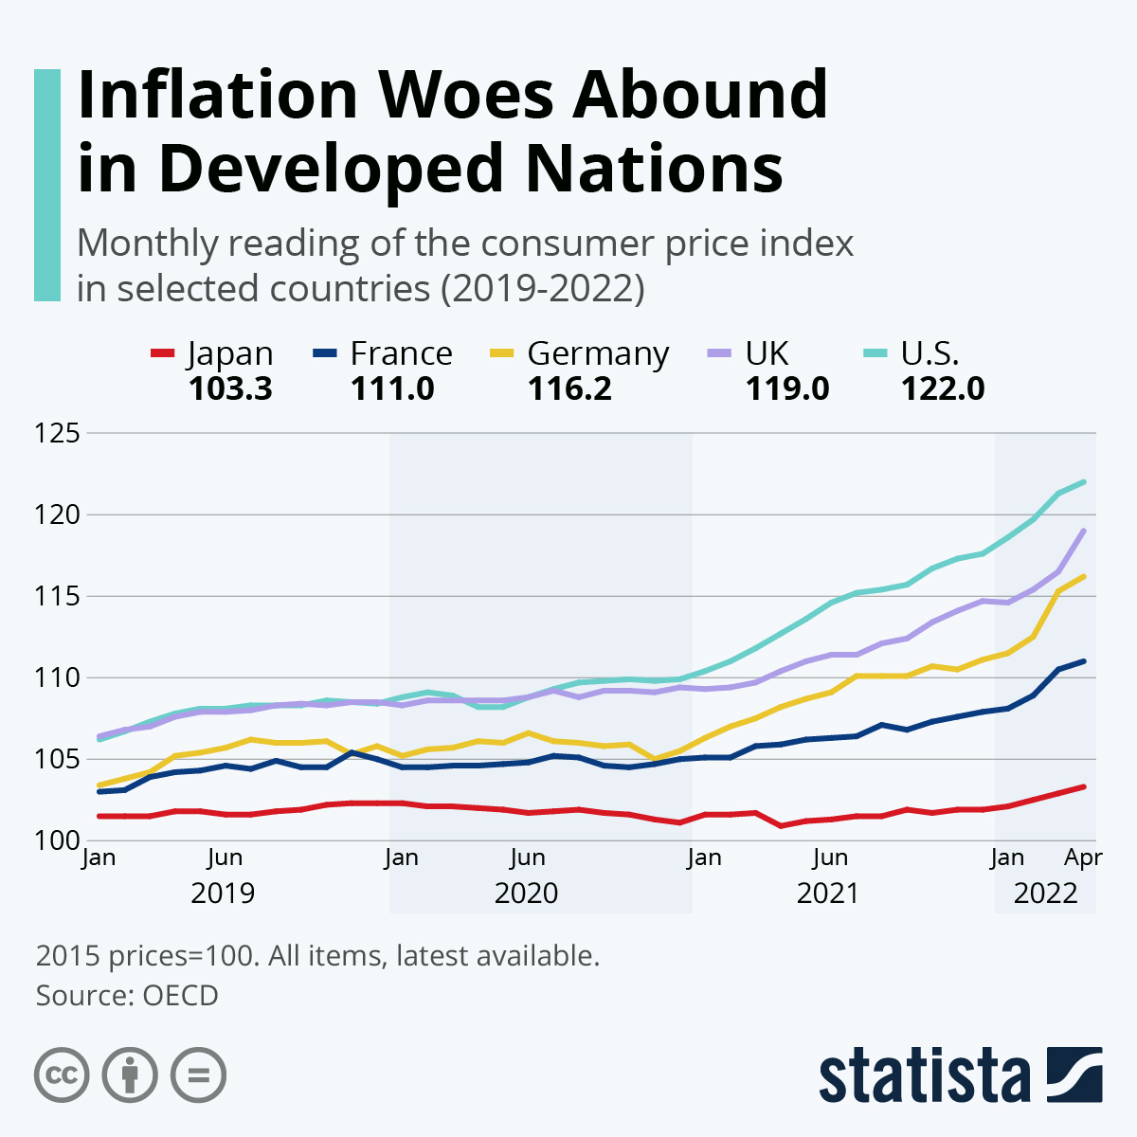

Slide 20
Next lecture
Cost Estimates
Accounting Principles

