Slide 1
CTC 374 Review
Breakeven Problems
  Linear (and intro to Nonlinear)
    Find breakeven quantity
    Determine/maximize revenue or net profit
Present Economy Breakeven:
Determine which machine is more cost effective based on product quantity

Slide 2
CTC 374
Replacement Analysis and Capital Recovery Cost

Slide 3
Objective
Know how to complete a replacement analysis
Know how to calculate a capital recovery cost

Slide 4
Replacement Analysis
Use to determine whether an existing asset should be replaced with a new asset

Slide 5
Definition
Existing Asset is known as the DEFENDER
New Asset is defined as the CHALLENGER
P-Initial investment
n-expected life
s-salvage value
AOC-annual operating costs

Slide 6
Reasons for Replacement
Deterioration
  Higher O&M costs; less reliability than anticipated
Requirement change
  Consumer wants more/less/different
Technology
  New technology provides new challengers
Financing
  Better interest rates

Slide 7


Viewpoints
Outsider: Conduct analysis assuming you’re an impartial 3rd party
Insider (Company): Can be tempting to try and recover past losses-Don’t use

Slide 8
Past loss examples
Market Value < Book Value
Capacity of defender is inadequate
O&M costs of defender is higher than anticipated
Losses have occurred, but shouldn’t be considered for replacement analysis

Slide 9
Insider vs. Outsider Approach Defender
Filter Press-Purchased 3 years ago for $30K
Historical O&M : 4K,5K,6K
Remaining life: 5 years
Est. Salvage value: 2K
Current BV: $12,600
Current MV: $9,000
Estimated Future O&M: 7K,8K,9K,10K,11K

Slide 10
Insider vs. Outsider Approach Challenger
New Filter Press: $36K
Estimated life: 10 years
Estimated O&M and Salvage Values—see next slide

Slide 11
Challenger Data
EOY | Estimated O&M | Estimated Salvage
1 | 0
2 | 1K | 24.6K
3 | 2K | 19.8K
4 | 3K | 15.6K
5 | 4K | 12K
6 | 5K | 9K
7 | 6K | 6.6K
8 | 7K | 4.8K
9 | 8K | 3.6K
10 | 9K | 3K

Slide 12
Insider (Company)Viewpoint
(note: MARR not given)
EOY | Defender | Challenger
0 | 0 | -36K+9K=-27K
1 | -7K | 0
2 | -8K | -1K
3 | -9K | -2K
4 | -10K | -3K
5 | -11K+2K=-9K | -4K+12K=+8K
AW= | -$8426 | -$7997

Slide 13
Notes for Insider Cash Flow
Defender Cash flow at EOY 0 is $0 because it costs nothing for company to keep the existing equipment (KEEP USED)
Challenger Cash flow at EOY 0 assumes that the company buys the new equipment and sells the old equipment at year EOY 5 (BUY NEW; SELL USED)
Note that the BV and Initial investment of the existing equipment are not used

Slide 14
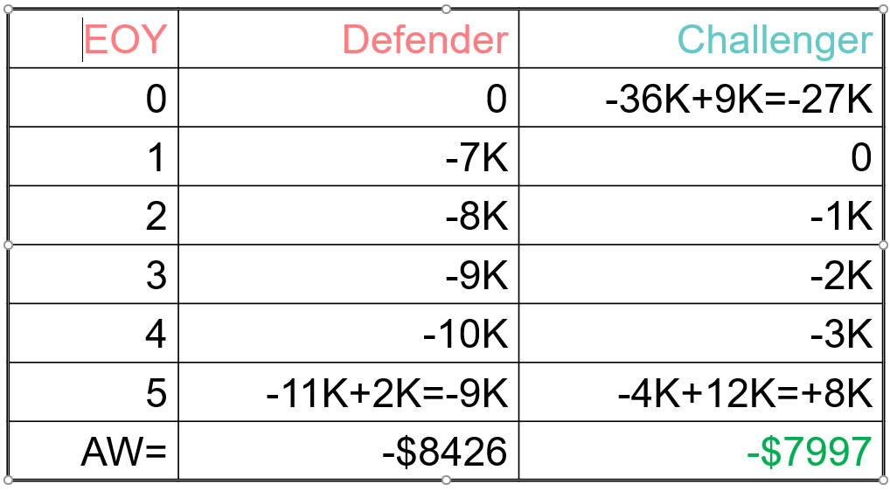
Outsider
Viewpoint
EOY | Defender | Challenger
0 | (buy used) -9K | (buy new) -36K
1 | -7K | 0
2 | -8K | -1K
3 | -9K | -2K
4 | -10K | -3K
5 | -11K+2K=-9K | -4K+12K=+8K
AW= | -$11,111 | -$10,682
(note: MARR not given)

Slide 15
Notes for Outsider Cash Flow
Defender Cash flow at EOY 0 is -$9K because this would be the price of the used piece of equipment (BUY USED)
Challenger Cash flow at EOY 0 assumes that the company buys new equipment (BUY NEW)
Note that the BV and Initial investment of the existing equipment are not used

Slide 16
Capital Recovery Cost (CRC)
A uniform annual amount using purchase price (P), salvage value (SV), life (n) and an interest rate (i)
CRC=P(A/P_{i,n})-SV(A/F_{i,n})
Note: The salvage value is income (a negative cost)

Slide 17
Example
P=$82K
n=7 years
SV=$5K
i=15%
CR=82K(A/P_{15,7})-$5K(A/F_{15,7})
CR=82K(.2404)-$5K(.0904)
CR=$19,261 per year

Slide 18
Other Formulas for CRC:
CR=(P-SV)(A/F_{i,n})+P*i
CR=(P-SV)(A/P_{i,n})+SV*i
These alternate formulas can be derived from math equations; however---first equation is easier to remember

Slide 19
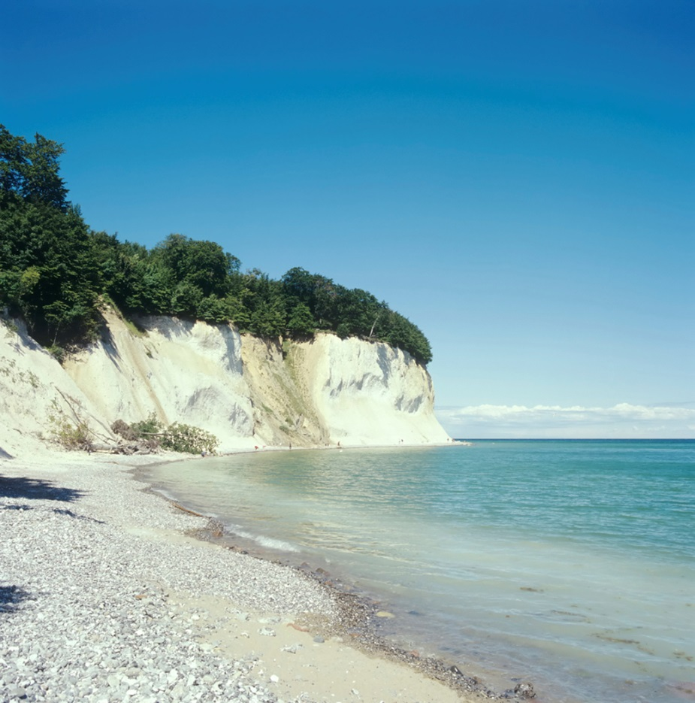
Next lecture
Price changes
(Inflation/Deflation)

